Slide 1
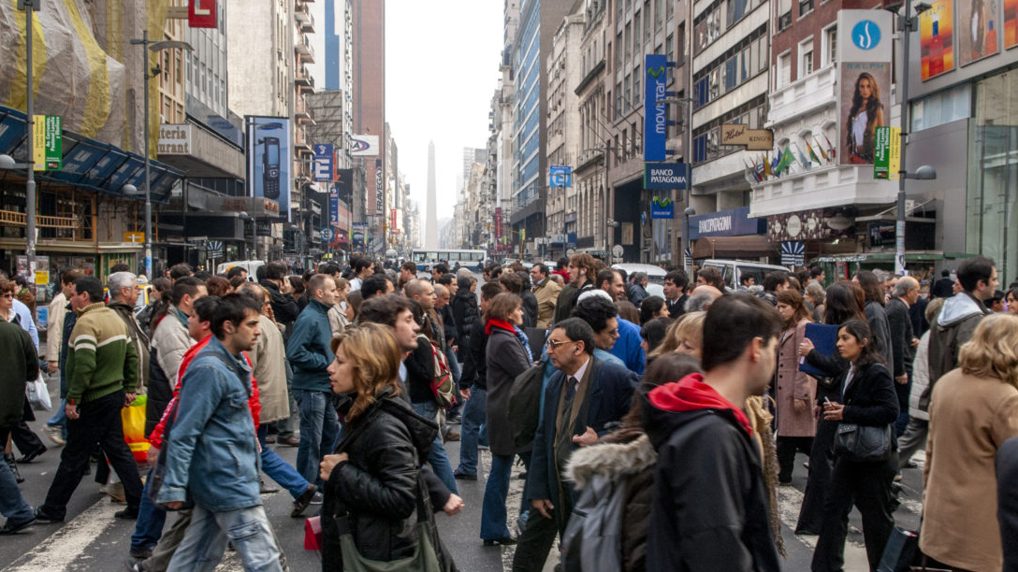

IMPACTING
LOSTNESS TOGETHER

Slide 2
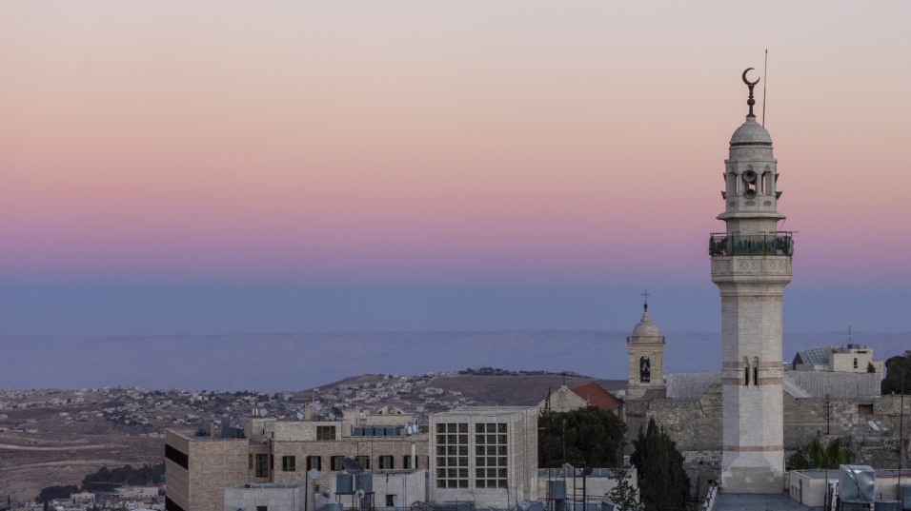

100% of your gifts to the Lottie Moon Christmas Offering® enable gospel transformation among the unreached.
imb.org/lottiemoon
Lottie Moon Christmas Offering® is a registered trademark of WMU®

Slide 3
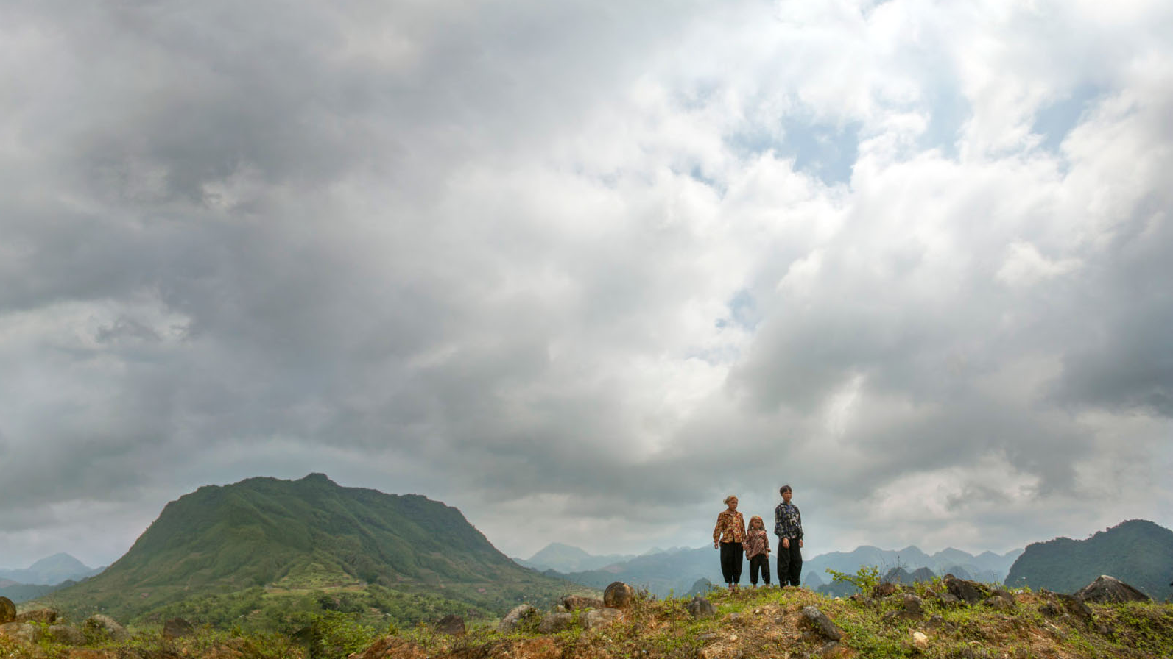
OUR CHURCH’S GOAL: $0,000,000
100% of your gifts to the Lottie Moon Christmas Offering® enable gospel transformation among the unreached.
imb.org/lottiemoon

Slide 4
GOD’S WORK THROUGH US IN
2022
122
Countries
728,589
People heard the gospel
178,177
New believers
21,231
New churches
102,417
Baptisms

Slide 5


