Slide 1
Progress toward
Engaging Unreached Peoples
2016 Edition
Data Values from 2015-EOY Public Reports
Explore other Global Research data products at
http://public.imb.org/globalresearch/Pages/default.aspx
Copyright © 2016 IMB, Global Research

Slide 2




Progress toward Engaging Unreached Peoples
No Longer Unreached
4,700 people groups
(3 billion people)
Engaged yet Unreached
3,700 people groups
(4 billion people)
11,500 people groups
(7.2 billion people)
Unreached
6,800 people groups
(4.2 billion people)
Who will take the gospel to the 3,100 people groups that remain Unengaged and Unreached?
Unengaged and Unreached
3,100 people groups
(200 million people)
Copyright © 2016 IMB, Global Research
Notes:
Most mission organizations agree engaging the world’s unreached people groups is a priority. Yet many organizations continue to deploy personnel among people groups that are no longer unreached or among groups already engaged by other evangelical organizations. There was a time when research data was incomplete so we did not know which groups lacked access to the gospel. Today that is no longer the case. Who will take the gospel to the 3,100 people groups that remain unengaged and unreached?
The world’s 7.2 billion people are scattered among some 11,500 unique people groups. A people group is a collection of people that share a common ethnic identity and language. Some 4,700 people groups are classified as “No Longer Unreached” meaning evangelical believers comprise 2% or more of their population. No Longer Unreached doesn’t mean they are no longer in need of evangelism and church planting efforts, but, typically means that there are sufficient evangelicals among them so that they are no longer a first priority group for mission organizations.
Some 6,800 people groups remain classified as Unreached. Unreached means that less than 2% of a groups population is evangelical Christian. There may be evangelicals among them, but in limited numbers. They remain in need of the gospel. But all Unreached people groups are not equal. Among these 6,800 Unreached people groups, 3,700 are currently engaged by one or more evangelical church or mission organization. We thank God that so many of the world’s remaining Unreached people groups are currently engaged. These groups account for roughly 55% of the world’s population.
But there is one final category of people groups … those who remain Unengaged and Unreached. These groups have limited, if any, evangelical believers among them. No known evangelical church or mission organization is implementing a church planting strategy among them. Who will take the gospel to these 3,100 people groups? Most of these people groups are small. The average population is just over 60,000. Many are isolated by geography or civil unrest. Many have no scripture in their heart language. The challenge is great. These unengaged and unreached people groups should be the highest priority for mission efforts.
This slide introduces a series of maps showing the geographic distribution of various categories of people groups.

Slide 3
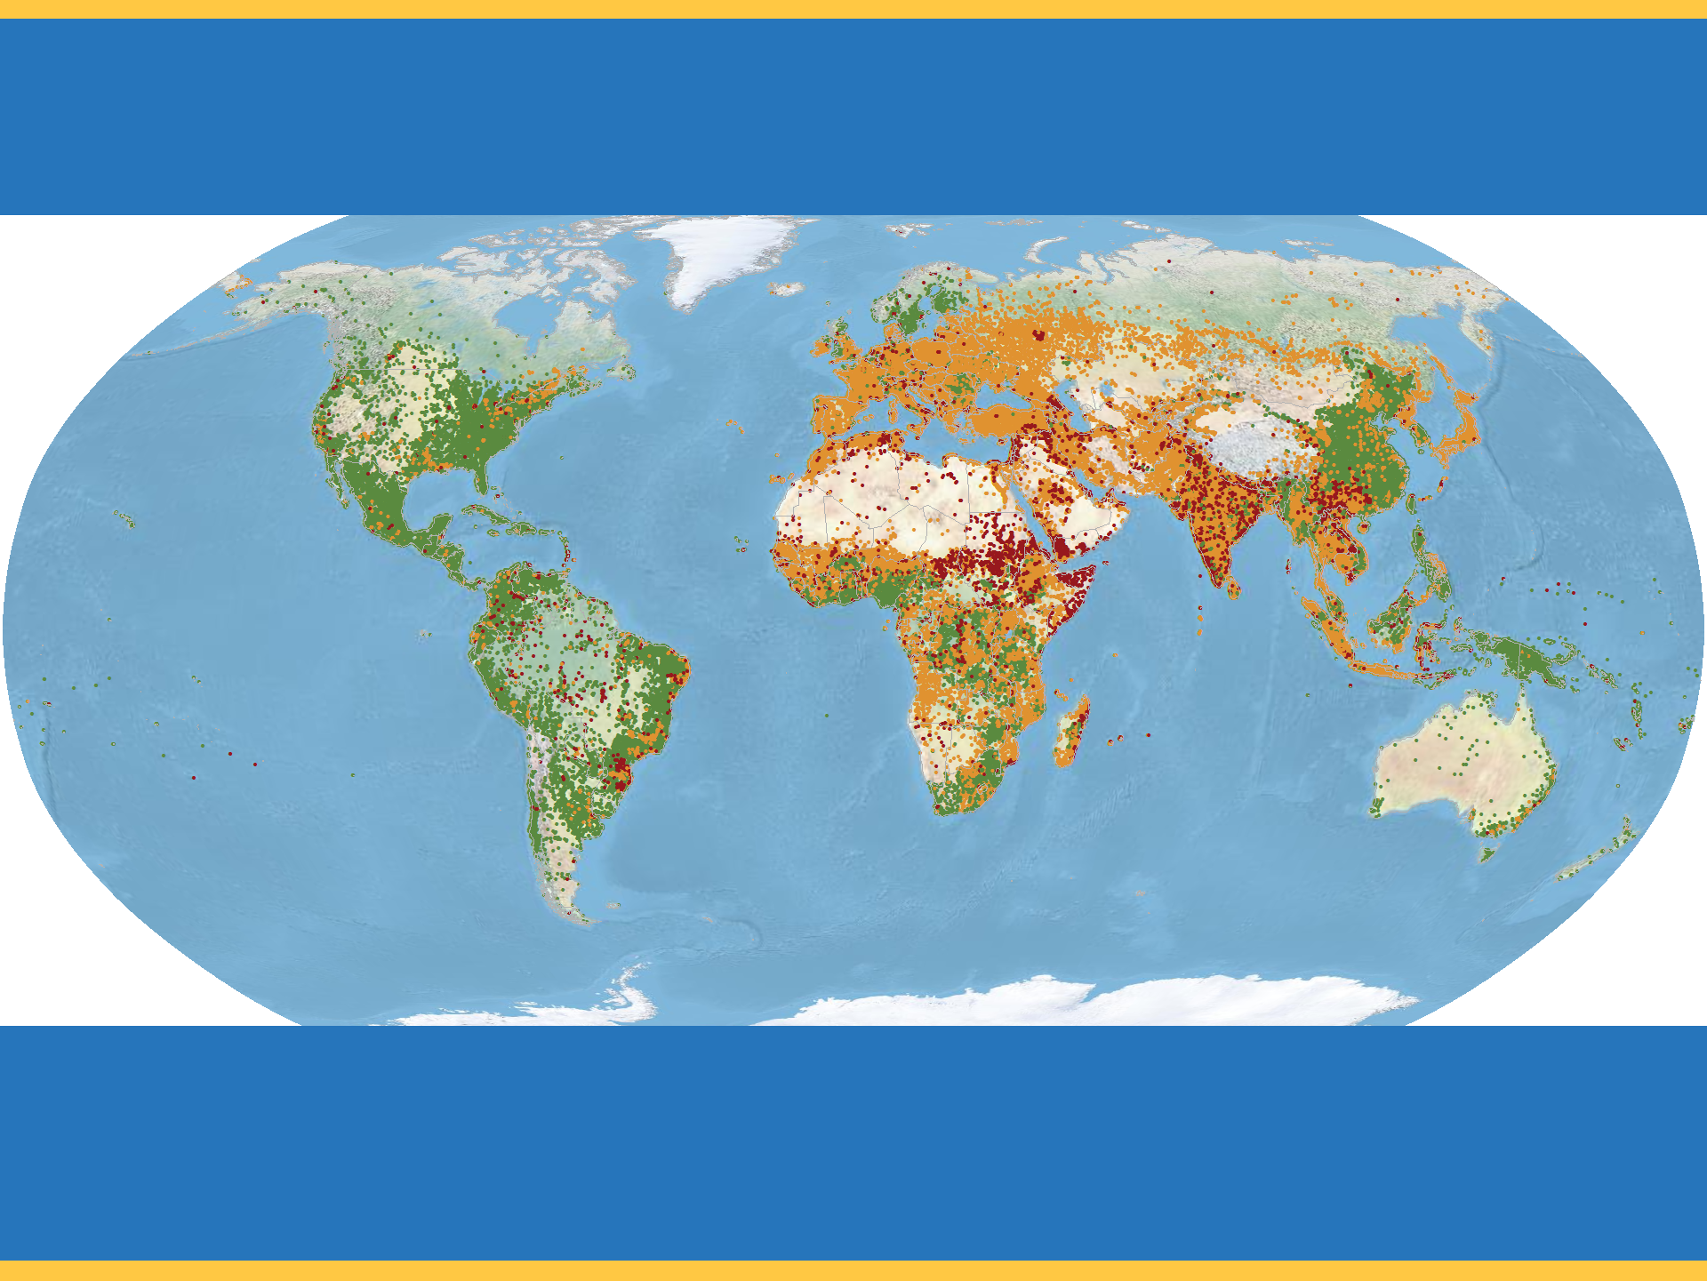

Progress toward Engaging Unreached Peoples
2016 Edition
imb
All People
11,500 people groups (7.2 billion people)
Each point approximates 50,000 people. Statuses are calculated by Global Research, IMB, January 2016. Robinson World Projection. Physical Basemap by US National Park Service. Geography by ESRI 2015.
Notes:
A people group is an ethno-linguistic group with a common self-identity that is shared by the various members. For strategic purposes it is the largest group within which the Gospel can spread without encountering barriers of understanding or acceptance. 11,500 people groups with a combined population of 7,200,000,000 are detailed in the IMB database (all values are rounded). Each people group is represented by one point for every 50,000 people. Data is taken from 2015-EOY GSEC Listing of people groups (12/31/2015).

Slide 4
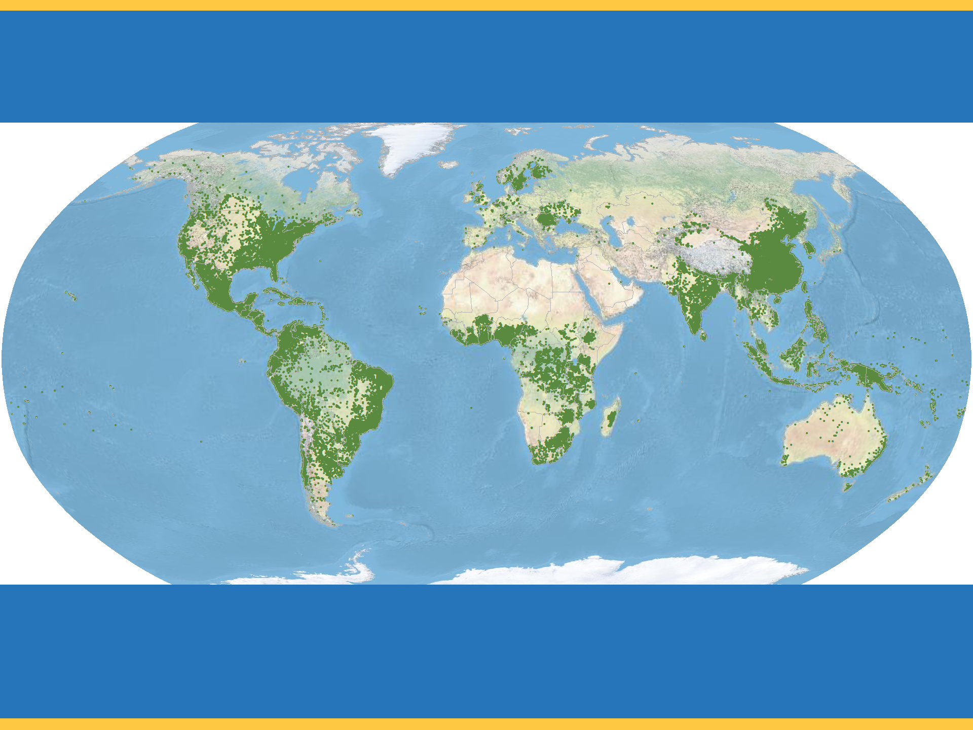

Progress toward Engaging Unreached Peoples
No Longer Unreached
imb
No Longer Unreached
4,700 people groups (3 billion people)
Each point approximates 50,000 people. Statuses are calculated by Global Research, IMB, January 2016. Robinson World Projection. Physical Basemap by US National Park Service. Geography by ESRI 2015.
Notes:
No Longer Unreached people groups are those among whom evangelical Christians account for 2 percent or more of the population. 4,700 No Longer Unreached people groups with a combined population of 3 billion are detailed in the IMB database (all values are rounded). Each people group is represented by one point for every 50,000 people. Data is taken from 2015-EOY GSEC Listing of people groups (12/31/2015).

Slide 5
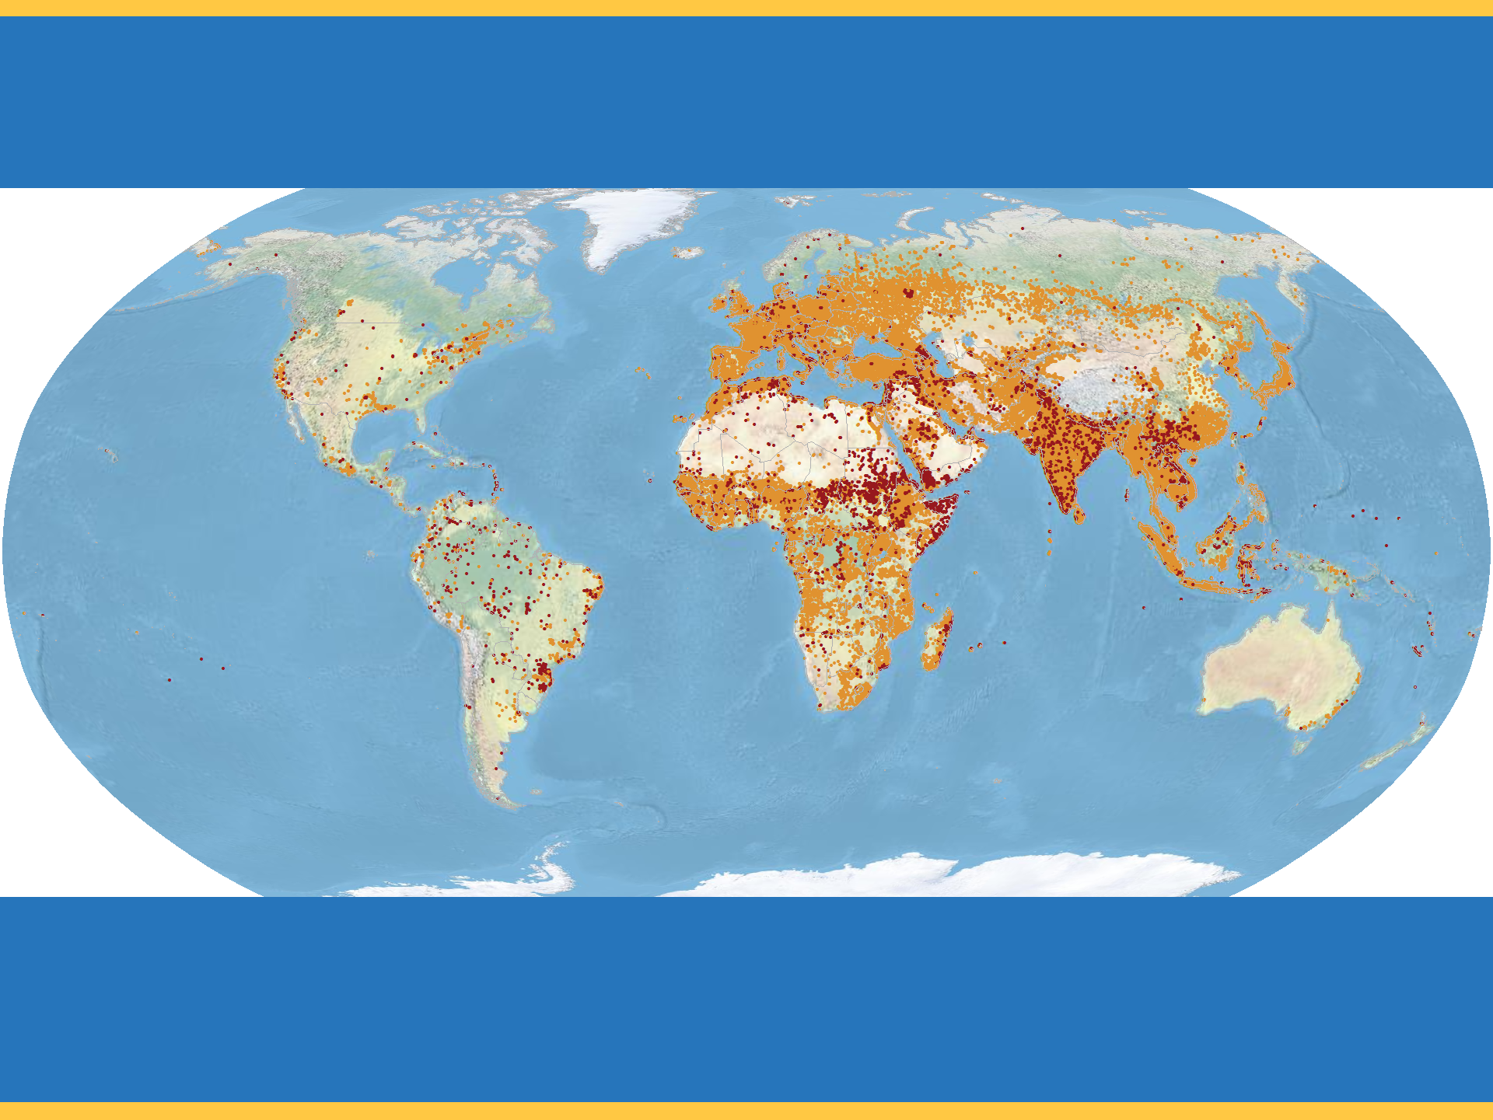

Progress toward Engaging Unreached Peoples
Unreached
imb
Unreached
6,800 people groups (4.2 billion people)
Each point approximates 50,000 people. Statuses are calculated by Global Research, IMB, January 2016. Robinson World Projection. Physical Basemap by US National Park Service. Geography by ESRI 2015.
Notes:
A people group is considered unreached when they are less than 2 percent evangelical. 6,800 Unreached people groups with a combined population of 4.2 billion are detailed in the IMB database (all values are rounded). Each people group is represented by one point for every 50,000 people. Data is taken from 2015-EOY GSEC Listing of people groups (12/31/2015).

Slide 6
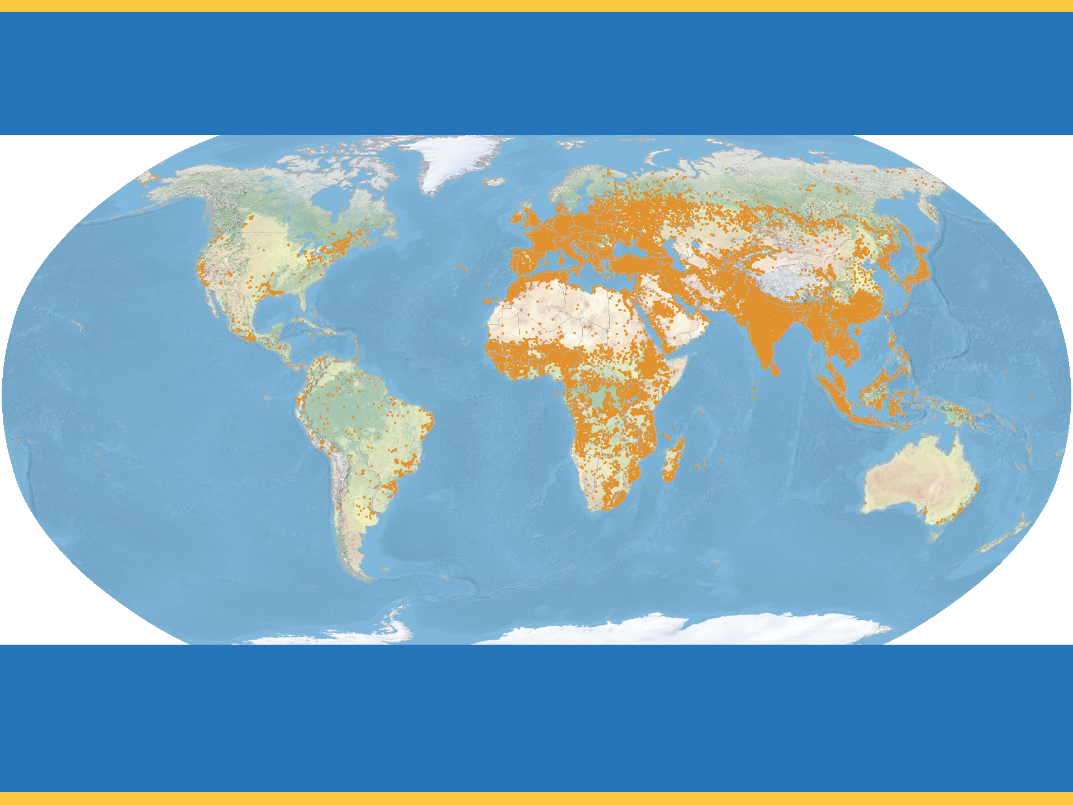

Progress toward Engaging Unreached Peoples
Engaged yet Unreached
imb
Engaged yet Unreached
3,700 people groups (4 billion people)
Each point approximates 50,000 people. Statuses are calculated by Global Research, IMB, January 2016. Robinson World Projection. Physical Basemap by US National Park Service. Geography by ESRI 2015.
Notes:
More than half of the world’s Unreached people groups are currently reported as engaged by one or more evangelical churches or organizations. A people group is engaged when a church planting strategy is being implemented among them. 3,700 Engaged yet Unreached people groups with a combined population of 4 billion are detailed in the IMB database (all values are rounded). Each people group is represented by one point for every 50,000 people. Data is taken from 2015-EOY GSEC Listing of people groups (12/31/2015).

Slide 7
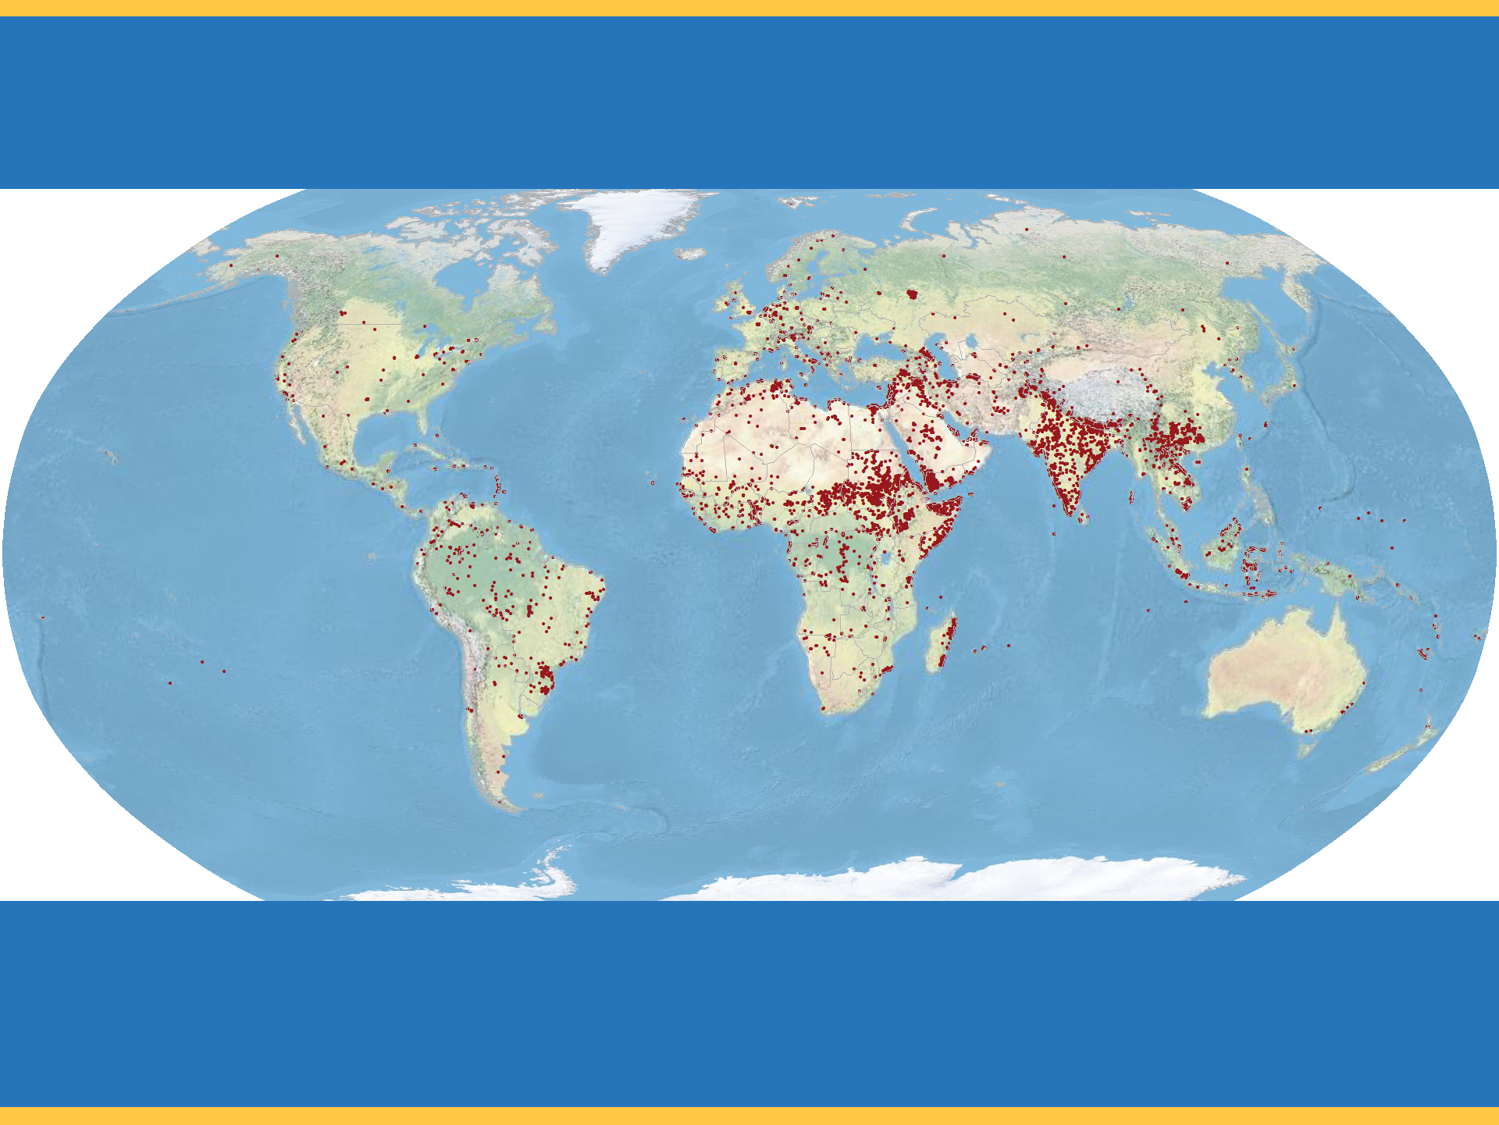

Progress toward Engaging Unreached Peoples
Unengaged and Unreached
imb
Unengaged and Unreached
3,100 people groups (200 million people)
Each point approximates 50,000 people. Statuses are calculated by Global Research, IMB, January 2016. Robinson World Projection. Physical Basemap by US National Park Service. Geography by ESRI 2015.
Notes:
Unengaged and Unreached people groups are those less than 2 percent evangelical among whom there is no indigenous community of evangelical Christians nor outside church or mission group implementing a church planting strategy. 3,100 Unengaged and Unreached people groups with a combined population of 200,000,000 are detailed in the IMB database (all values are rounded). Each people group is represented by one point for every 50,000 people. Data is taken from 2015-EOY GSEC Listing of people groups (12/31/2015).

