Slide 1
Global Status of Evangelical Christianity
2018 Update
GSEC Data Values from 2017-12 Public Report (1/1/2018)
Explore Global Research reports.
Explore an Interactive version of the latest GSEC Map.
Copyright © 2018 International Mission Board, Global Research

Slide 2
Global Status of Evangelical Christianity
The Global Status of Evangelical Christianity (GSEC) map portrays the spread of the gospel among people groups by measuring:
percentage of evangelicals;
access to evangelical print, audio, visual, or human resources;
recent church planting activity.
The GSEC model provides critical information for strategic decision makers.
Learn more at: peoplegroups.org
Status | Description
0 | No evangelical Christians or churches. No access to evangelical print, audio, visual or human resources.
1 | Less than 2 percent evangelical. Some evangelical resources available. No active church planting within the past two years.
2 | Less than 2 percent evangelical. Initial or localized church planting within the past two years.
3 | Less than 2 percent evangelical. Dispersed or widespread church planting within the past two years.
4 | Greater than or equal to 2 percent evangelical.
5 | Greater than or equal to 5 percent evangelical.
6 | Greater than or equal to 10 percent evangelical.
Copyright © 2018 International Mission Board, Global Research
Notes:
The Global Status of Evangelical Christianity (GSEC) map visualizes the spread of the gospel among people groups by measuring three factors: (1) percentage of evangelicals (groups less than 2% are considered unreached / groups greater than 2% are considered no longer unreached), (2) access to evangelical print, audio, visual, or human resources (GSEC reports summarize the availability of resources for each people group), and (3) recent church planting activity (specifically the level of activity within the past two years).

Slide 3
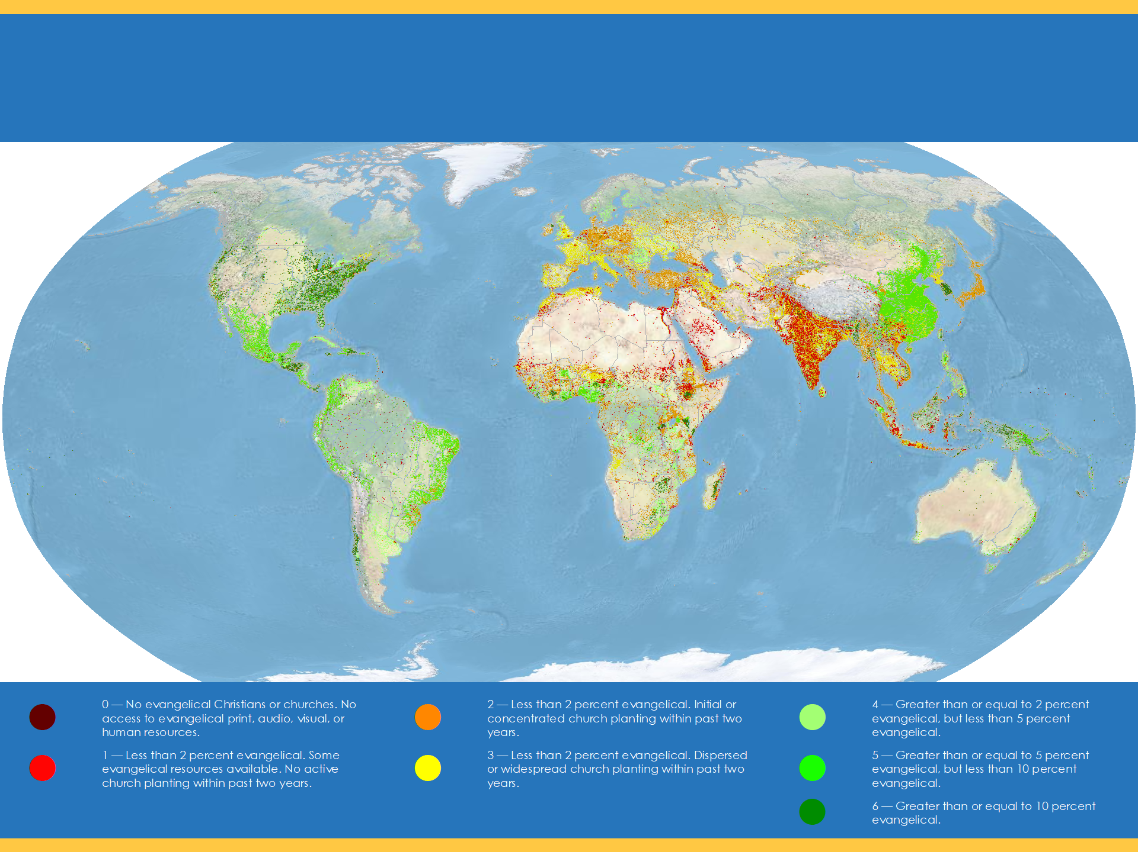
Global Status of Evangelical Christianity
imb
Each point approximates 50,000 people. Statuses calculated by Global Research, IMB, January 2018. Robinson World Projection. Physical Basemap by US National Park Service. Geography by ESRI 2017.
Copyright © 2018 International Mission Board, Global Research
Notes:
11,744 people groups with a combined population of 7,436,967,140 are detailed in the IMB database as of January 1, 2018. Each people group is represented by one point for every 50,000 people. All data is taken from 2017-12 GSEC Listing of people groups (1/1/2018).

Slide 4
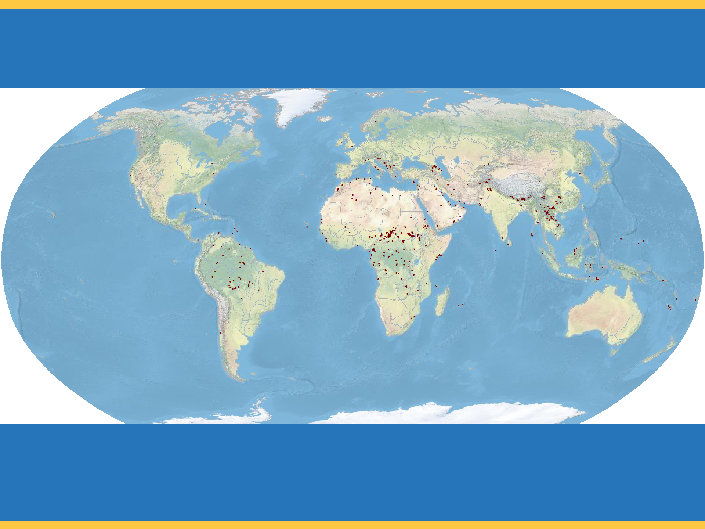
Global Status of Evangelical Christianity
imb
GSEC Status 0
No evangelical Christians or churches.
No access to evangelical print, audio, visual or human resources.
401 people groups with a combined population of 9,268,915 as of January 1, 2018.
Copyright © 2018 International Mission Board, Global Research
Notes:
401 people groups with a total population of 9,268,915 are classified as GSEC 0 as of January 1, 2018. GSEC 0 people groups have no evangelical Christians or churches and no access to evangelical print, audio, visual or human resources. GSEC values from 2017-12 GSEC Listing of people groups (1/1/2018).

Slide 5
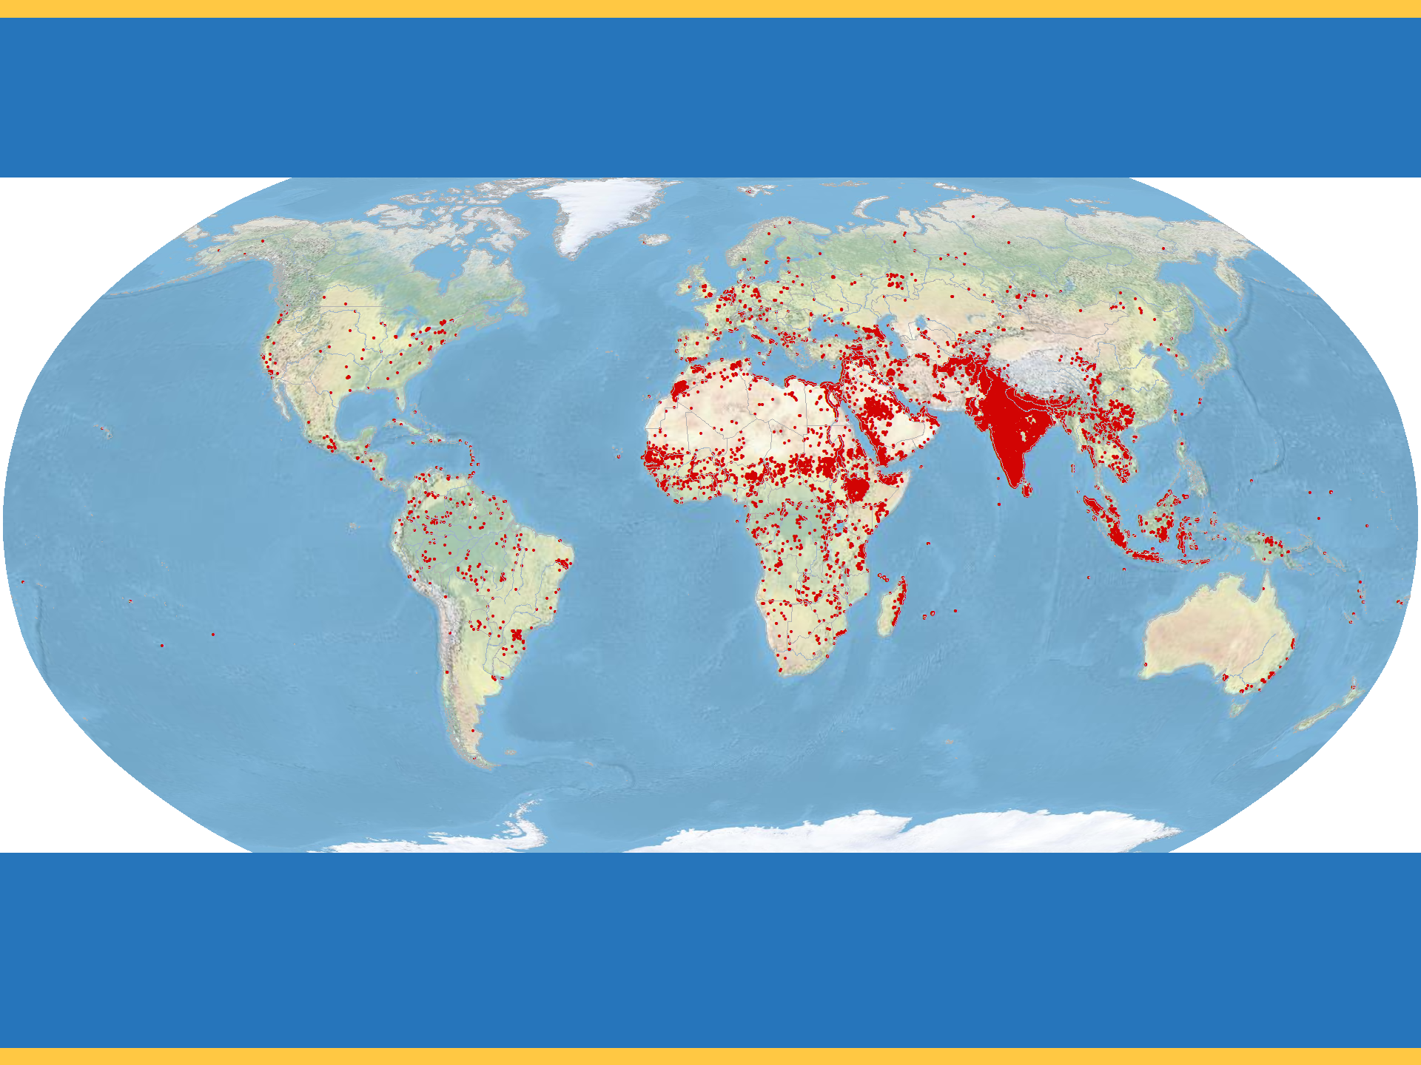
Global Status of Evangelical Christianity
imb
GSEC Status 1
Less than 2 percent evangelical. Some evangelical resources available.
No active church planting within the past two years.
4,507 people groups with a combined population of 919,049,170 as of January 1, 2018.
Copyright © 2018 International Mission Board, Global Research
Notes:
4,507 people groups with a total population of 919,049,170 are classified as GSEC 1 as of January 1, 2018. GSEC 1 people groups are less than 2% evangelical. Some evangelical resources are available in their heart language but there has been no active church planting among them within the past two years. GSEC values from 2017-12 GSEC Listing of people groups (1/1/2018).

Slide 6
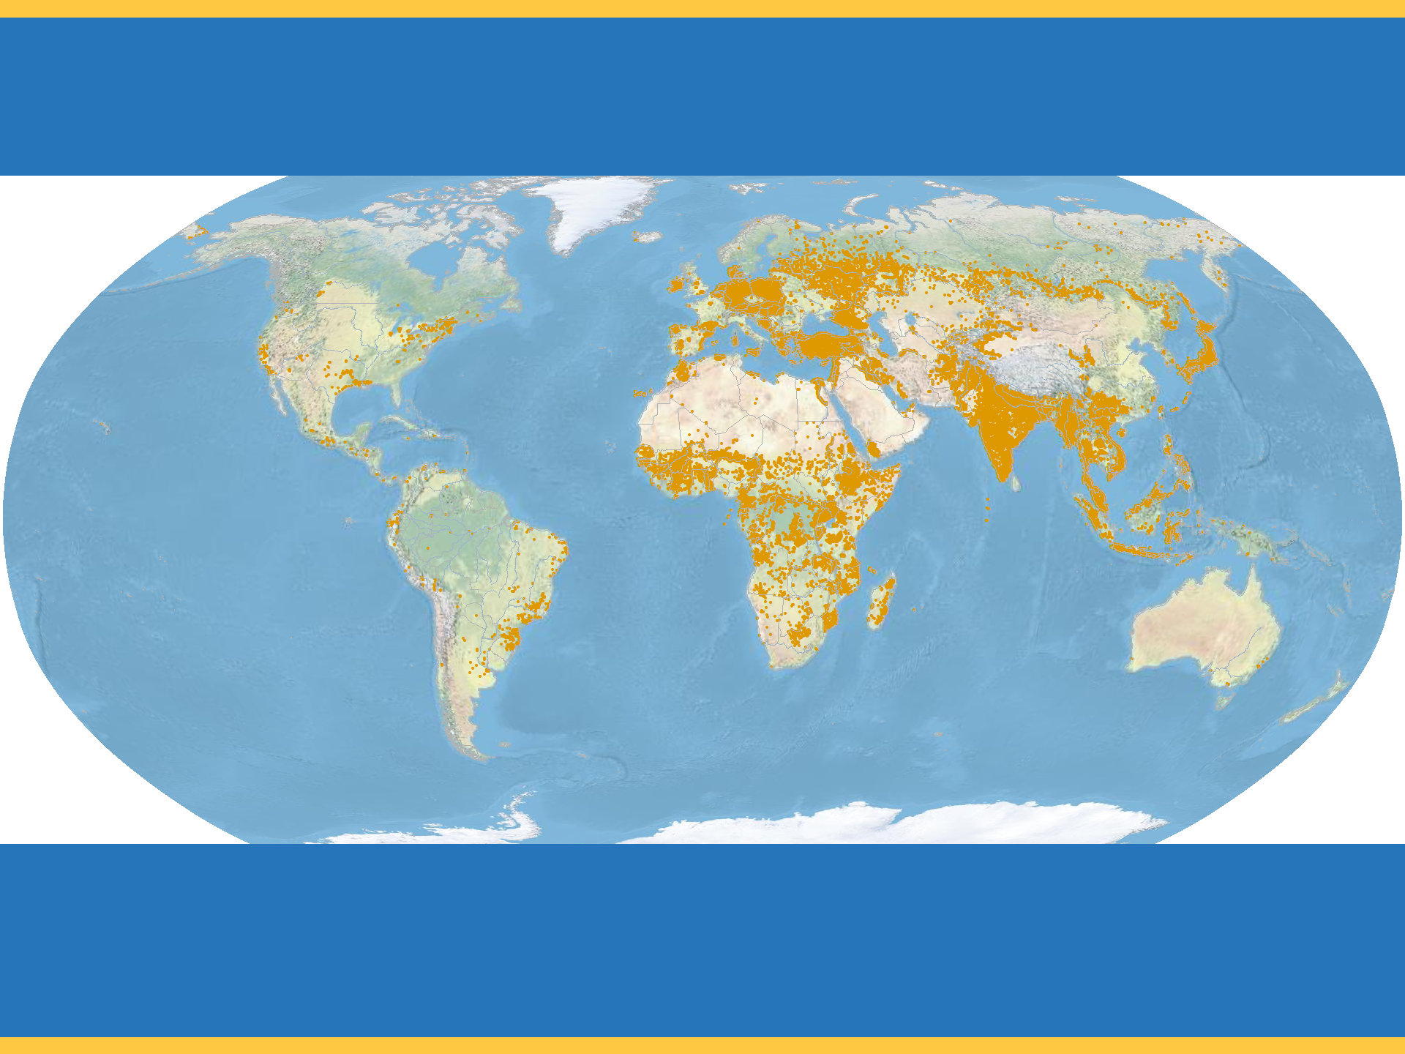
Global Status of Evangelical Christianity
imb
GSEC Status 2
Less than 2 percent evangelical.
Initial or localized church planting within the past two years.
1,754 people groups with a combined population of 1,864,236,850 as of January 1, 2018.
Copyright © 2018 International Mission Board, Global Research
Notes:
1,754 people groups with a total population of 1,864,236,850 are classified as GSEC 2 as of January 1, 2018. GSEC 2 people groups are less than 2% evangelical. Initial or localized church planting has been reported within the past two years. GSEC values from 2017-12 GSEC Listing of people groups (1/1/2018).

Slide 7
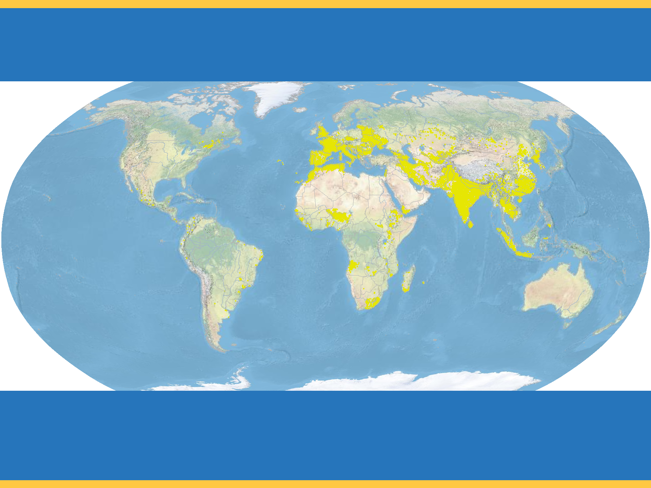
Global Status of Evangelical Christianity
imb
GSEC Status 3
Less than 2 percent evangelical.
Dispersed or widespread church planting within the past two years.
377 people groups with a combined population of 1,556,532,600 as of January 1, 2018.
Copyright © 2018 International Mission Board, Global Research
Notes:
377 people groups with a total population of 1,556,532,600 are classified as GSEC 3 as of January 1, 2018. GSEC 3 people groups are less than 2% evangelical but widespread church planting has been reported within the past two years. GSEC values from 2017-12 GSEC Listing of people groups (1/1/2018).

Slide 8
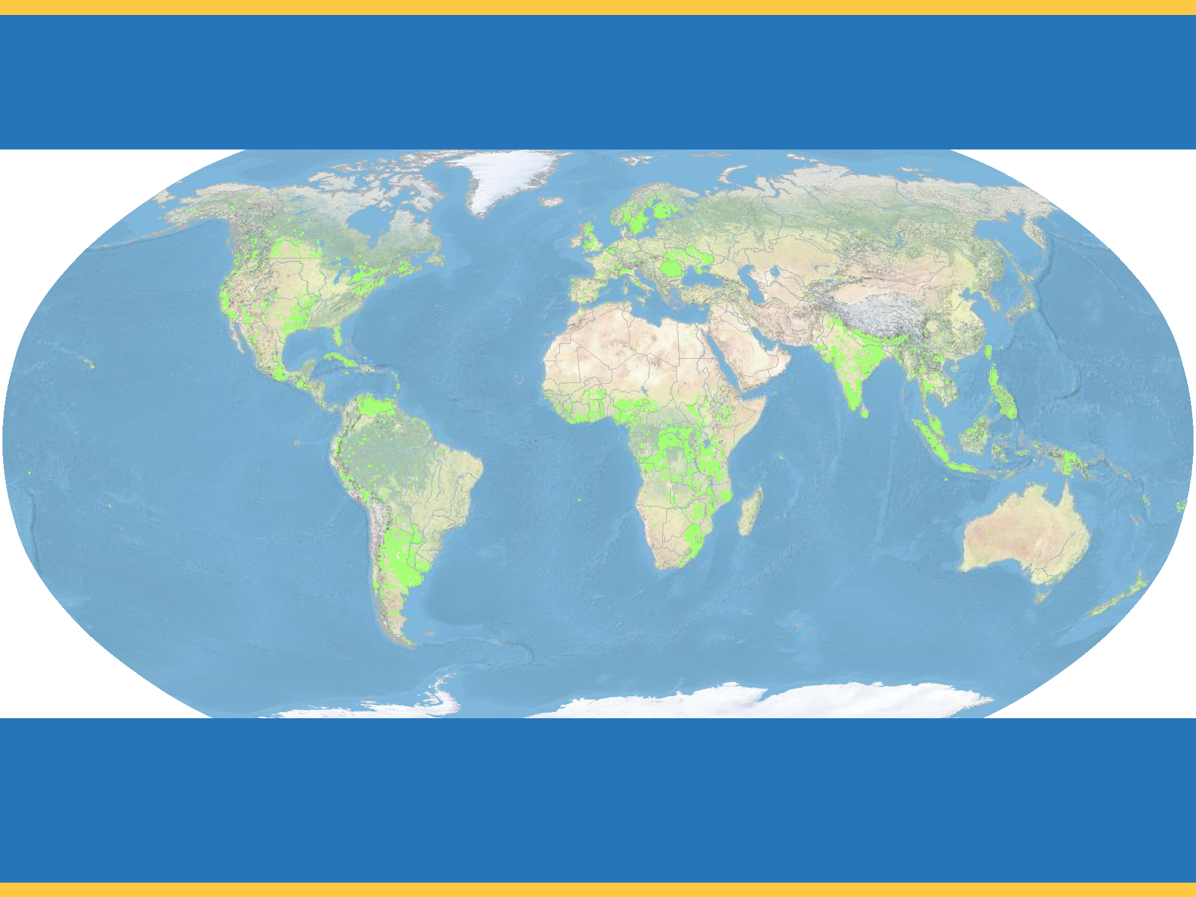
Global Status of Evangelical Christianity
imb
GSEC Status 4
Greater than or equal to 2 percent evangelical.
1,370 people groups with a combined population of 573,549,895 as of January 1, 2018.
Copyright © 2018 International Mission Board, Global Research
Notes:
1,370 people groups with a total population of 573,549,895 are classified as GSEC 4 as of January 1, 2018. GSEC 4 people groups are greater than or equal to 2% evangelical but less than 5% evangelical. GSEC values from 2017-12 GSEC Listing of people groups (1/1/2018).

Slide 9
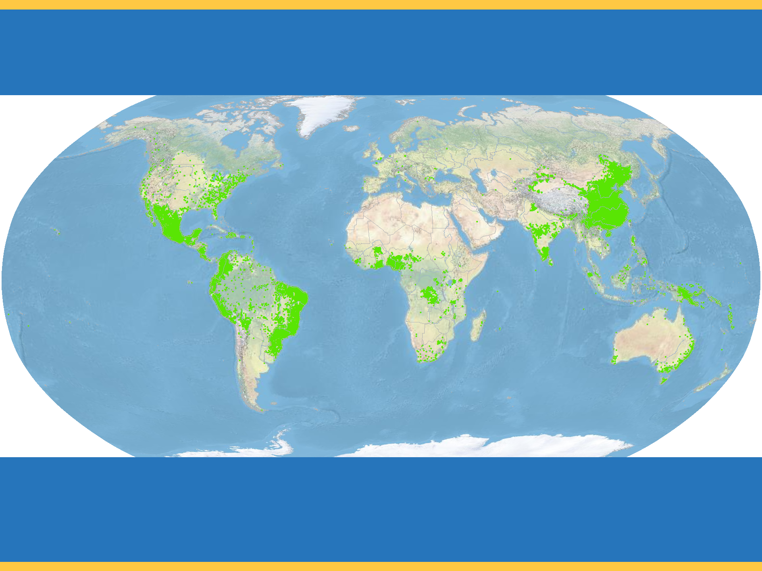
Global Status of Evangelical Christianity
imb
GSEC Status 5
Greater than or equal to 5 percent evangelical.
1,479 people groups with a combined population of 1,952,468,945 as of January 1, 2018.
Copyright © 2018 International Mission Board, Global Research
Notes:
1,479 people groups with a total population of 1,952,468,945 are classified as GSEC 5 as of January 1, 2018. GSEC 5 people groups are greater than or equal to 5% evangelical but less than 10% evangelical. GSEC values from 2017-12 GSEC Listing of people groups (1/1/2018).

Slide 10
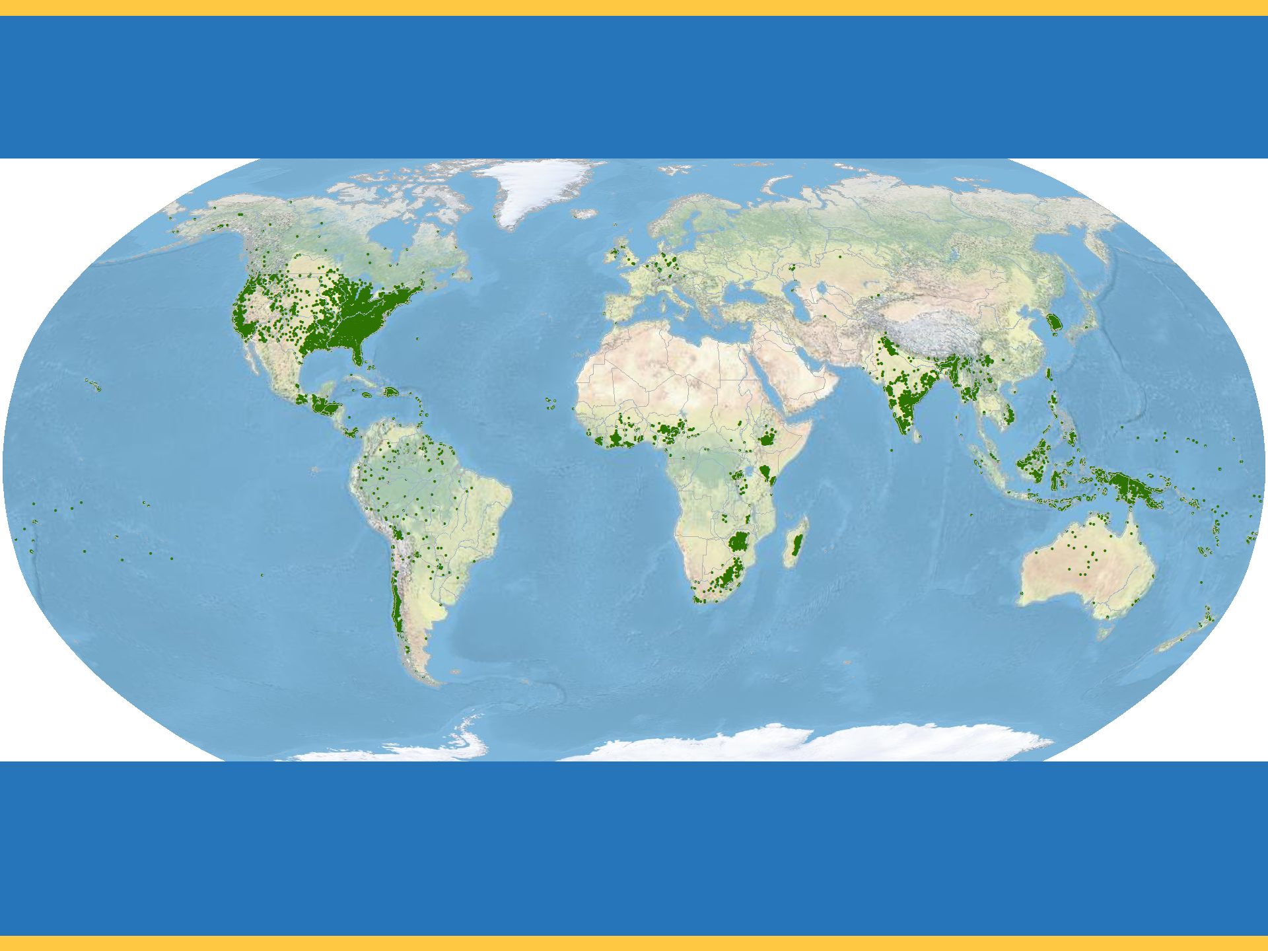
Global Status of Evangelical Christianity
imb
GSEC Status 6
Greater than or equal to 10 percent evangelical.
1,856 people groups with a combined population of 561,860,765 as of January 1, 2018.
Copyright © 2018 International Mission Board, Global Research
Notes:
1,856 people groups with a total population of 561,860,765 are classified as GSEC 6 as of January 1, 2018. GSEC 6 people groups are greater than or equal to 10% evangelical. GSEC values from 2017-12 GSEC Listing of people groups (1/1/2018).

Slide 11
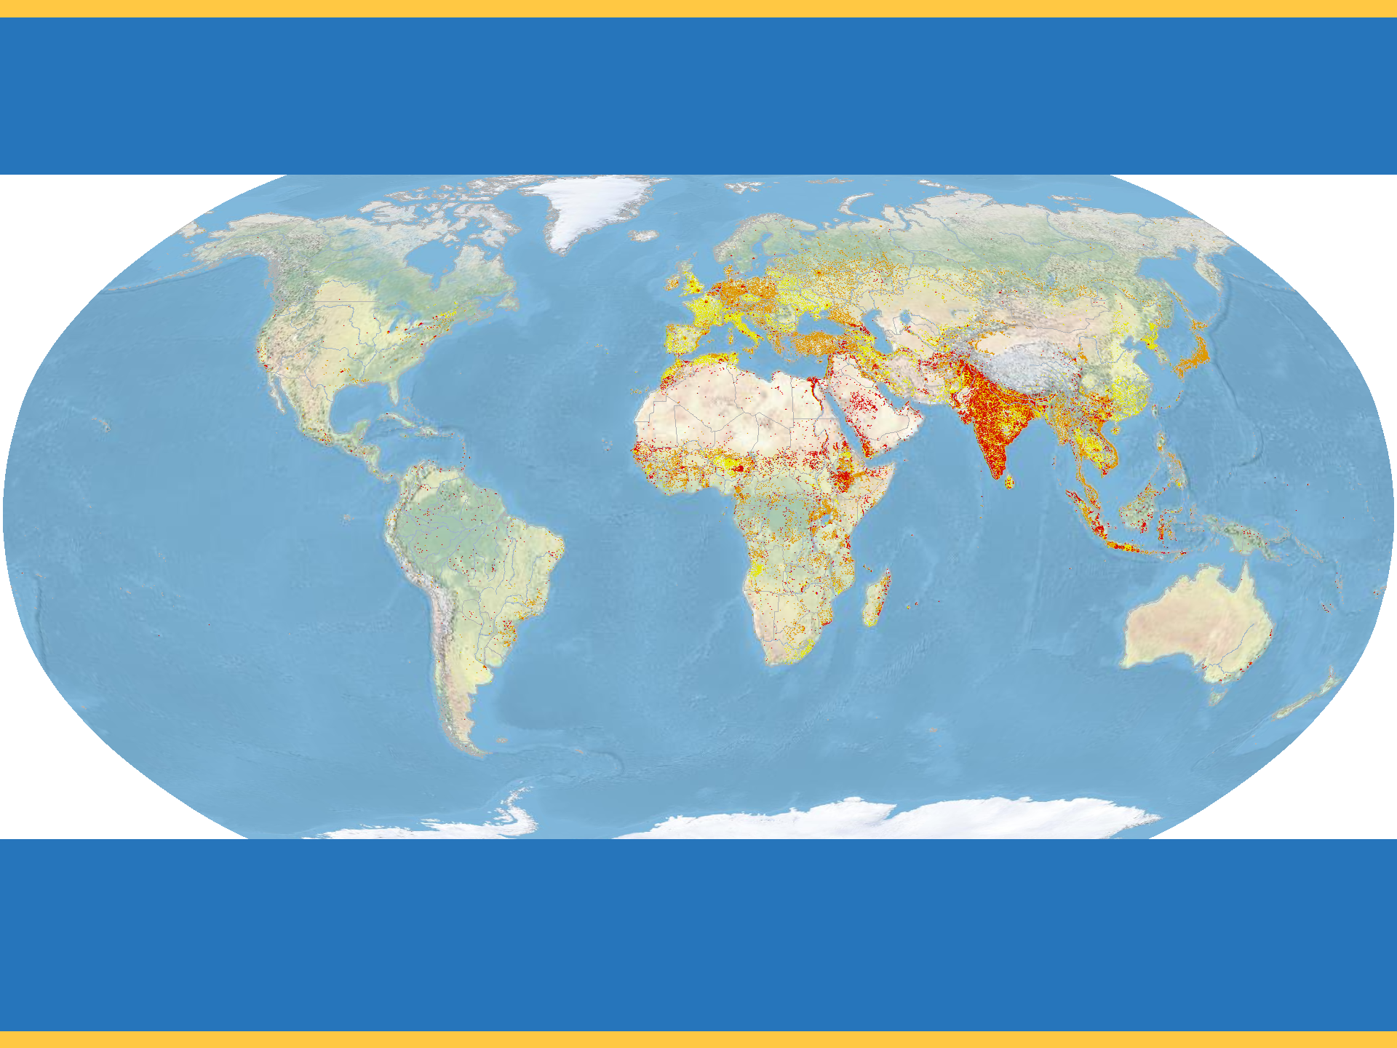
Global Status of Evangelical Christianity
imb
Unreached People Groups
An Unreached People Group (UPG) is a people group with less than 2 percent evangelical Christians.
7,039 people groups with a total population of 4,349,087,535 are classified as UPGs as of January 1, 2018.
Copyright © 2018 International Mission Board, Global Research
Notes:
7,039 People Groups with a combined population of 4,349,087,535 are Unreached as of January 1, 2018. An Unreached People Group (UPG) is a people group among whom evangelical Christians comprise less than 2 percent of the population. GSEC Values from 2017-12 GSEC Listing of people groups (1/1/2018).

