Slide 1
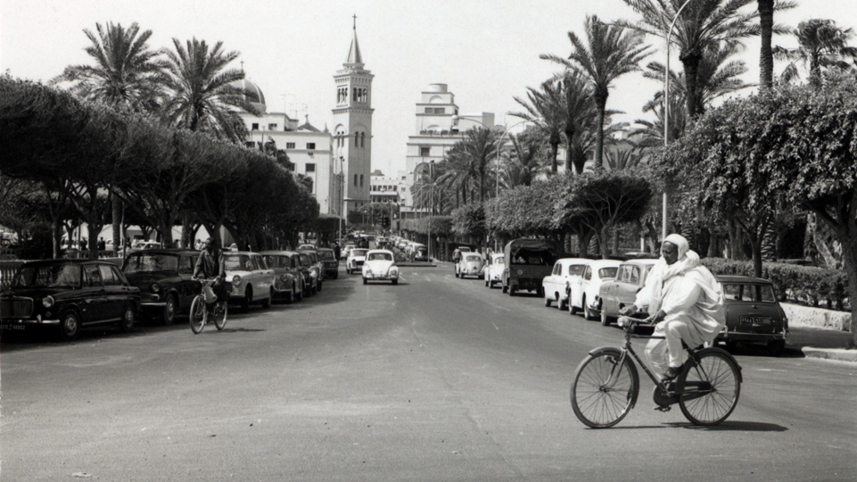
PRAY FOR LIBYA

Slide 2
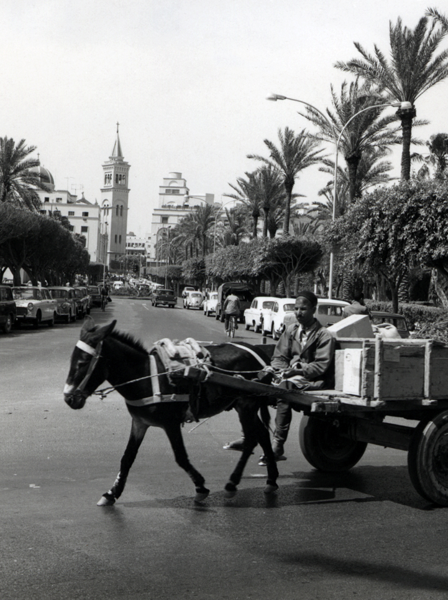
Cyclone Daniel hit the city of Derna in Libya on Sunday, September 10. As of September 14, the Libyan government has confirmed 8,000 dead, with another 10,000 missing. Thousands have entered a Christless eternity, and millions more are processing their grief without the hope of the gospel.
Let us pray together for the Lord to have mercy on the people of Libya, filling them with lasting hope.
“O Lord, be gracious to us; we wait for you. Be our arm every morning, our salvation in the time of trouble” (Isaiah 33:2).

Slide 3
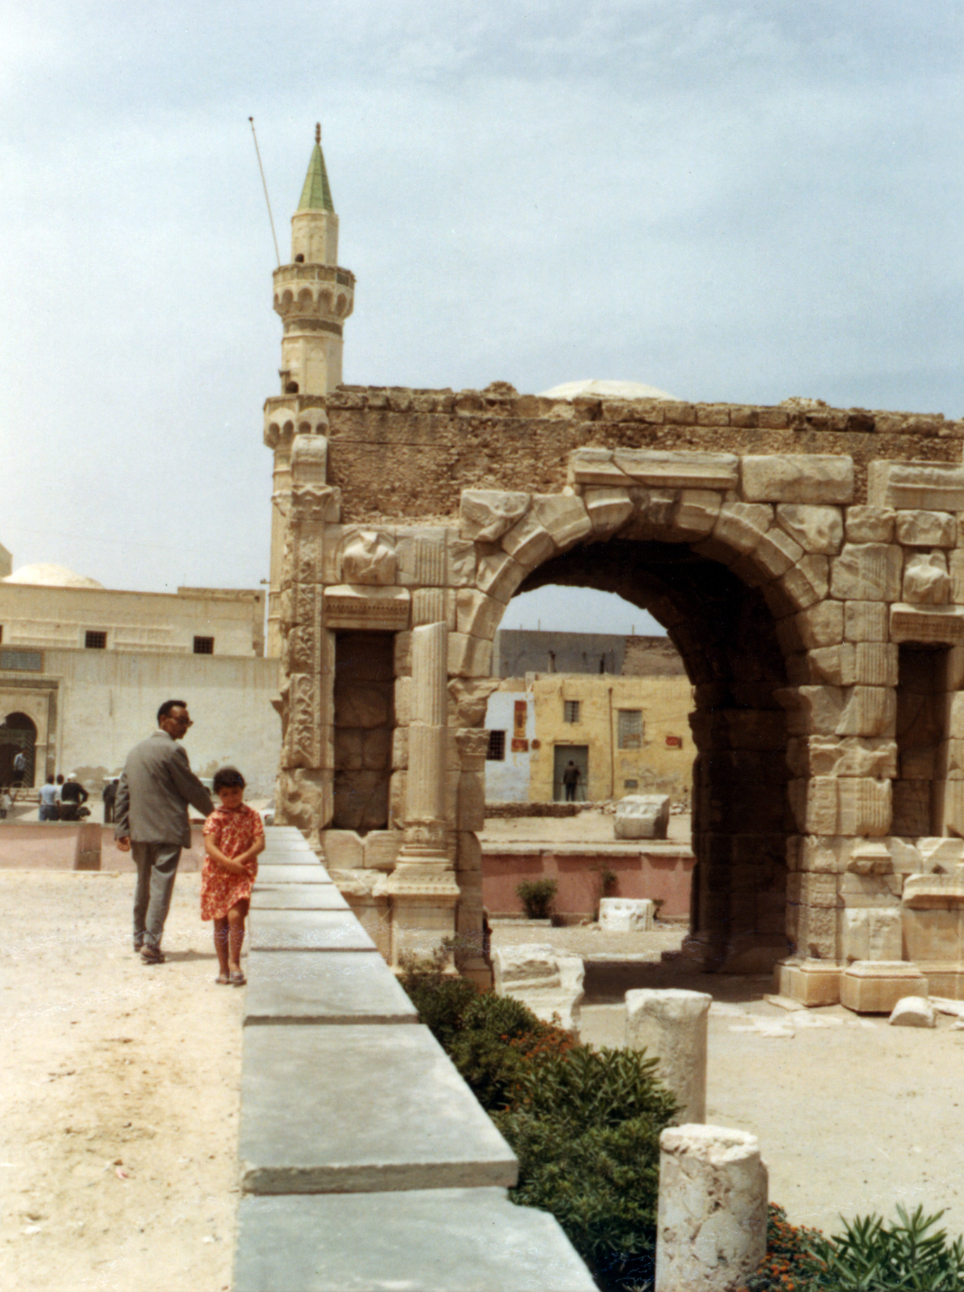
PRAY FOR LOSTNESS
News outlets are reporting that bodies are being washed up onto the land every day and that death surrounds the survivors. Most in this region have never had a chance to hear and respond to the good news of Jesus.
Let us pray together that survivors will have the opportunity to hear and respond to the gospel and that they will be comforted in their grief.
“He will wipe away every tear from their eyes,
and death shall be no more, neither shall there
be mourning, nor crying, nor pain anymore,
for the former things have passed away” (Revelation 21:4).

Slide 4
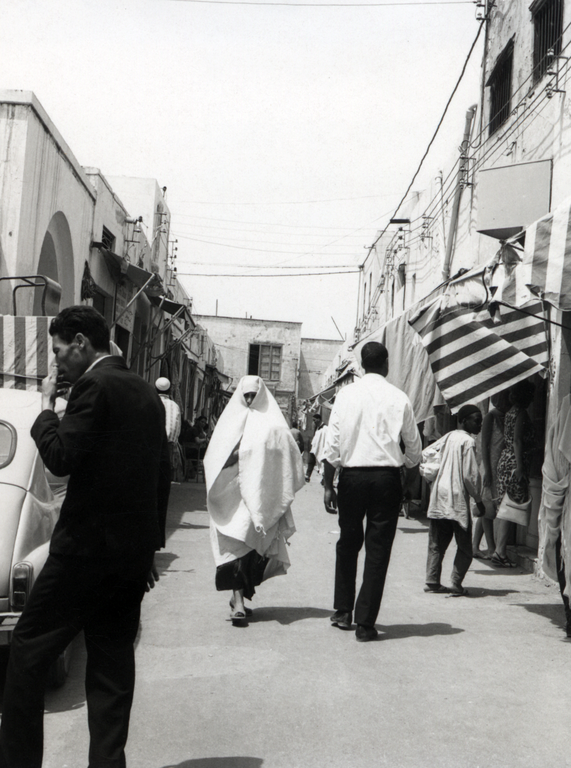
PRAY FOR GOSPEL ACCESS
Though it is illegal to proselytize and distribute religious literature in Libya, praise God that the Bible has been translated into Arabic. Praise God that His Word is powerful and able to transform lives, even in the most closed countries.
Pray that Libyans will have the opportunity to read God’s Word and be transformed by it. Pray for any who might secretly follow Jesus. Pray that they will find each other and have fellowship. Ask that they will be encouraged by God’s Word and His Spirit.
“For the word of God is living and active, sharper than any two-edged sword, piercing to the division of soul and of spirit, of joints and of marrow, and discerning the thoughts and intentions of the heart” (Hebrews 14:12).

Slide 5
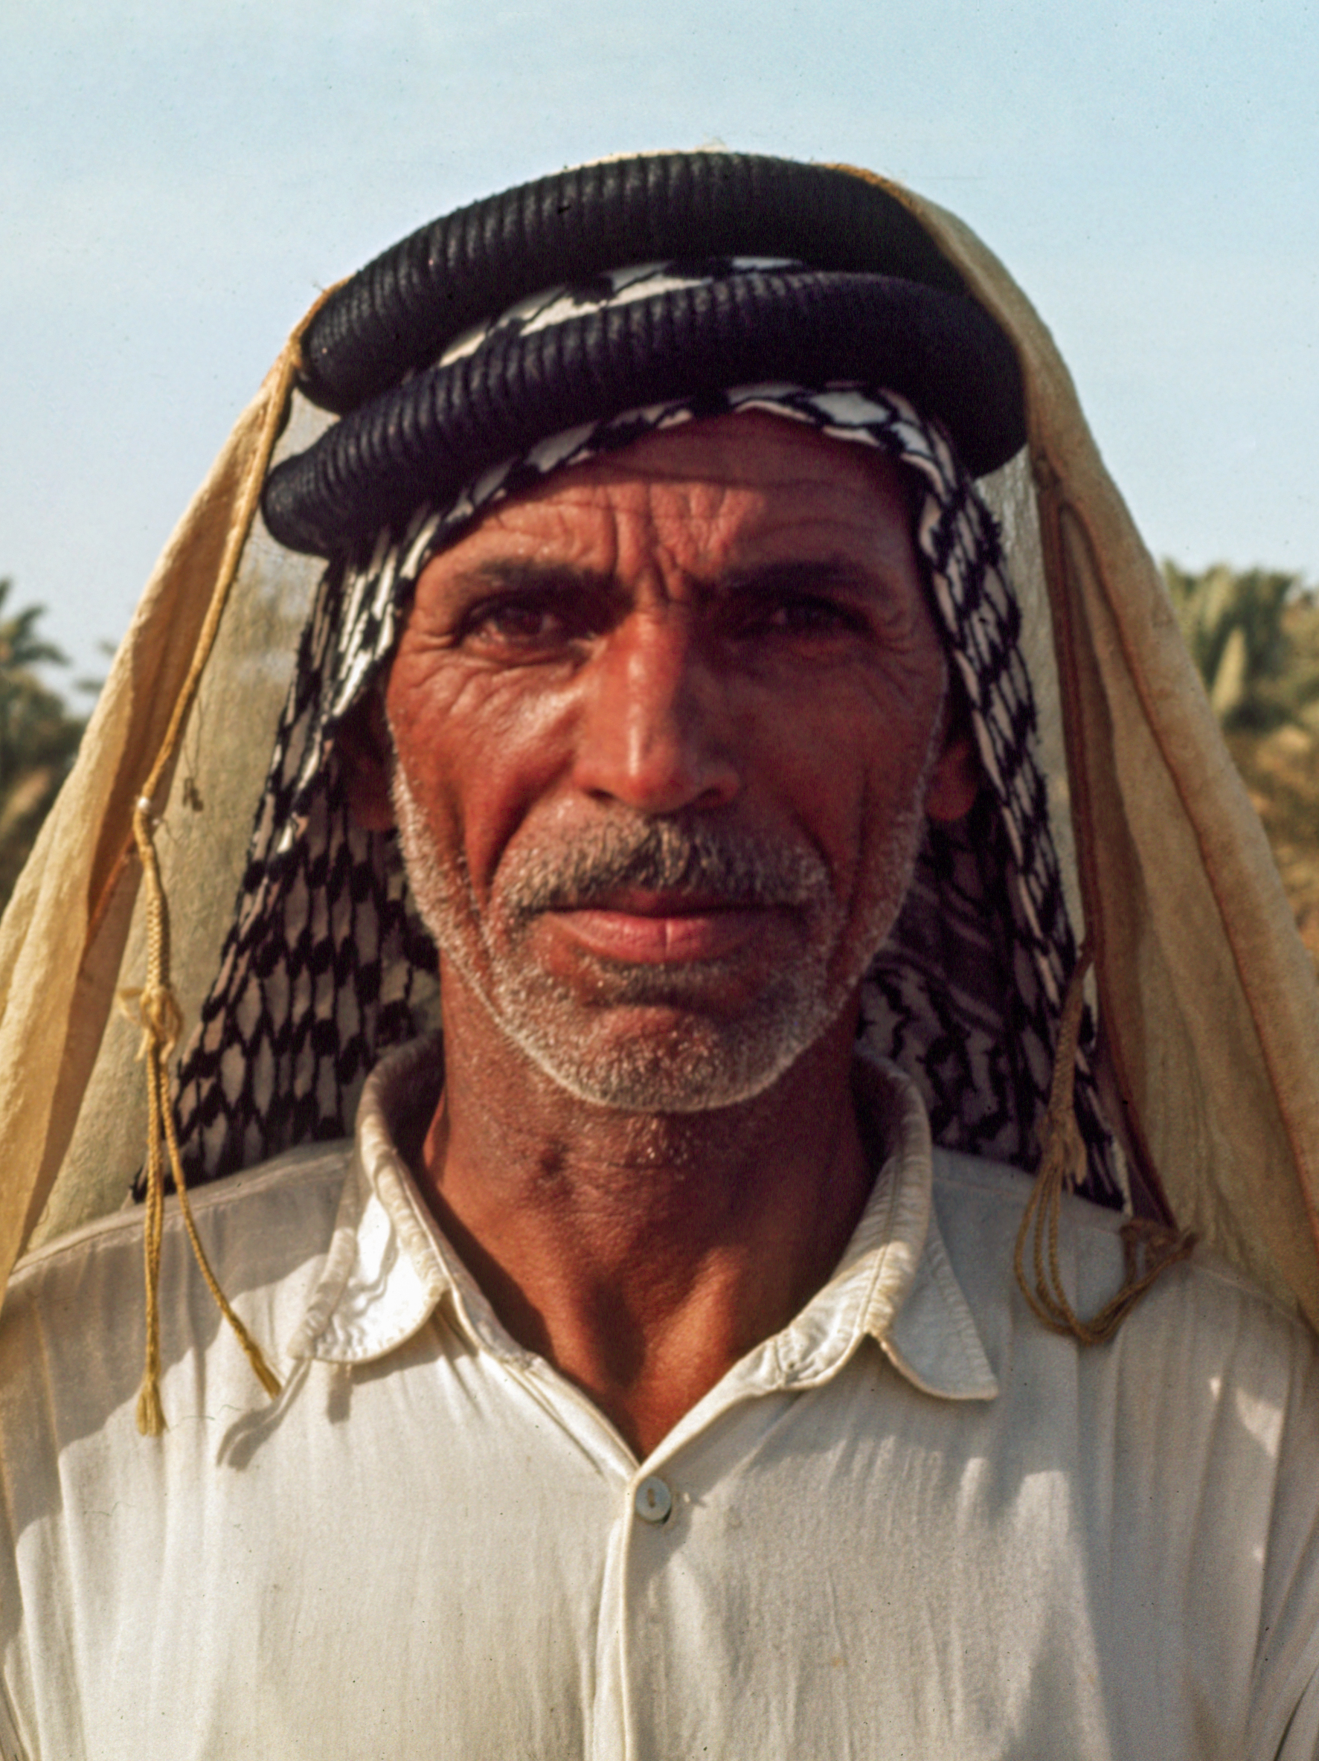
PRAY FOR PHYSICAL NEEDS
The infrastructure in Libya is frail, and they are not accepting much foreign aid. People need shelter, food, and clean water.
Pray that God will provide for the needs of the people affected by the floods. Pray that He will show them His fatherly care and they will have the opportunity to know that every good gift comes from Him.
“Look at the birds of the air: they neither sow nor reap nor gather into barns, and yet your heavenly Father feeds them. Are you not of more value than they?” (Matthew 6:26).

Slide 6
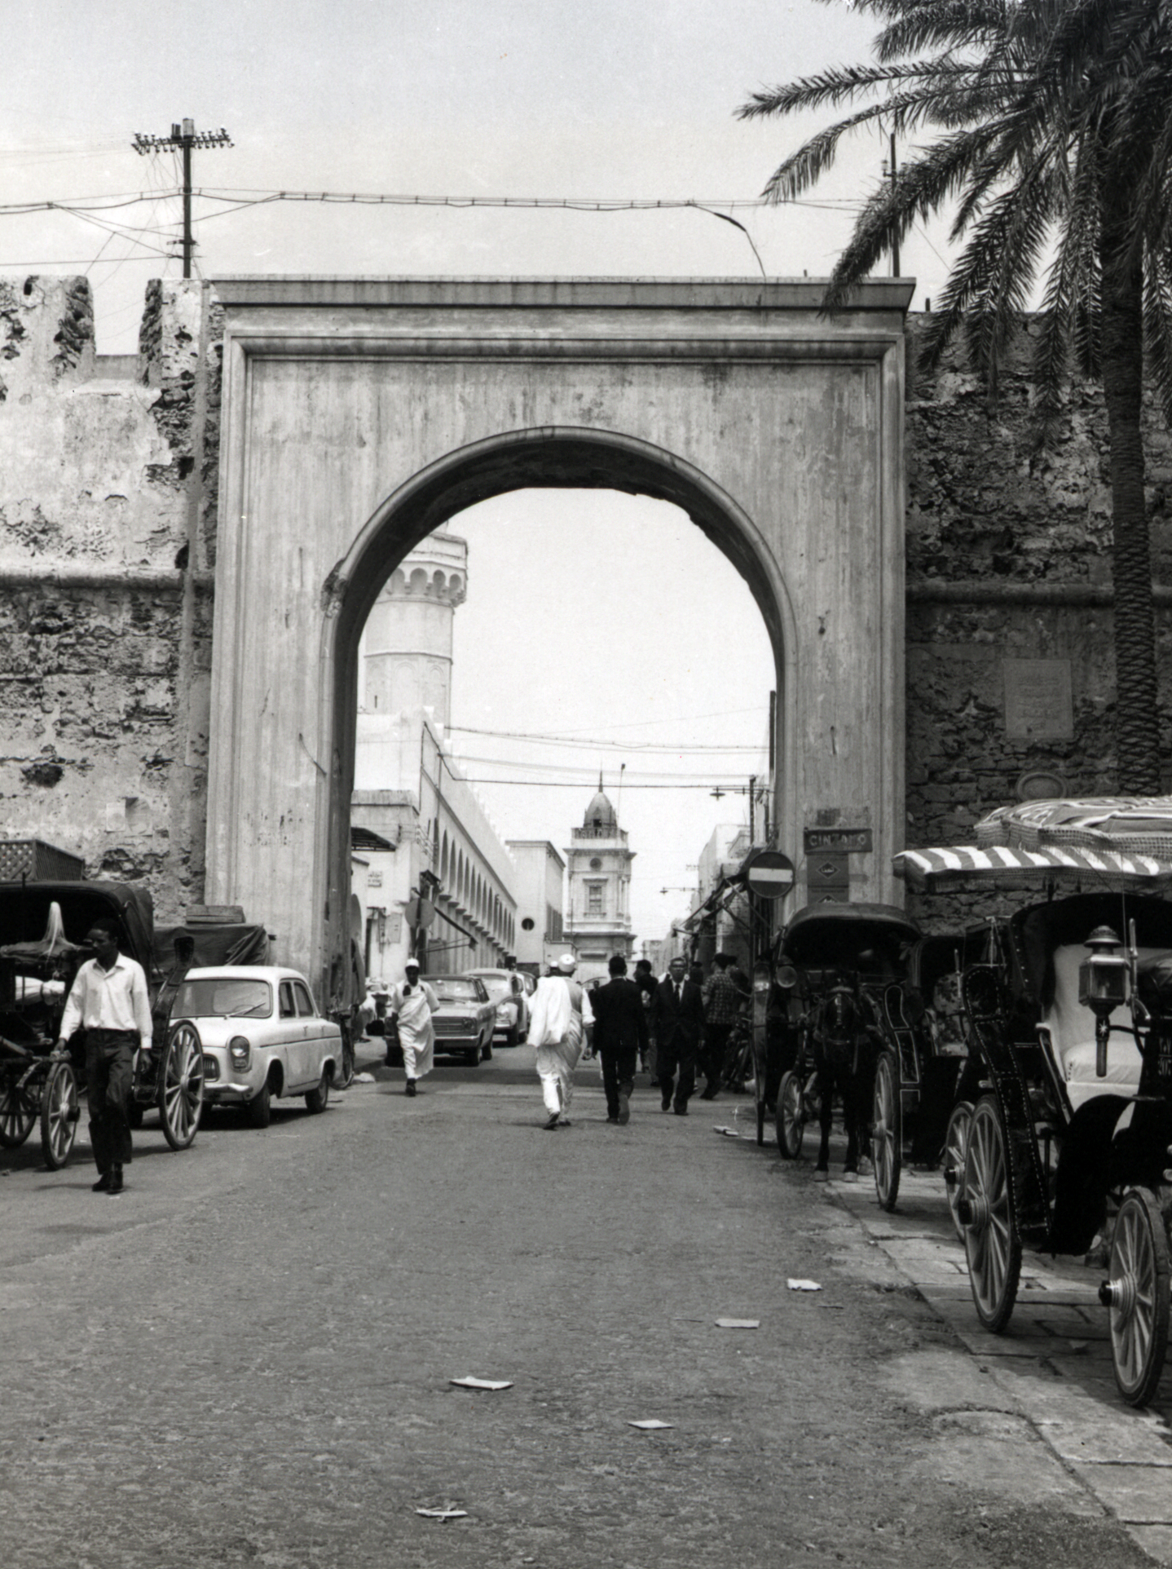
PRAY FOR THE CHURCH
Though access to Libya by Christian organizations is prohibited, the omnipresent God hears our prayers and is not limited in His reach. He is at work.
Pray that God will burden the hearts of Christians around the world for the people of Libya and that we will be united in prayer, asking Him to do the impossible and open doors to the gospel.
“Continue steadfastly in prayer, being watchful in it with thanksgiving. At the same time, pray also for us, that God may open to us a door for the word, to declare the mystery of Christ” (Colossians 4:2-3a).

Slide 7
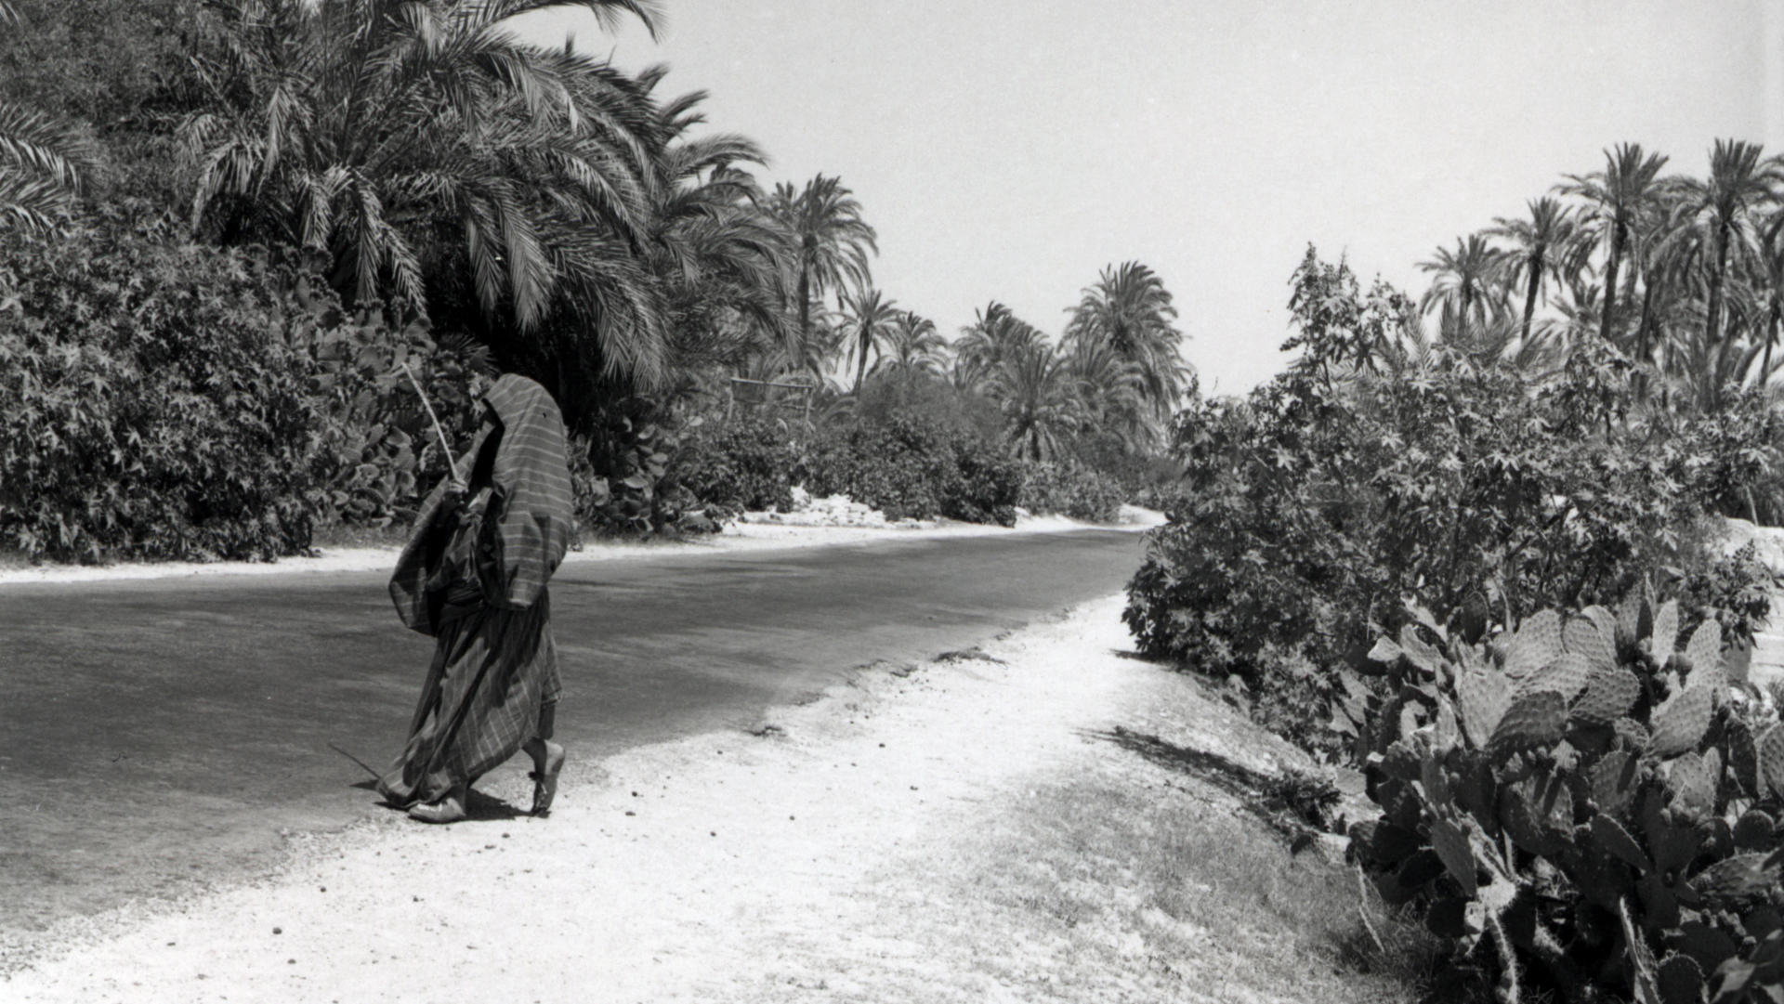
PRAY FOR LIBYA

