Slide 1
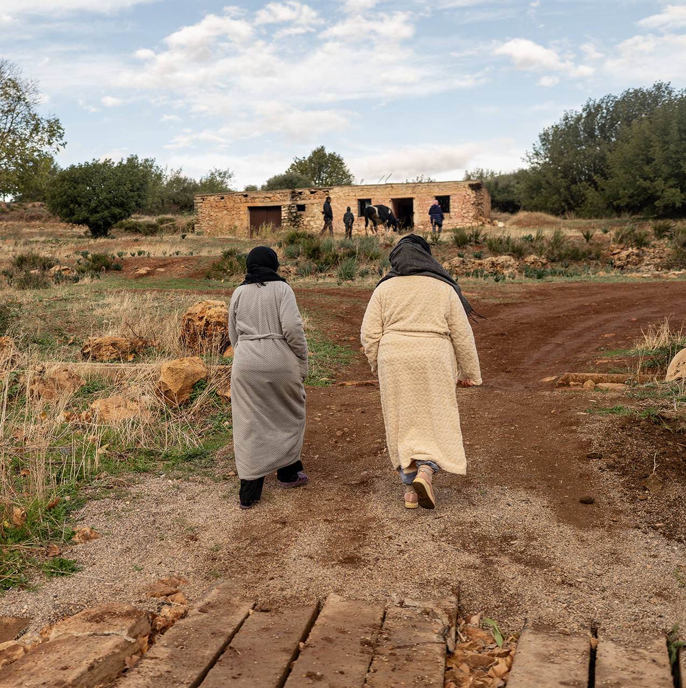
PRAY FOR
Morocco
Earthquake
Victims

Slide 2
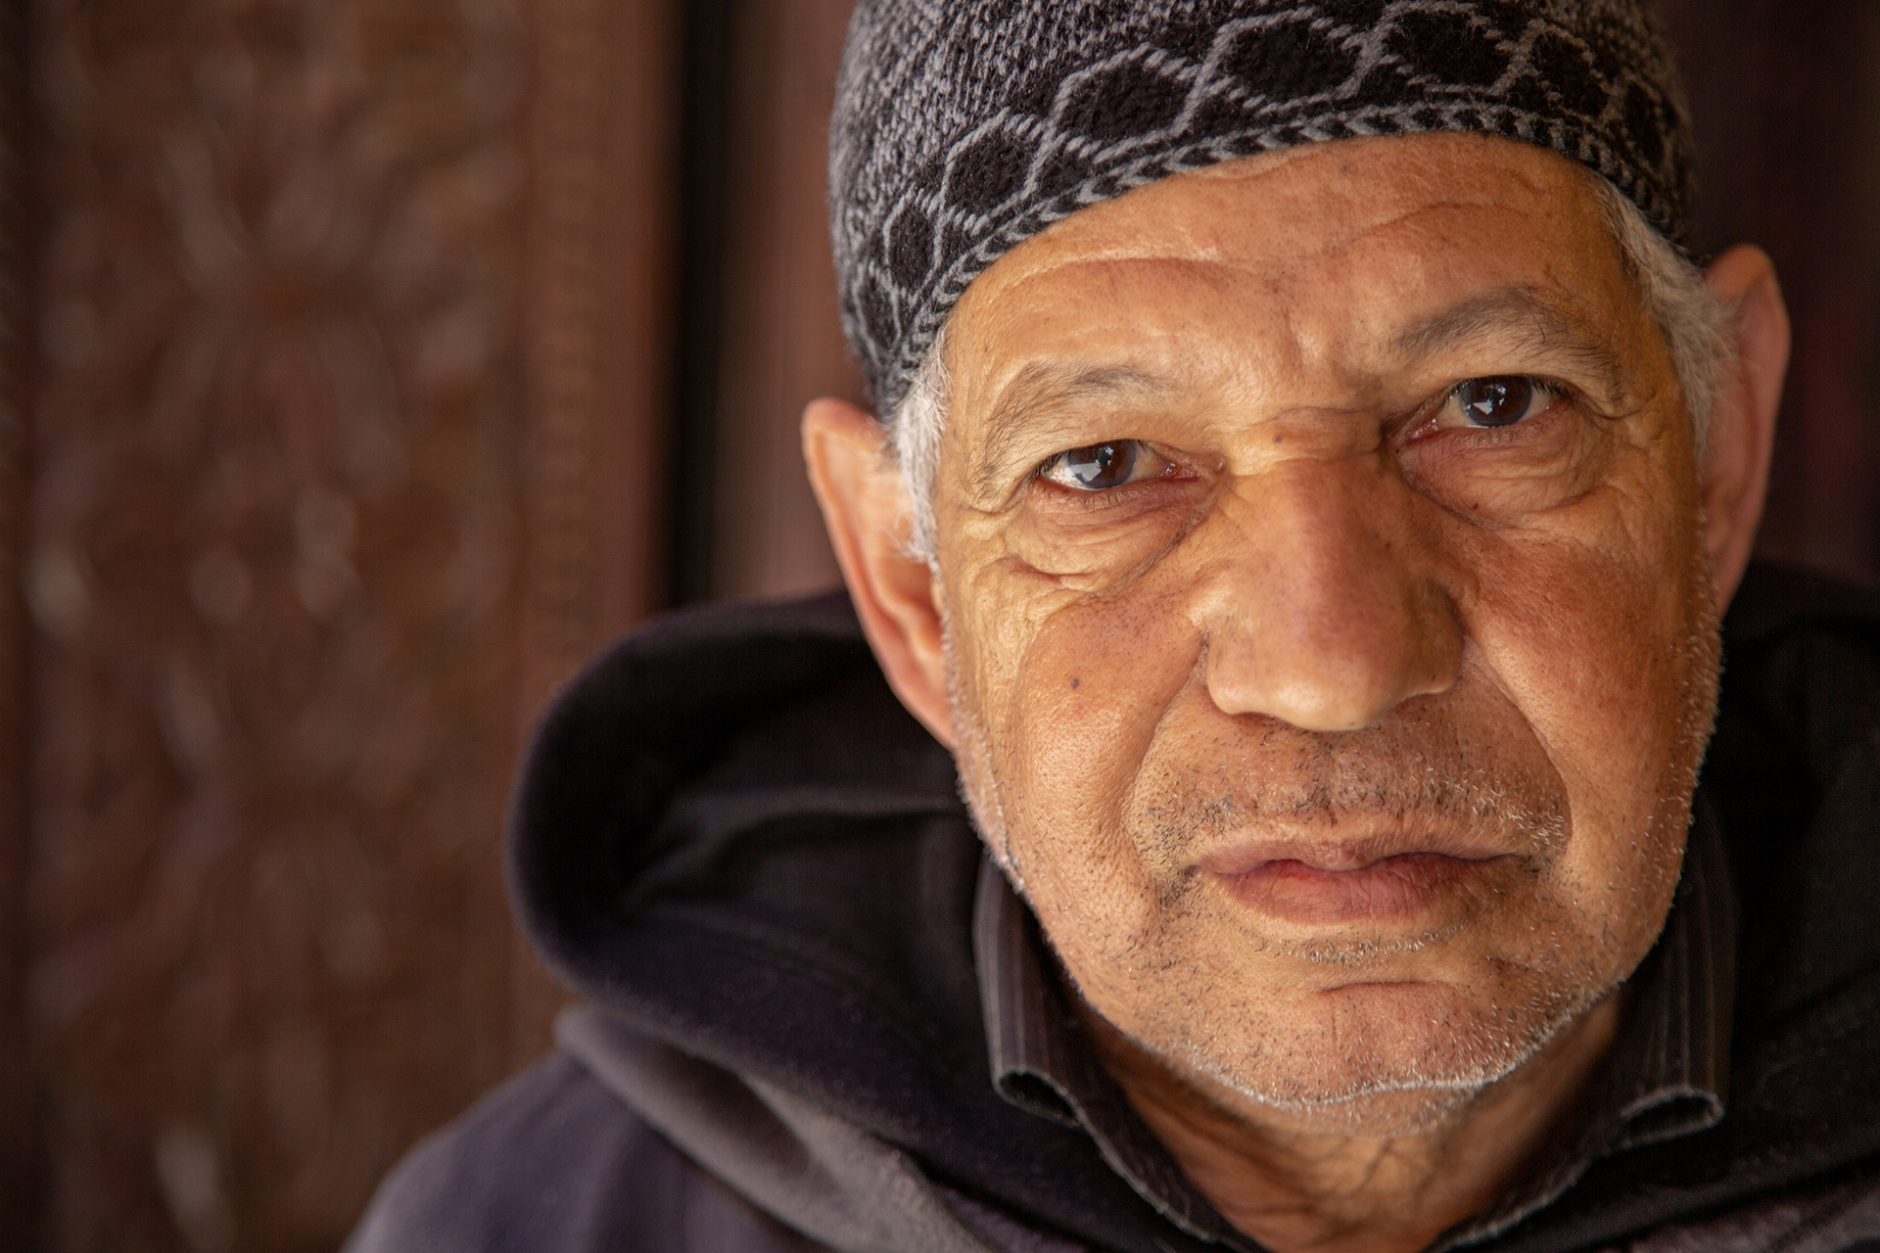
Thousands of people entered eternity after a 6.8 earthquake struck Morocco on September 8.
We won’t be silent.
Let’s cry out to God, together, for people of Morocco.
“Continue steadfastly in prayer, being watchful in it with thanksgiving.”
COLOSSIANS 4:2
Notes:
Less than 2% of the 37 million people in Morocco believe the gospel and have placed their faith in Jesus Christ. 3.5 million of them likely have little to no access to the gospel.

Slide 3
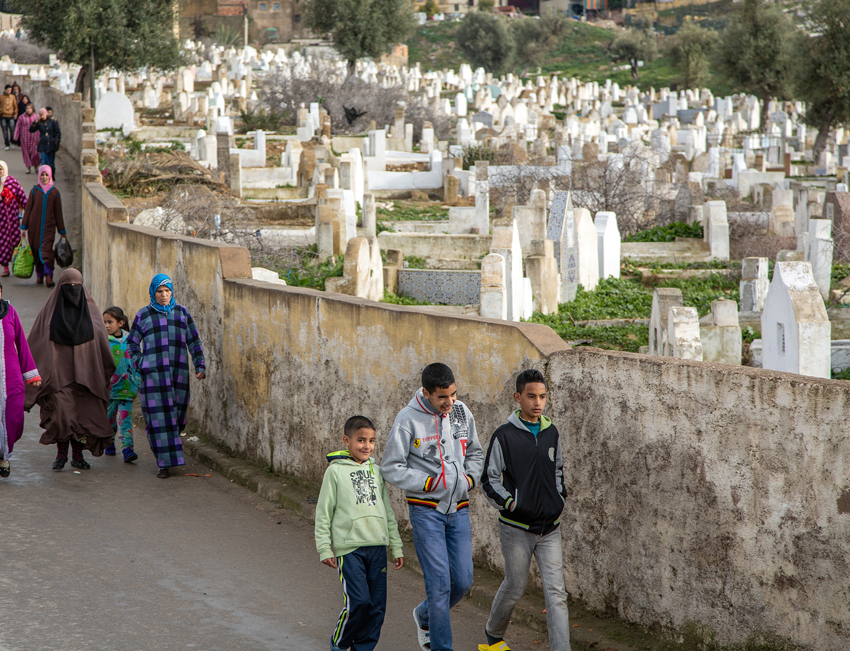
PRAY FOR LOSTNESS
Moroccans mourn their loved ones and worry about their spiritual state.
They believe Muslims must be buried within 24 hours of death or Allah may not accept them.
Many dead remained under the rubble for longer than 24 hours.
Pray for Moroccans to find their hope in Jesus Christ and His righteousness.

Slide 4
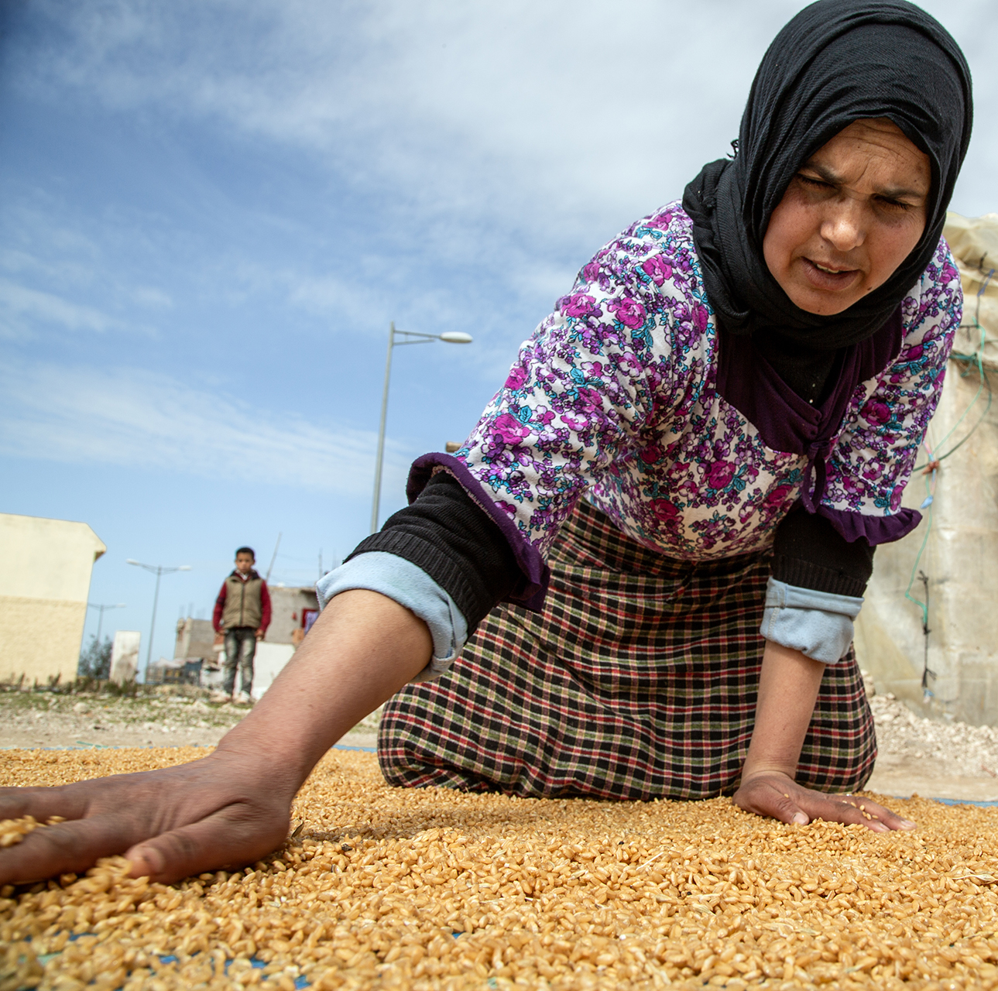
PRAY FOR GOSPEL ACCESS
Local believers reached devastated areas with help within hours of the earthquake.
Thank God for sending help.
Pray for wisdom and humility as local believers serve their fellow Moroccans.
Ask for opportunities to be the aroma of Christ.
Notes:
Roads are blocked and resources are being depleted, but God made a way for local believers to reach devastated areas with urgently needed help within hours of the earthquake hitting Morocco.
Pray for wisdom and humility as local believers work with many organizations to help hurting Moroccans.

Slide 5
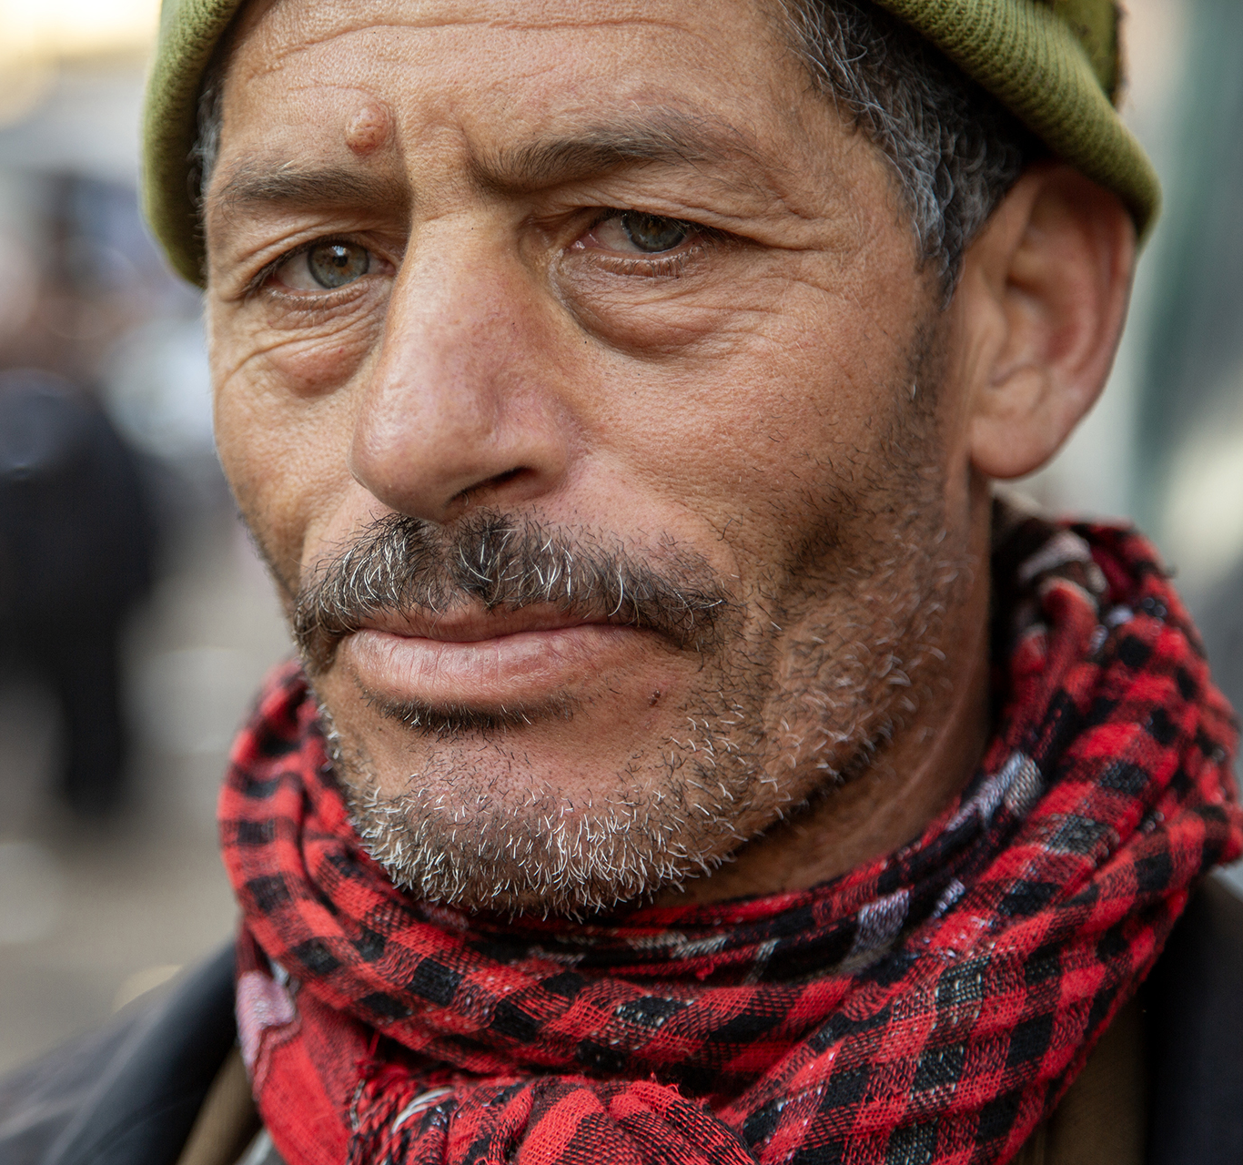
PRAY FOR THE CHURCH
Let’s thank God for the believers in Morocco.
Ask Him to give believers boldness to share about the hope they have in Christ.
May this disaster renew an urgency for sharing the good news of God’s love with the lost around them.

Slide 6
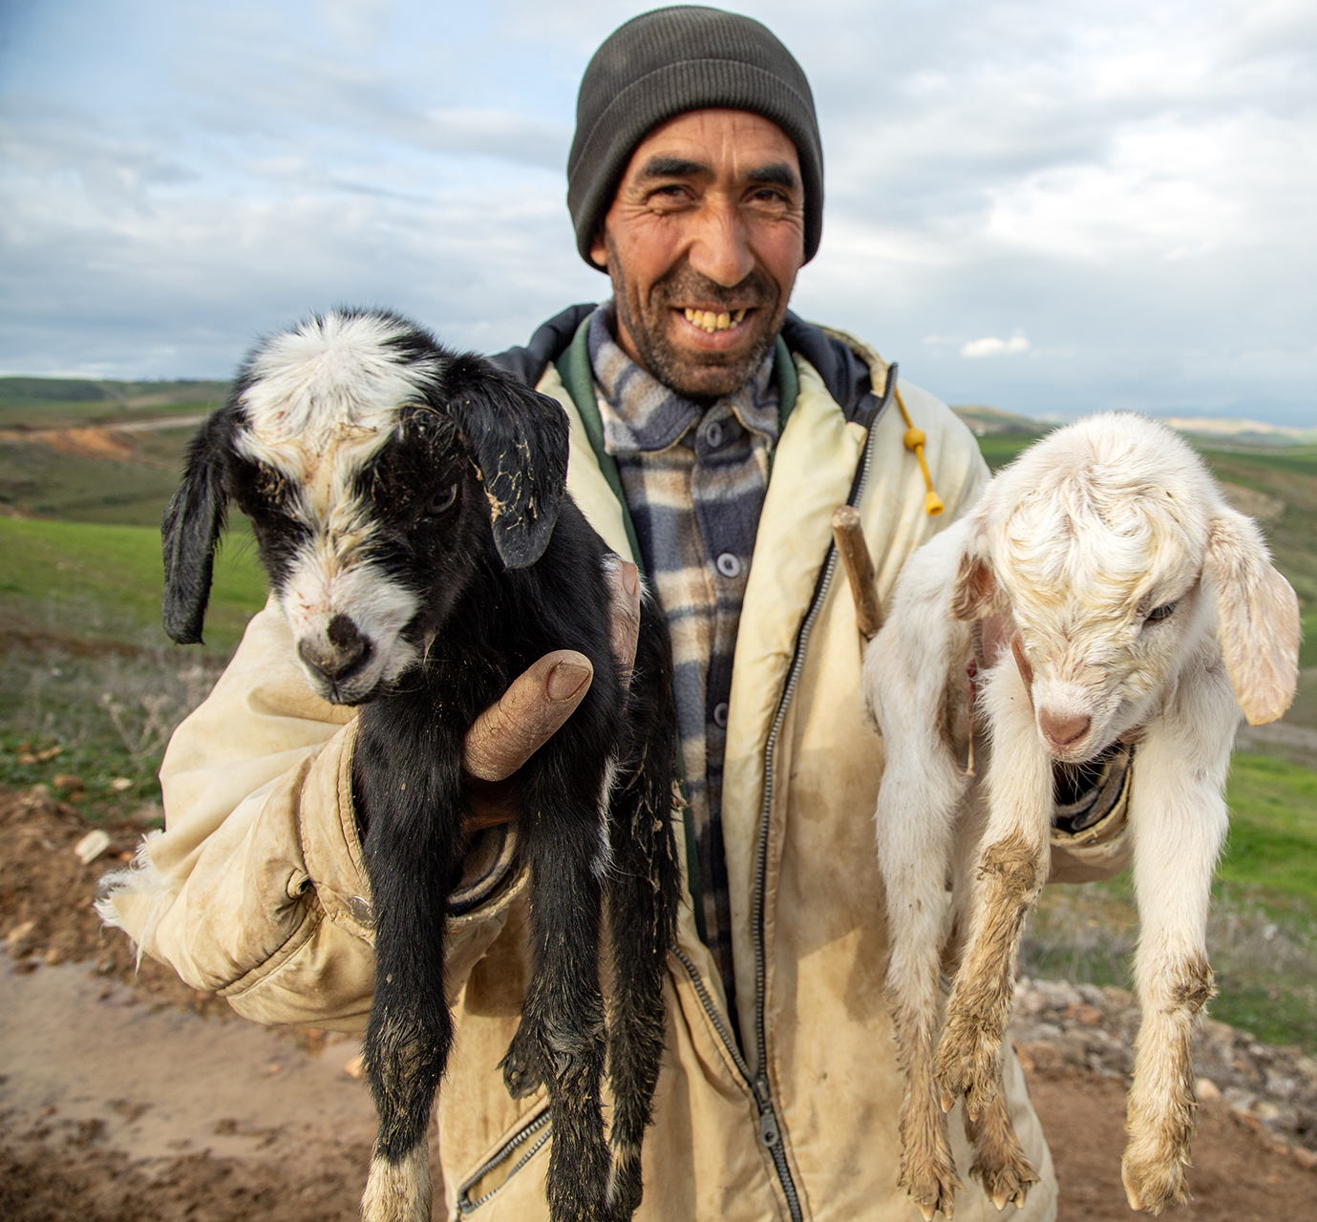
THANK YOU FOR JOINING US IN PRAYER.
Find more prayer requests
at imb.org/pray and on the IMB Pray app.

