Slide 1
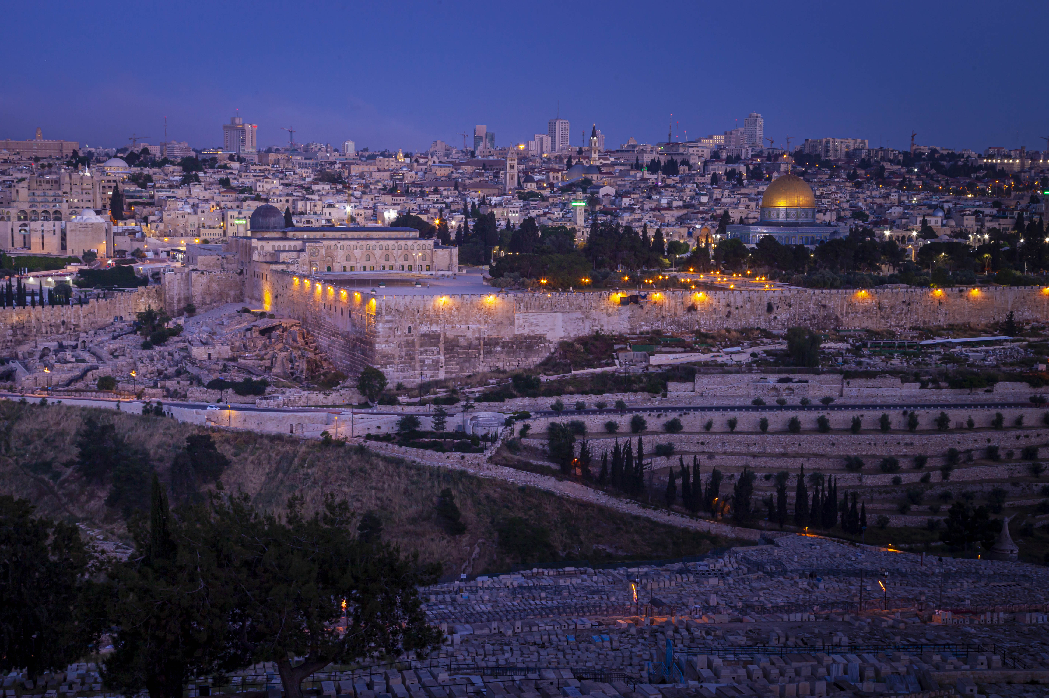
PRAY FOR PEACE
in the
HOLY LAND

Slide 2
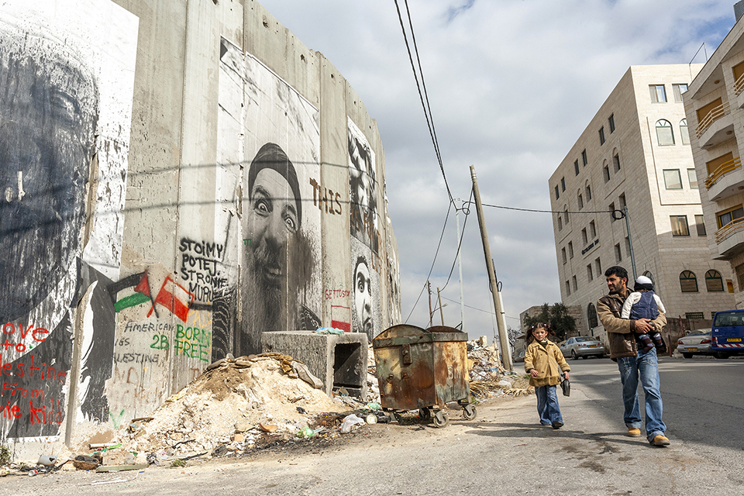
As we watch devastating events taking place in the Holy Land, we are not mere spectators. We don’t just see headlines. We see people. Right now they are injured, frightened, missing. They are lost. As this crisis unfolds, we will not ignore it. We will not be silent. We will not stand still. We will cry out to God on their behalf, asking Him to bring about true peace as only He can. Join us now as we pray, together.
“Come to me, all who labor and are heavy laden, and I will give you rest.” Matthew 11:28

Slide 3
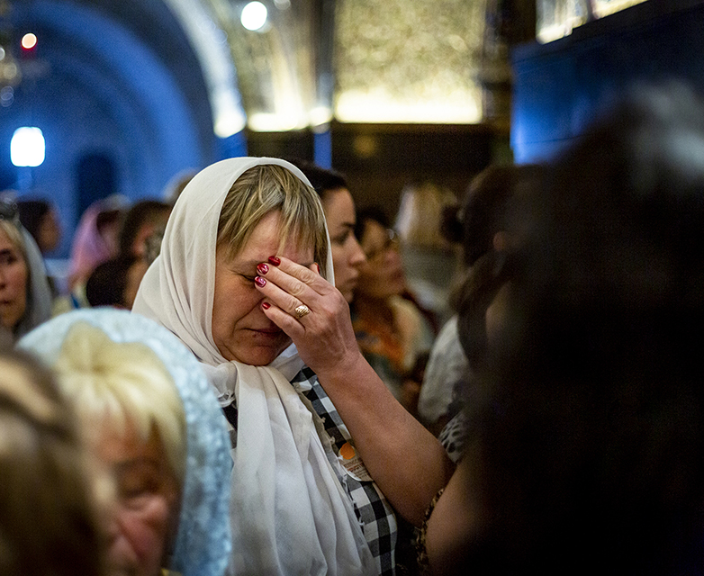
PRAY FOR PHYSICAL NEEDS
Men, women, and children are facing unspeakable horrors. While this region has a history of unrest, the escalation of violence demands an urgency in our intercession. Pray now that God would have mercy on the millions who are suffering and comfort those who have lost loved ones. Ask God to bless the efforts of those distributing aid. Pray He will provide opportunities for them to share His love.
“I lift up my eyes to the hills. From where does my help come? My help comes from the Lord, who made heaven and earth.” Psalm 121:1-2

Slide 4
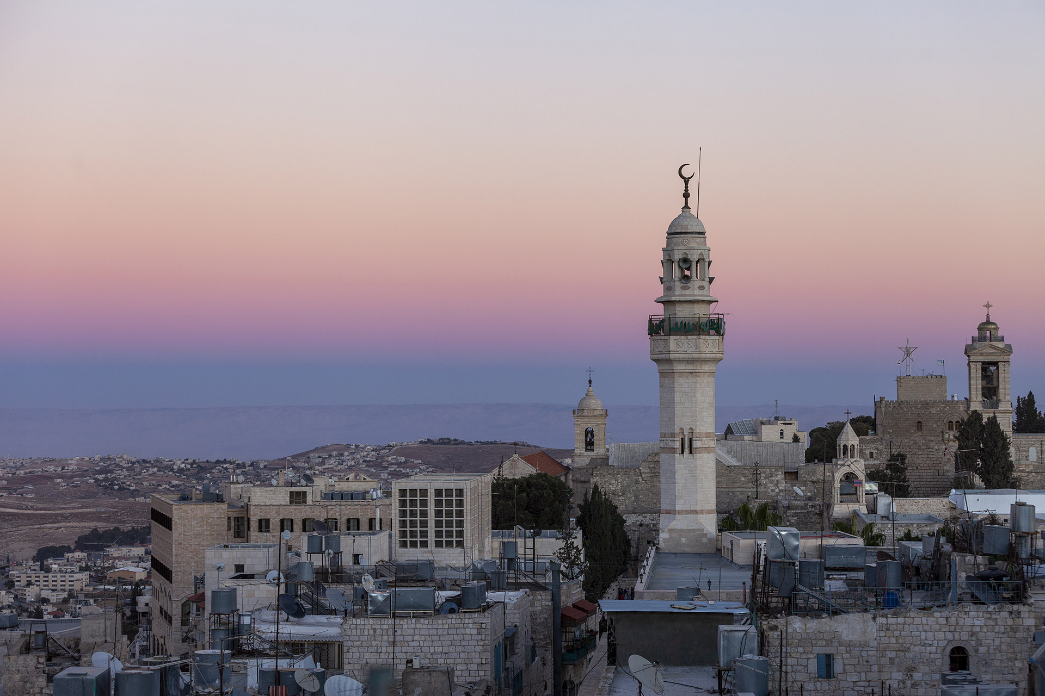
PRAY FOR LOSTNESS
Rockets are launched and the streets are filled with violence. Amid this chaos, the lost are living and dying in darkness. While the nations rage, God is still in control and near to all who call out to Him. Pray that God will use current events to draw the lost into a relationship with His Son.
“But seek first the kingdom of God and his righteousness, and all these things will be added to you.” Matthew 6:33

Slide 5
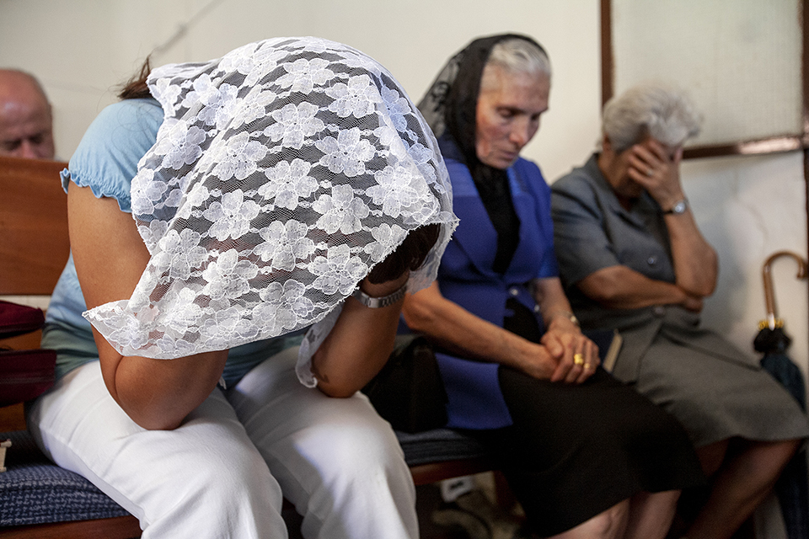
PRAY FOR GOSPEL ACCESS
Believers are walking through this crisis with non-believing neighbors, friends, and family members.
Pray that believers will have attitudes of peace amid the current situation. Pray that the lost will ask them about the peace they have in times of trouble.
“But in your hearts honor Christ the Lord as holy, always being prepared to make a defense to anyone who asks you for a reason for the hope that is in you; yet do it with gentleness and respect.” 1 Peter 3:15

Slide 6
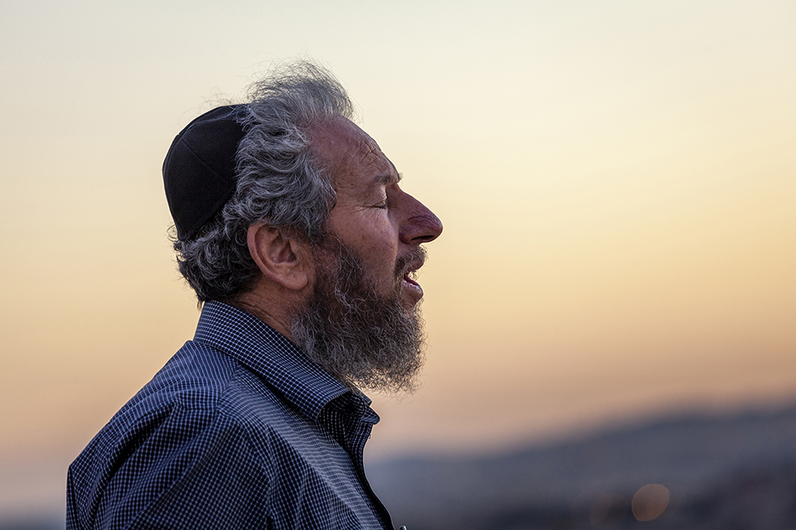
PRAY FOR THE CHURCH
In a land impacted by years of hatred, believers from diverse backgrounds who are united in Christ can display God’s love to each other and to their neighbors.
Pray that they will seek to share and be the light of Jesus to their neighbors.
“But you will receive power when the Holy Spirit has come upon you, and you will be my witnesses in Jerusalem and in all Judea and Samaria, and to the end of the earth.” Acts 1:8

Slide 7
PRAY FOR PEACE
in the
HOLY LAND

