Slide 1


Slide 2

Missions College
Creative ways for
Developing and Maintaining a Strong Prayer Emphasis for Missions in your Church
Brian and Carol – IMB Central Asia

Slide 3
Intro: Story #1

Slide 4
Table Discussion:
What grade would you give your church on praying for missions?
A, B, C, D, F? And why?
What does prayer in your church look like now?

Slide 5
What is Intercessory Prayer?
Praying to God on behalf of others

Slide 6
Table Discussion: Why?
Daniel 10:12-13 Matthew 9:37-38
Luke 10:2 John 14:16-17
John 15:1-11 John 15:16
John 16:24 Ephesians 6:10-20
2 Thessalonians 3:1-4 James 4:2-3
What did you learn about the importance of intercessory prayer?

Slide 7
Table Discussion: How?
Matthew 6:5-15 Matthew 21:22
Luke 18-1-8 Acts 2:42-47
Acts 4:23-31 Acts 10:9-48
Romans 12:12 Ephesians 6:18-19
Philippians 4:6 Colossians 4:2-4
1 Thessalonians 5:16-18 James 1:5-8
James 5:16-18 1 John 5:14-15
What did God show you?

Slide 8

Pray without ceasing
1 Thessalonians 5:16-18
“Be joyful always; pray continually; give thanks in all circumstances, for this is God’s will for you in Christ Jesus.” NIV
Pray with persistence

Slide 9
Story # 2

Slide 10
A Framework for Prayer
Lostness – The world’s greatest problem
Gospel Advance – The only solution to the world’s greatest problem
The Global Church – The body of Christ, around the world, including Southern Baptists and global missionary partners.
Missionary Presence – This is the way the good news gets to the nations.

Slide 11
Table Prayer: The Lost
Pray for:
Those who have never heard the good news of Jesus to hear and repent of their sin, placing their faith in Jesus Christ as Lord.
God to powerfully transform lives in every nation, tribe, people, and language.

Slide 12
Table Prayer: Gospel Advance
Ask for God to send out laborers into the harvest field
Pray for: Open hearts (Acts 16:14)
Open doors (Colossians 4:3-4)
Open mouths (Ephesians 6:18-20)
Gospel access that leads to gospel belief and gospel multiplication among the lost
Missionaries and missionary teams so that the gospel will spread rapidly

Slide 13
Table Prayer: The Global Church
Pray for:
The Church to be unified and focused on fulfilling the Great Commission.
The globalization of missions. This refers to people being sent out from many different countries, all with the same task of addressing the world’s greatest problem of lostness.
God to unify His Church around the world and keep us focused on fulfilling the Great Commission.

Slide 14
Table Prayer: Missionary Presence
Pray for:
Missionary access. Pray for God to send out laborers into the harvest field to plant churches and support and grow local work where churches are already present.
God to sustain missionaries on the field, care for their families, and give them the endurance to stay and minister cross-culturally.

Slide 15
Story #3

Slide 16

Ways to develop and maintain a strong prayer emphasis for missions in your church
Broad
Deep

Slide 17
Broad strategies

Slide 18

Loving the Lost through Prayer
52 people groups

Slide 19
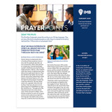
Prayer Points
- Monthly

Slide 20
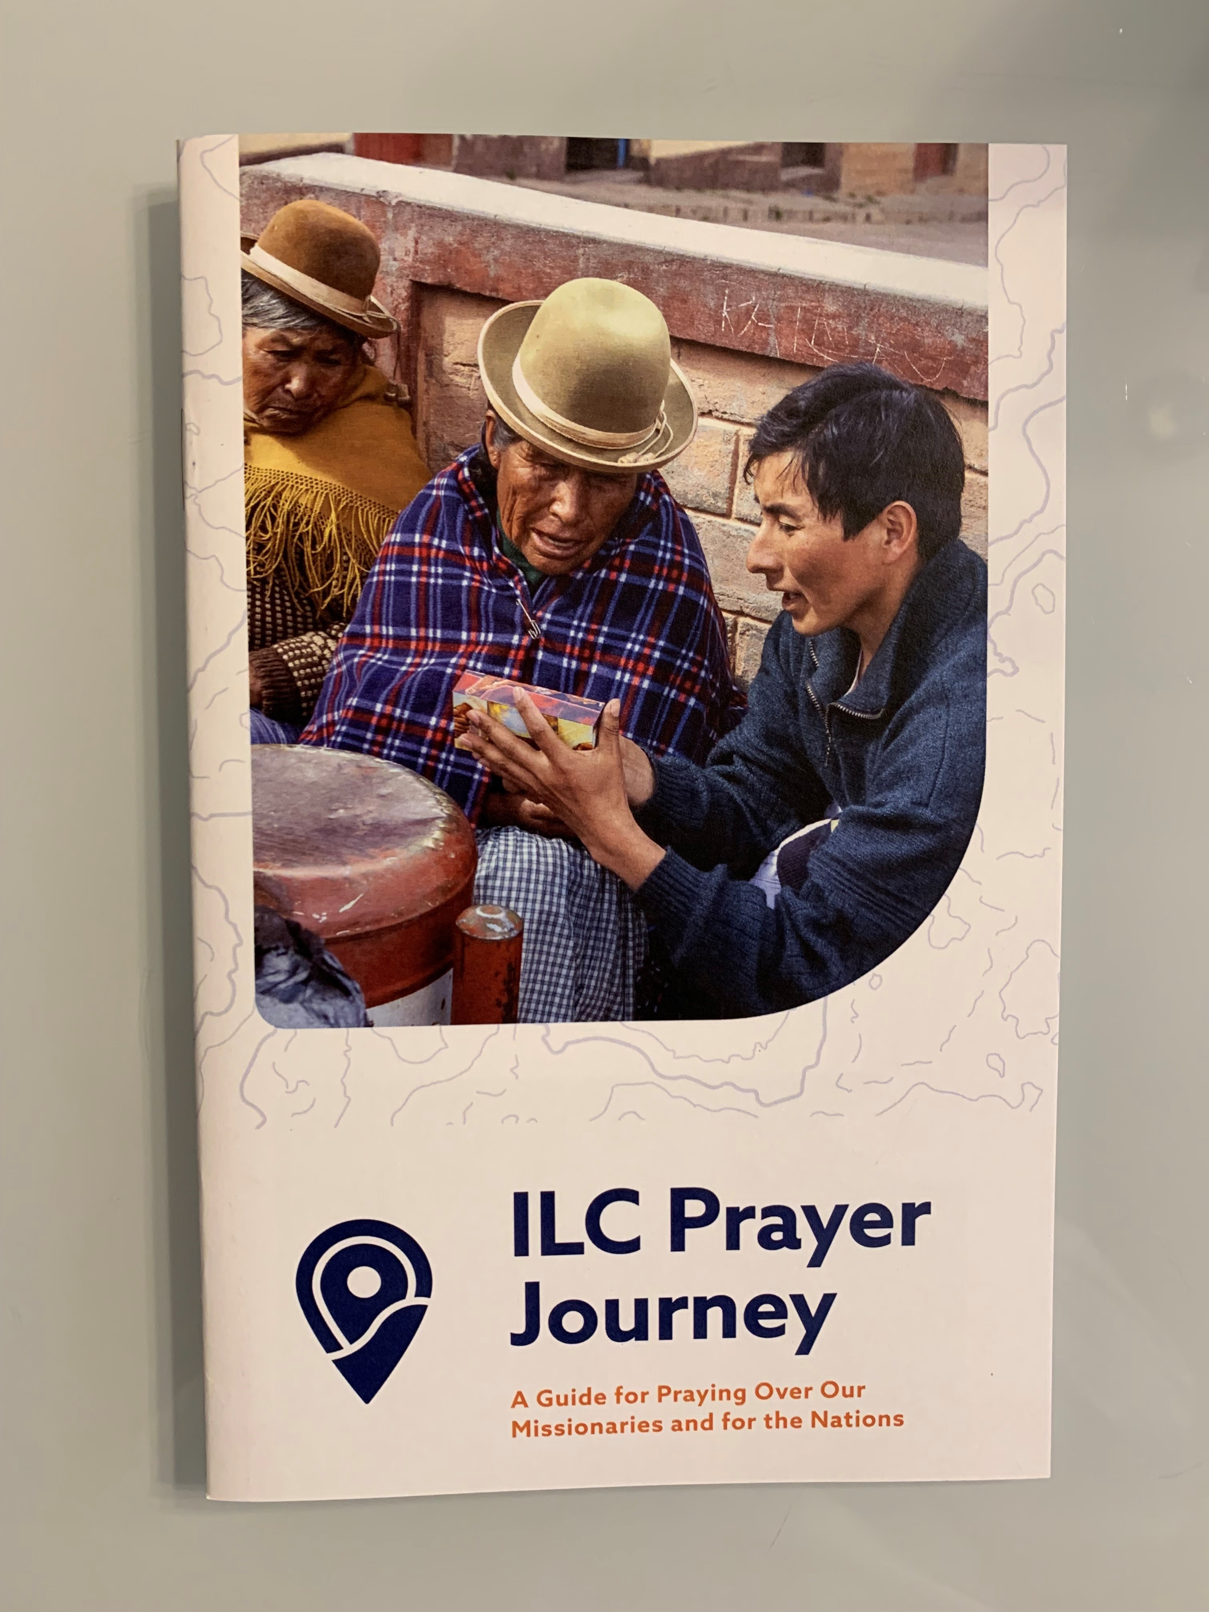
Prayer walk – ILC Prayer Journey

Slide 21
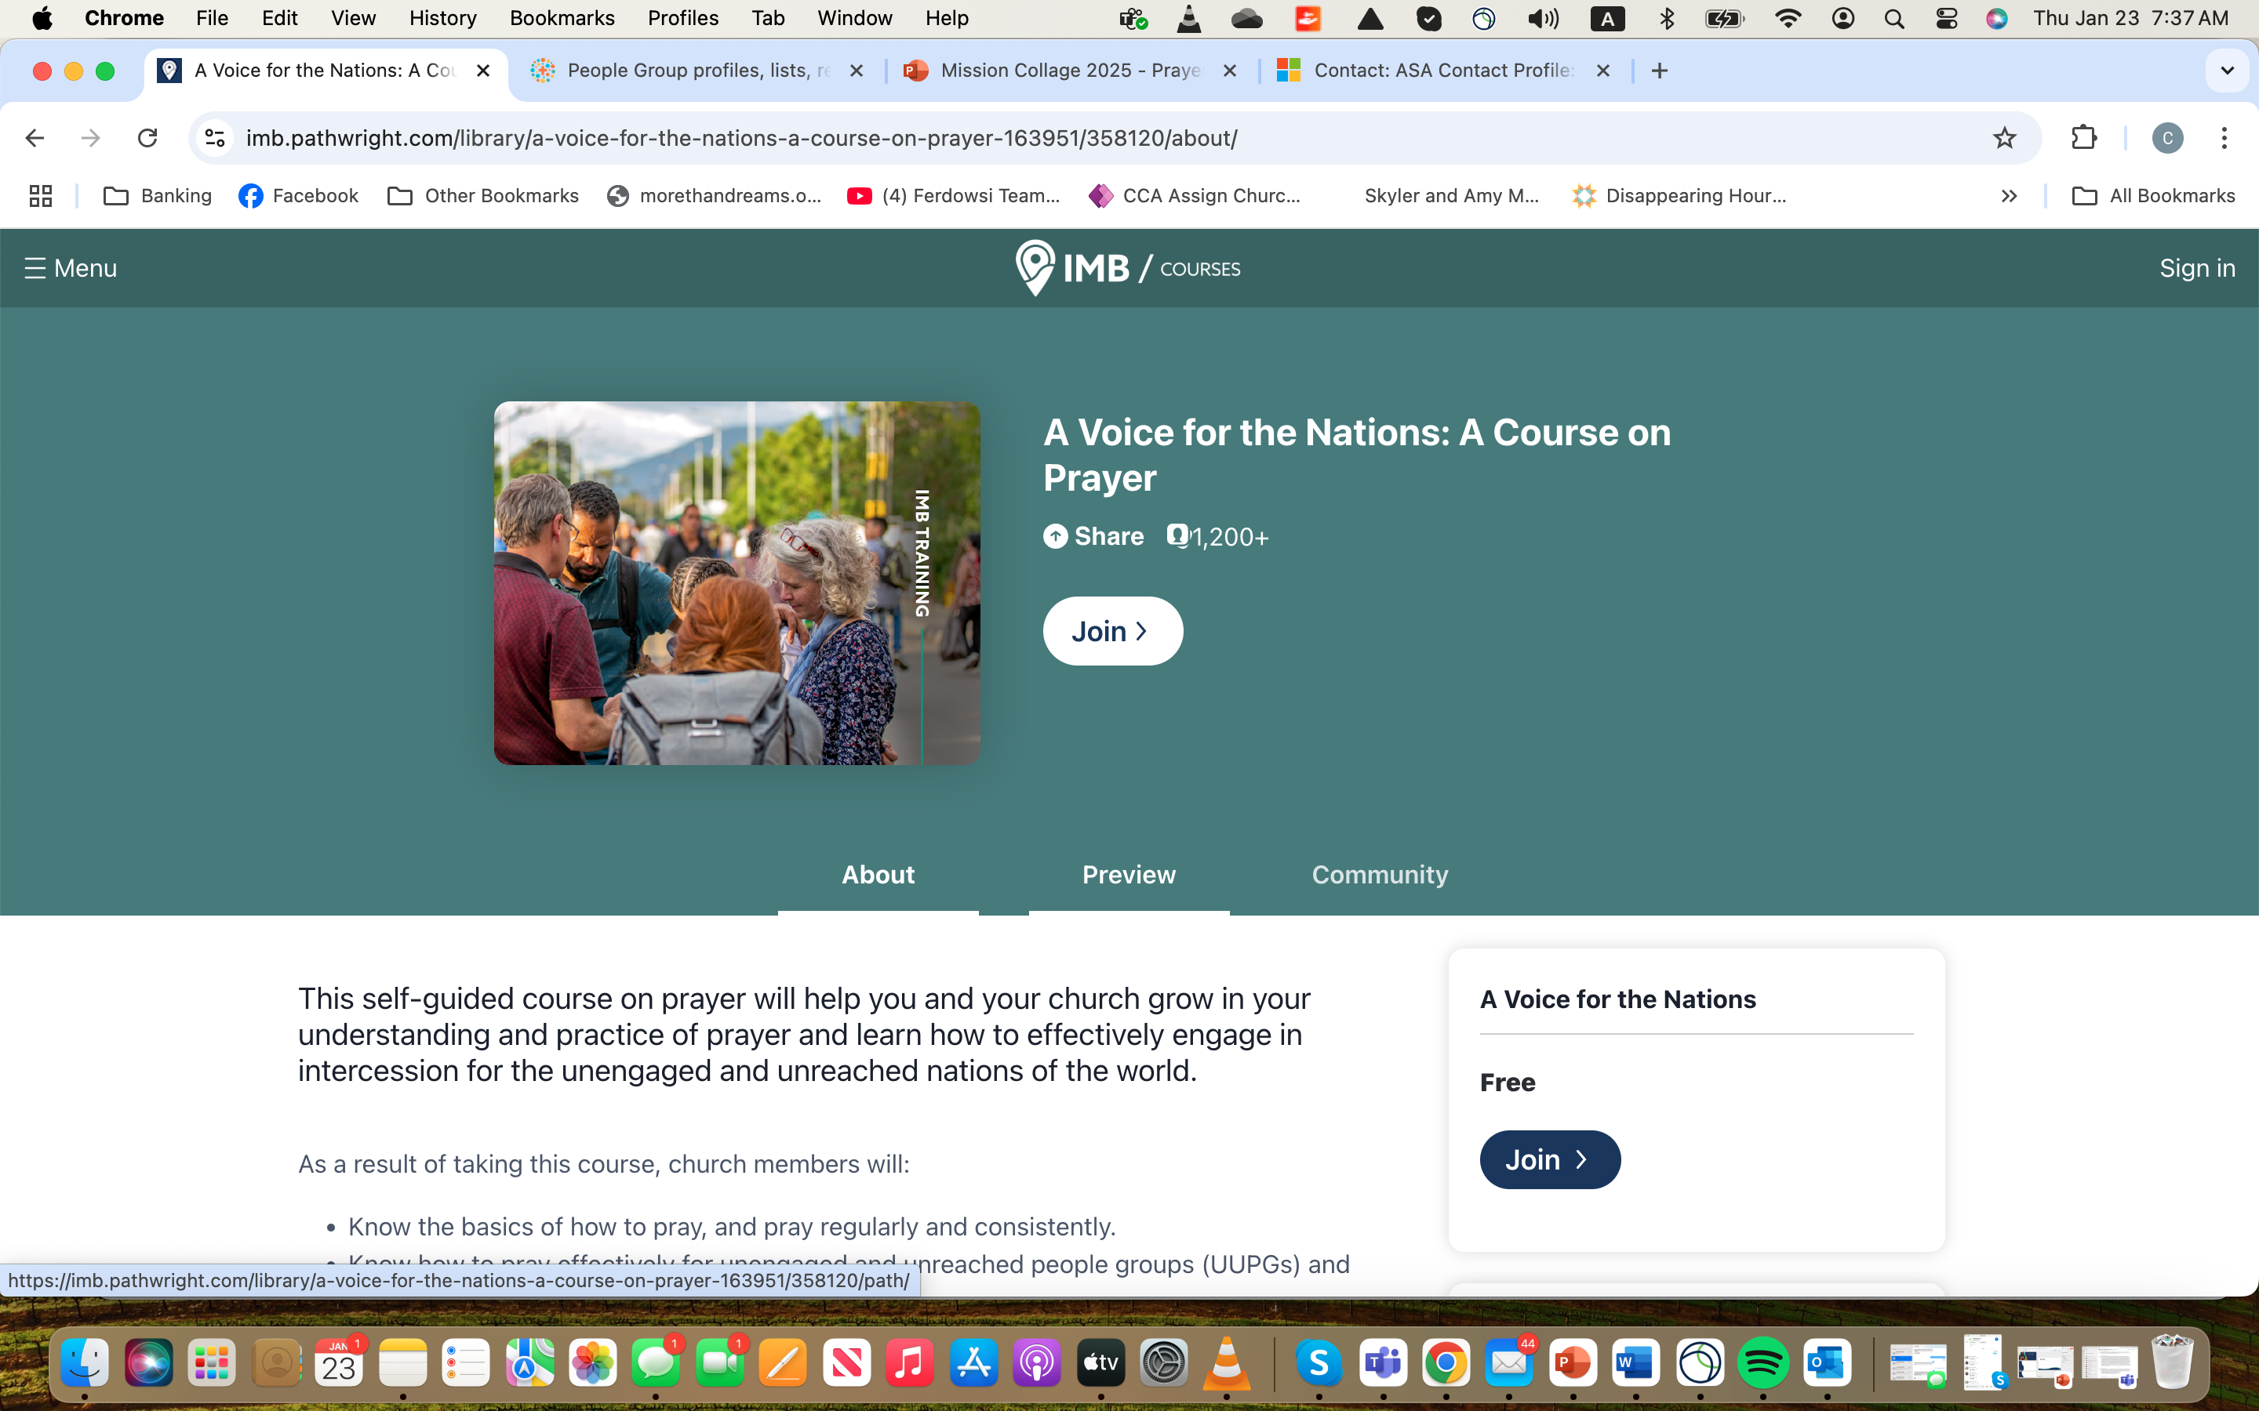
A Voice for the Nations -
Pathwright course on Prayer

Slide 22
https://joshuaproject.net/people_groups
Christmas Gift Tree- UUPG Tree

Slide 23
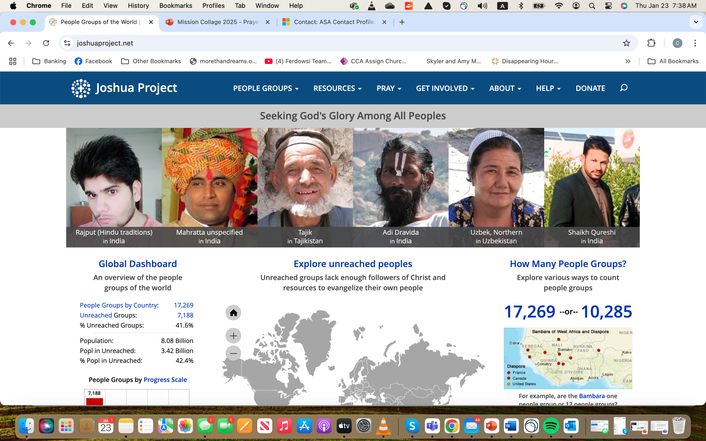
https://joshuaproject.net/people_groups

Slide 24
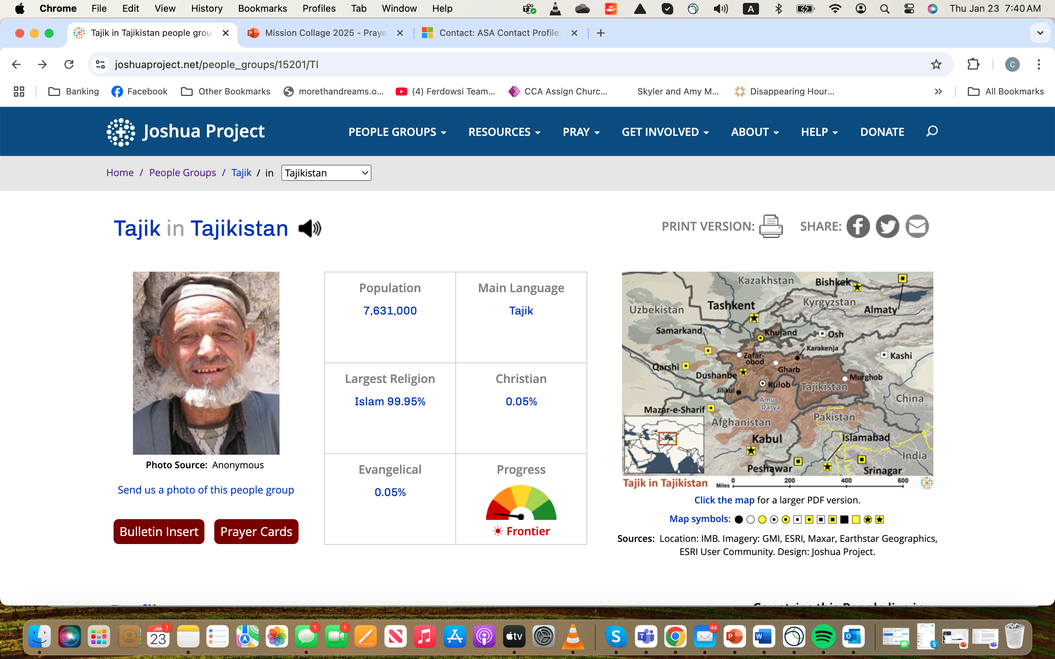

Slide 25
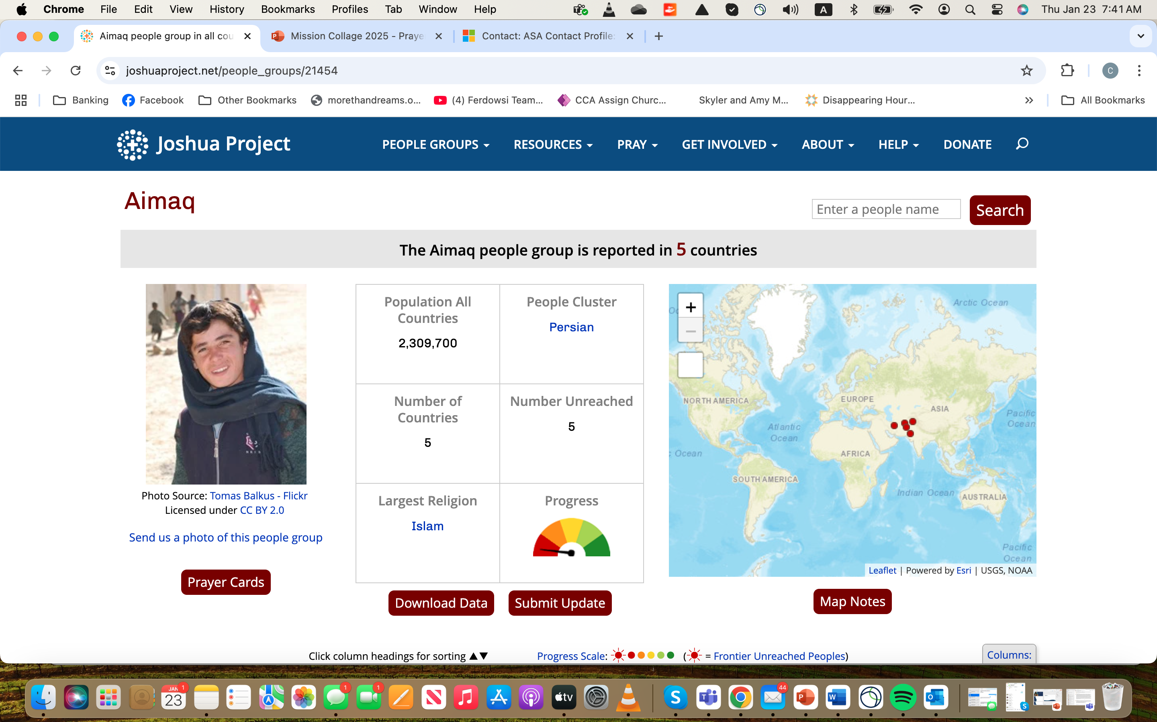

Slide 26
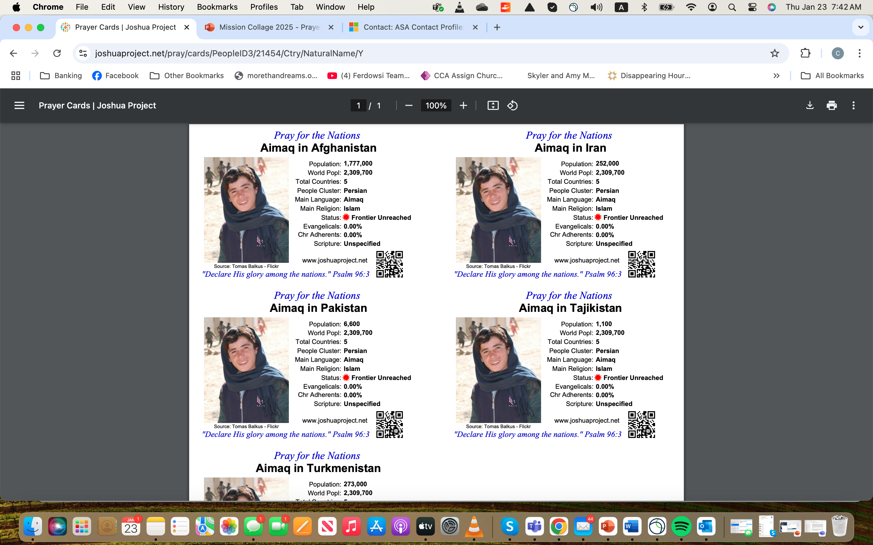

Slide 27
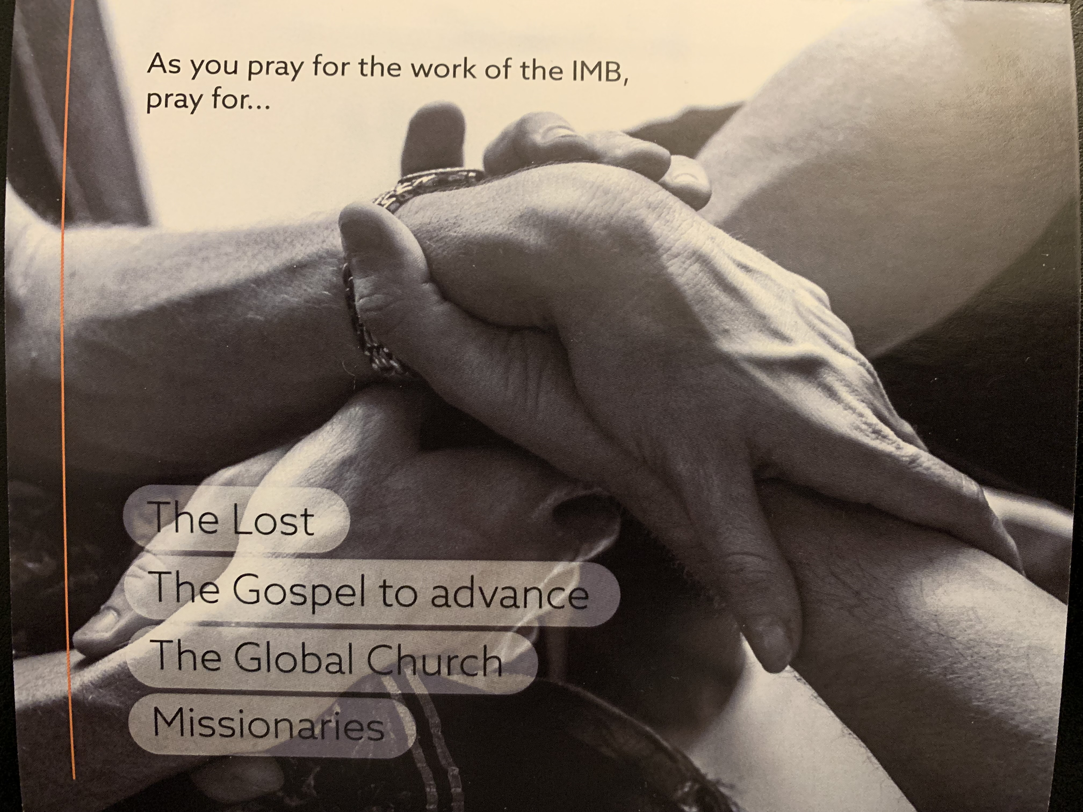
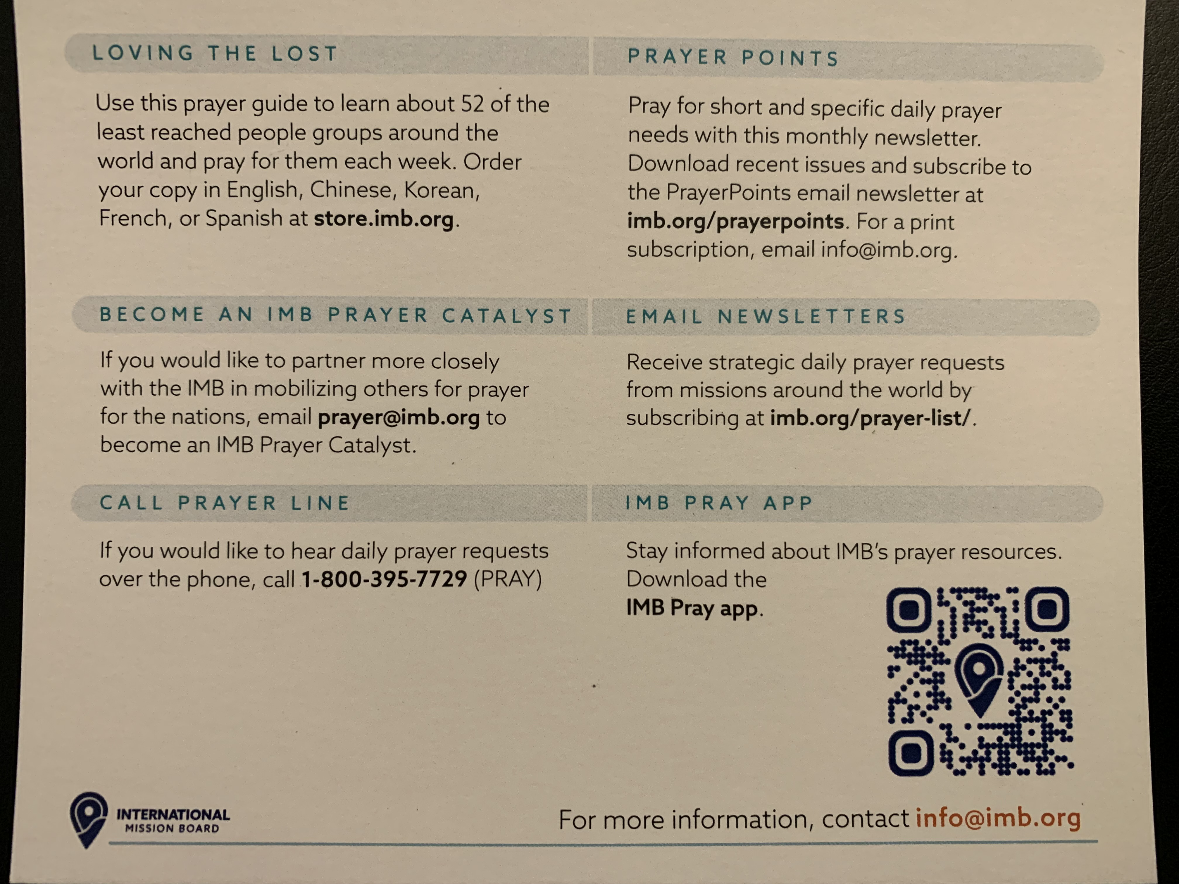
prayer@imb.org
Prayer Catalyst

Slide 28
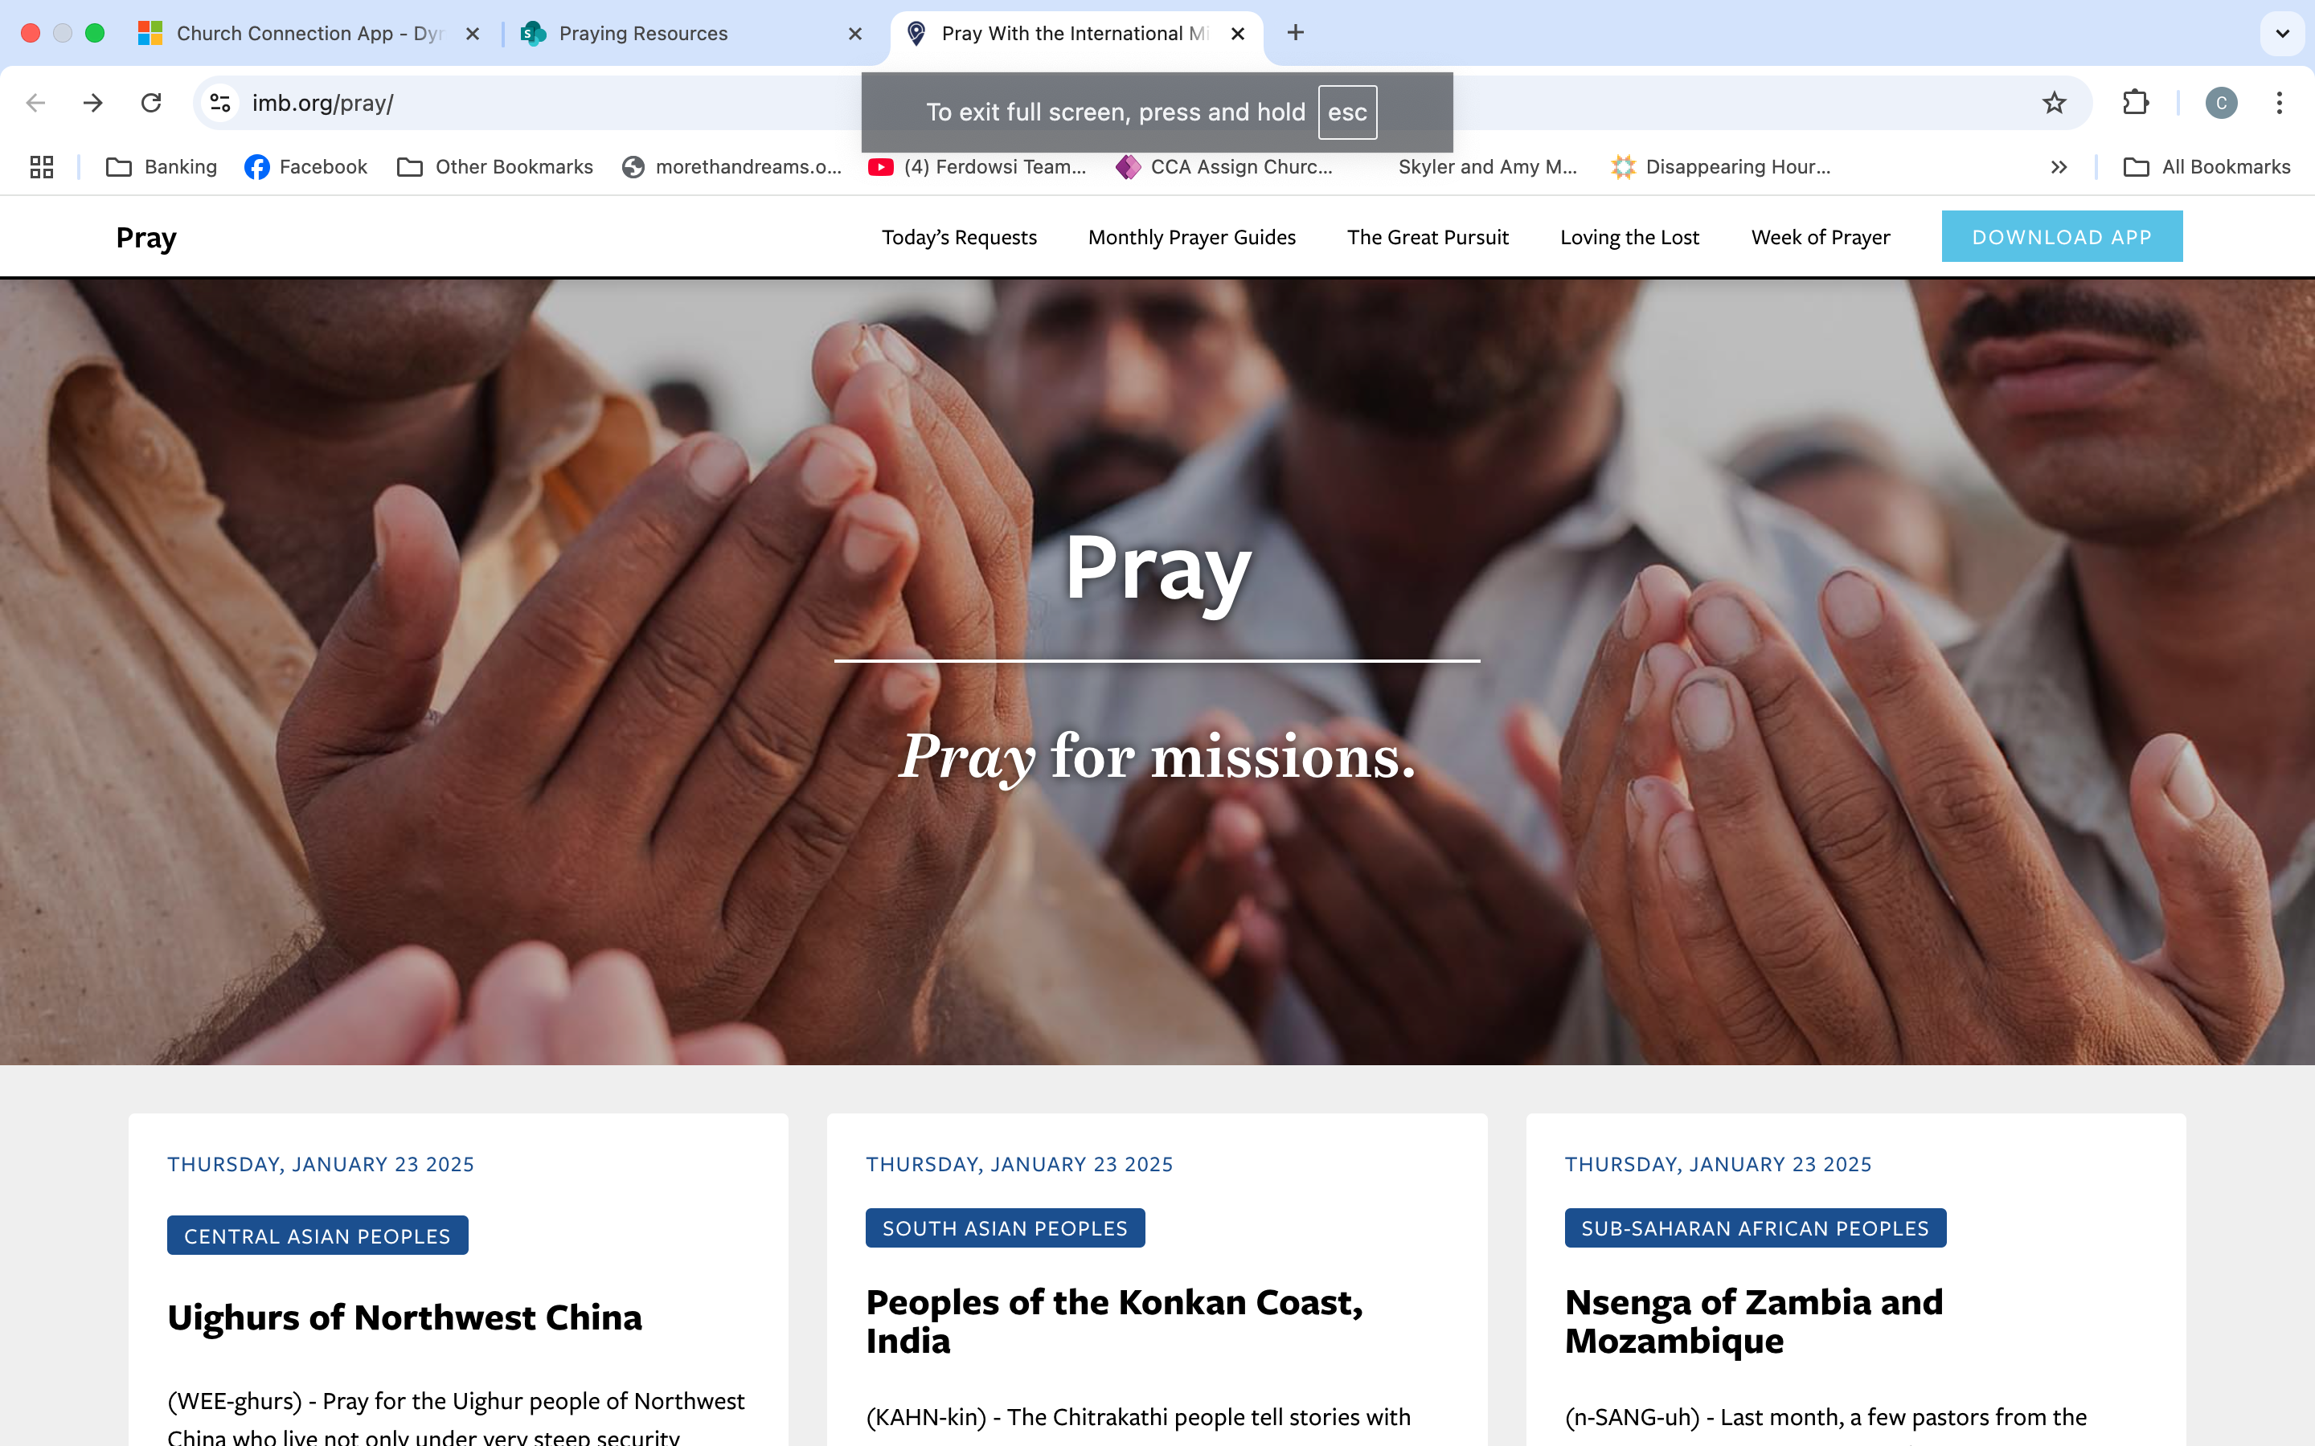
prayer@imb.org

Slide 29
Story #4

Slide 30

Deep Strategies

Slide 31
Do you know who your IMB missionary is?

Slide 32
Missions Champion
Usually a Layperson
connects with Missionary monthly for specific requests – personal and to be shared

Slide 33
Monthly Prayer Focus for Missions at the church
Featured "Missionary of the Month"
Weekly prayer requests for Missions
SS Class or Small Group adopts a missionary

Slide 34
Region specific creative prayer event
Ladies Tea for Central Asia
Ladies Tea for South Asia
Ladies Tea for NAME
Etc…
Use setting and props that are regional to set the mood for prayer

Slide 35
Men’s prayer Breakfast for Central Asia
Men’s prayer Breakfast for South Asia
Etc…
Prayer Event featuring a specific food of your Missionary
Kabob prayer night
Egg roll night w/spicy soup

Slide 36
Skype Calls
Zoom Calls
Teams Calls
Short (1 min) Video from the field with prayer requests

Slide 37
Resource List
Joshua Project Resources Unreached Peoples https://joshuaproject.net/
Pathwright Course on Prayer:
https://imb.pathwright.com/library/a-voice-for-the-nations-a-course-on-prayer-163951/358120/about/
ILC Prayer Journey – A Guide for Praying Over Our Missionaries and for the Nations
IMB Web Site: Pray for Missions
https://www.imb.org/pray/
IMB Prayer Department: Help with missions related prayer needs for your church Prayer@imb.org
MB Pray Phone Apps: Download at: https://www.imb.org/pray/
IMB.ORG Physical and digital Prayer Resources: https://store.imb.org/prayer-resources/
Loving the Lost Through Prayer (2025) – includes digital version option

Slide 38
Resource List cont.
https://www.mobiresources.org/
Prayer Points Newsletters - Monthly
Missionary Task Prayer Card – different languages
6 Marks of a Transformed Disciple Maker bookmark
IMB 18-Month Prayer Calendar

Slide 39
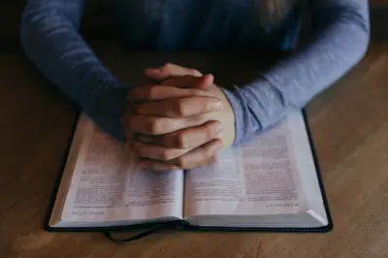
What are your next steps?

Slide 40
