Slide 1


Slide 2
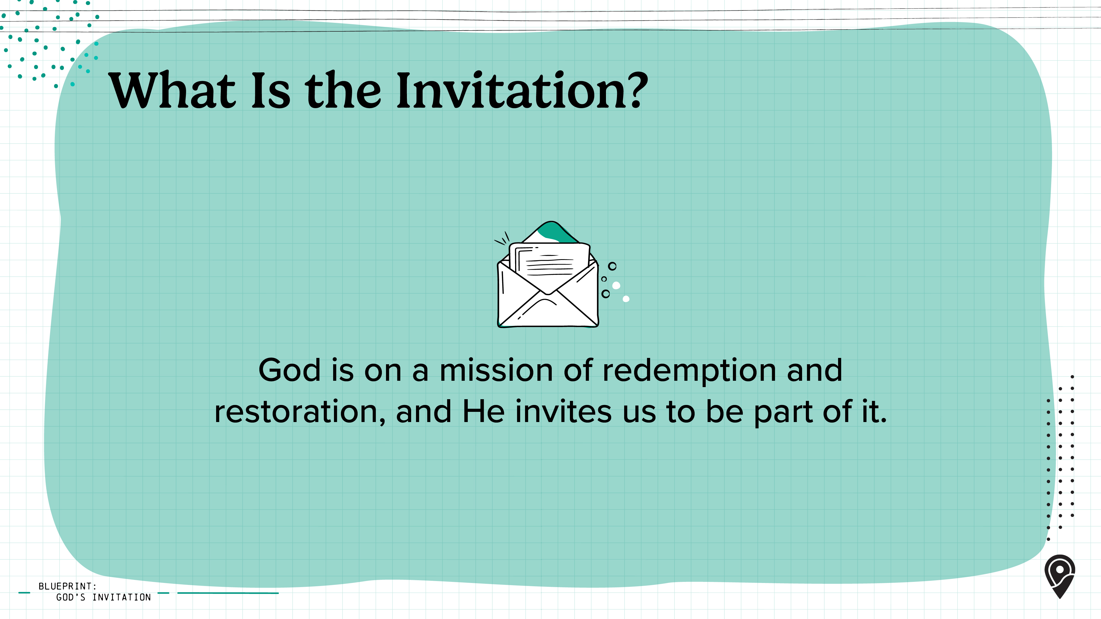
Notes:
As we've already seen, God has chosen to work through His people to accomplish His purposes. His mission is still going, and He still invites us to join in it.
Scripture is clear: lost people need to hear the gospel, turn from their sin and rebellion, and believe in Jesus to be saved (see Romans 10:14).
So we, as the Church, must respond to Christ's commission by sending Christ followers—through local churches—to share the gospel with the lost all over the world and make disciples for His glory.
We should desire to participate in God’s mission because:
-As God transforms us, He aligns our hearts with His own.
-We share in God’s desire for all people to hear and receive the gospel.
-We desire to bring glory to God.

Slide 3
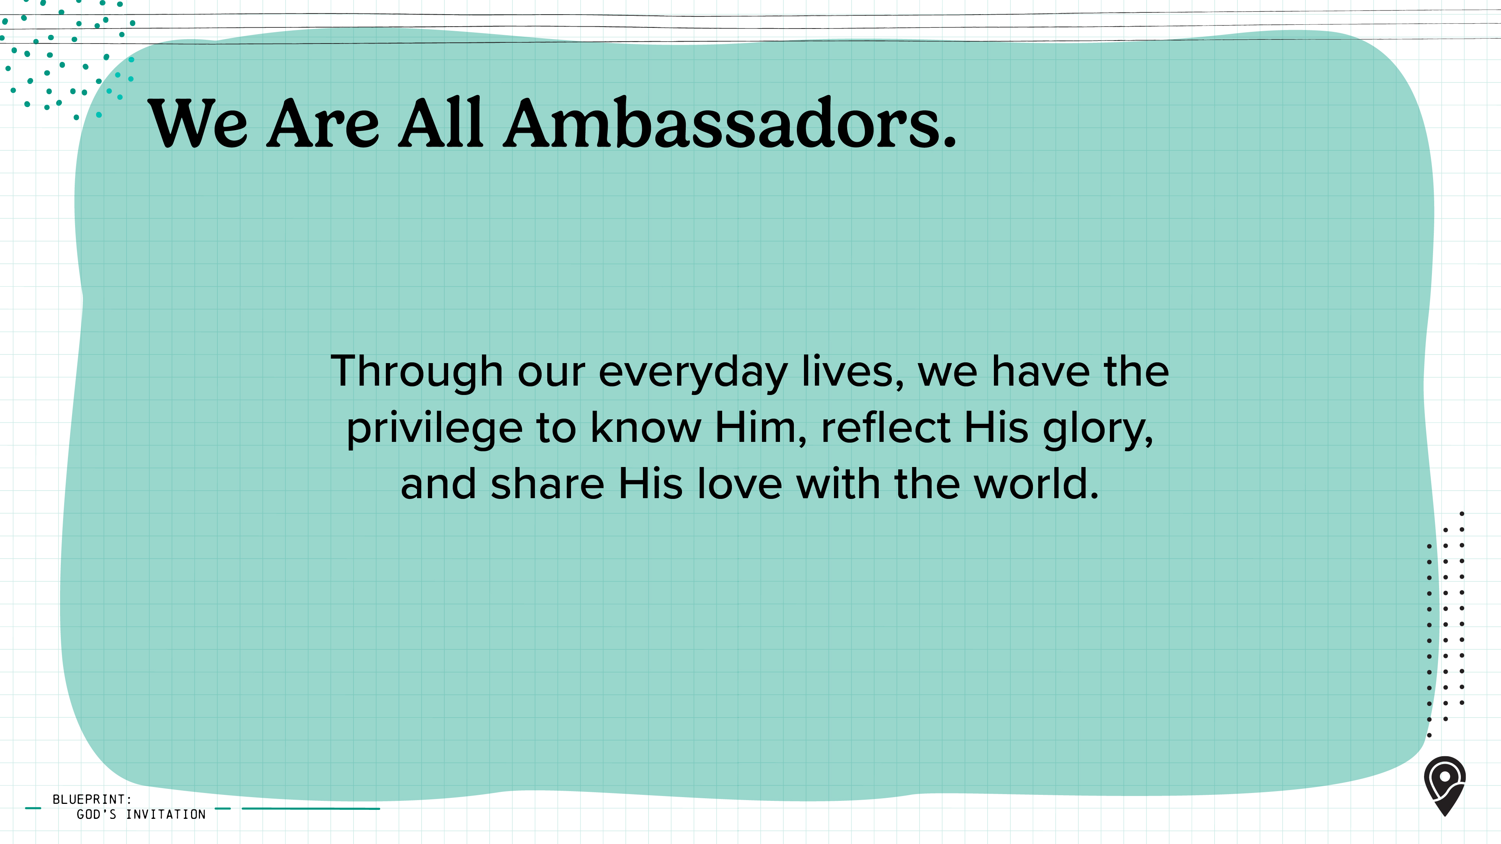
Notes:
In 2 Corinthians 5:18–20, Paul writes that God has entrusted us with the "ministry of reconciliation," calling us ambassadors for Christ.
An ambassador represents the heart and mission of their leader wherever they go, and that's exactly what we're called to do—to share Jesus in our classrooms, dorm rooms, friendships, joys, and even our frustrations.
Through our everyday lives, we have the privilege to know Him, reflect His glory, and share His love with the world.

Slide 4
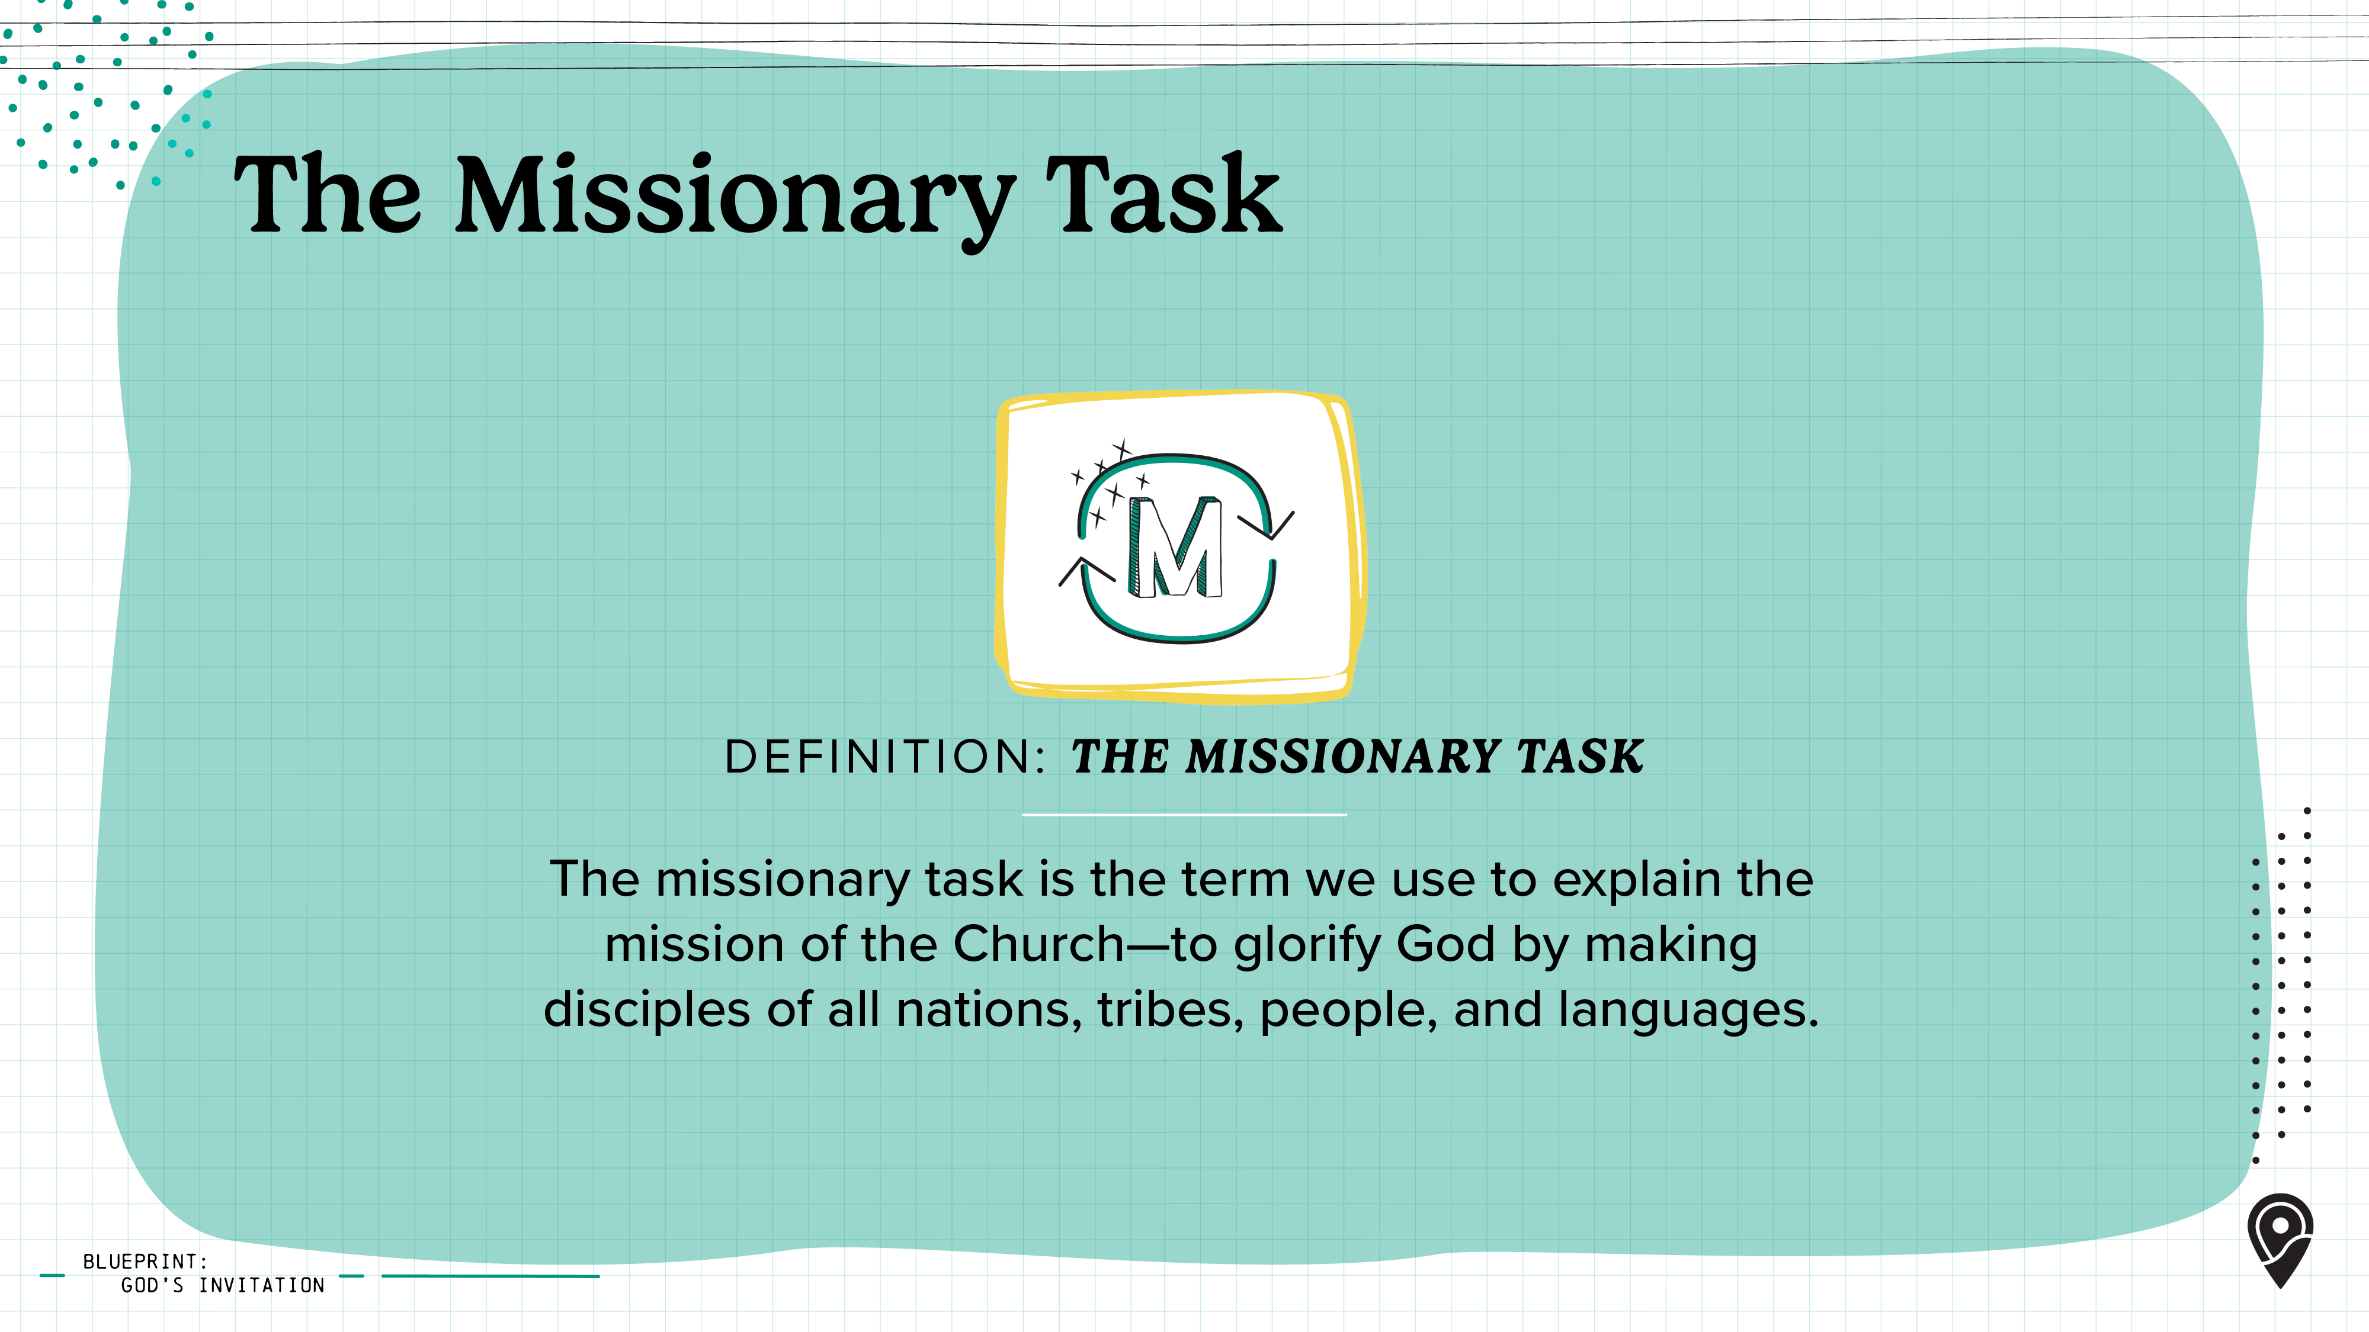
Notes:
The command to make disciples of all nations wasn't just given to the original apostles or to missionaries—it's for all of us. And we can join His mission through our local church in six simple ways.
[Leader: View the next slide to introduce the six components of the missionary task.]

Slide 5
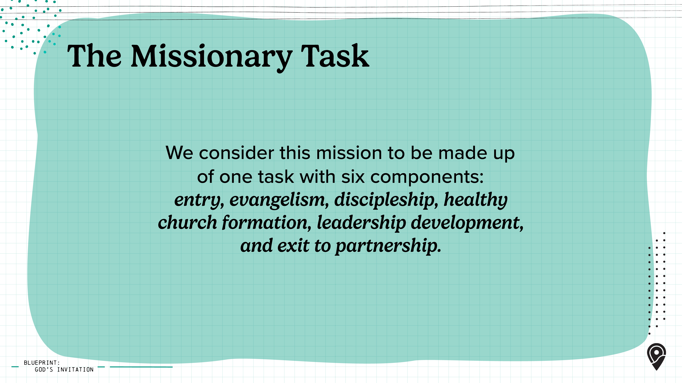
Notes:
While the components do not always happen neatly in this order, they are all necessary in the task of missions.

Slide 6
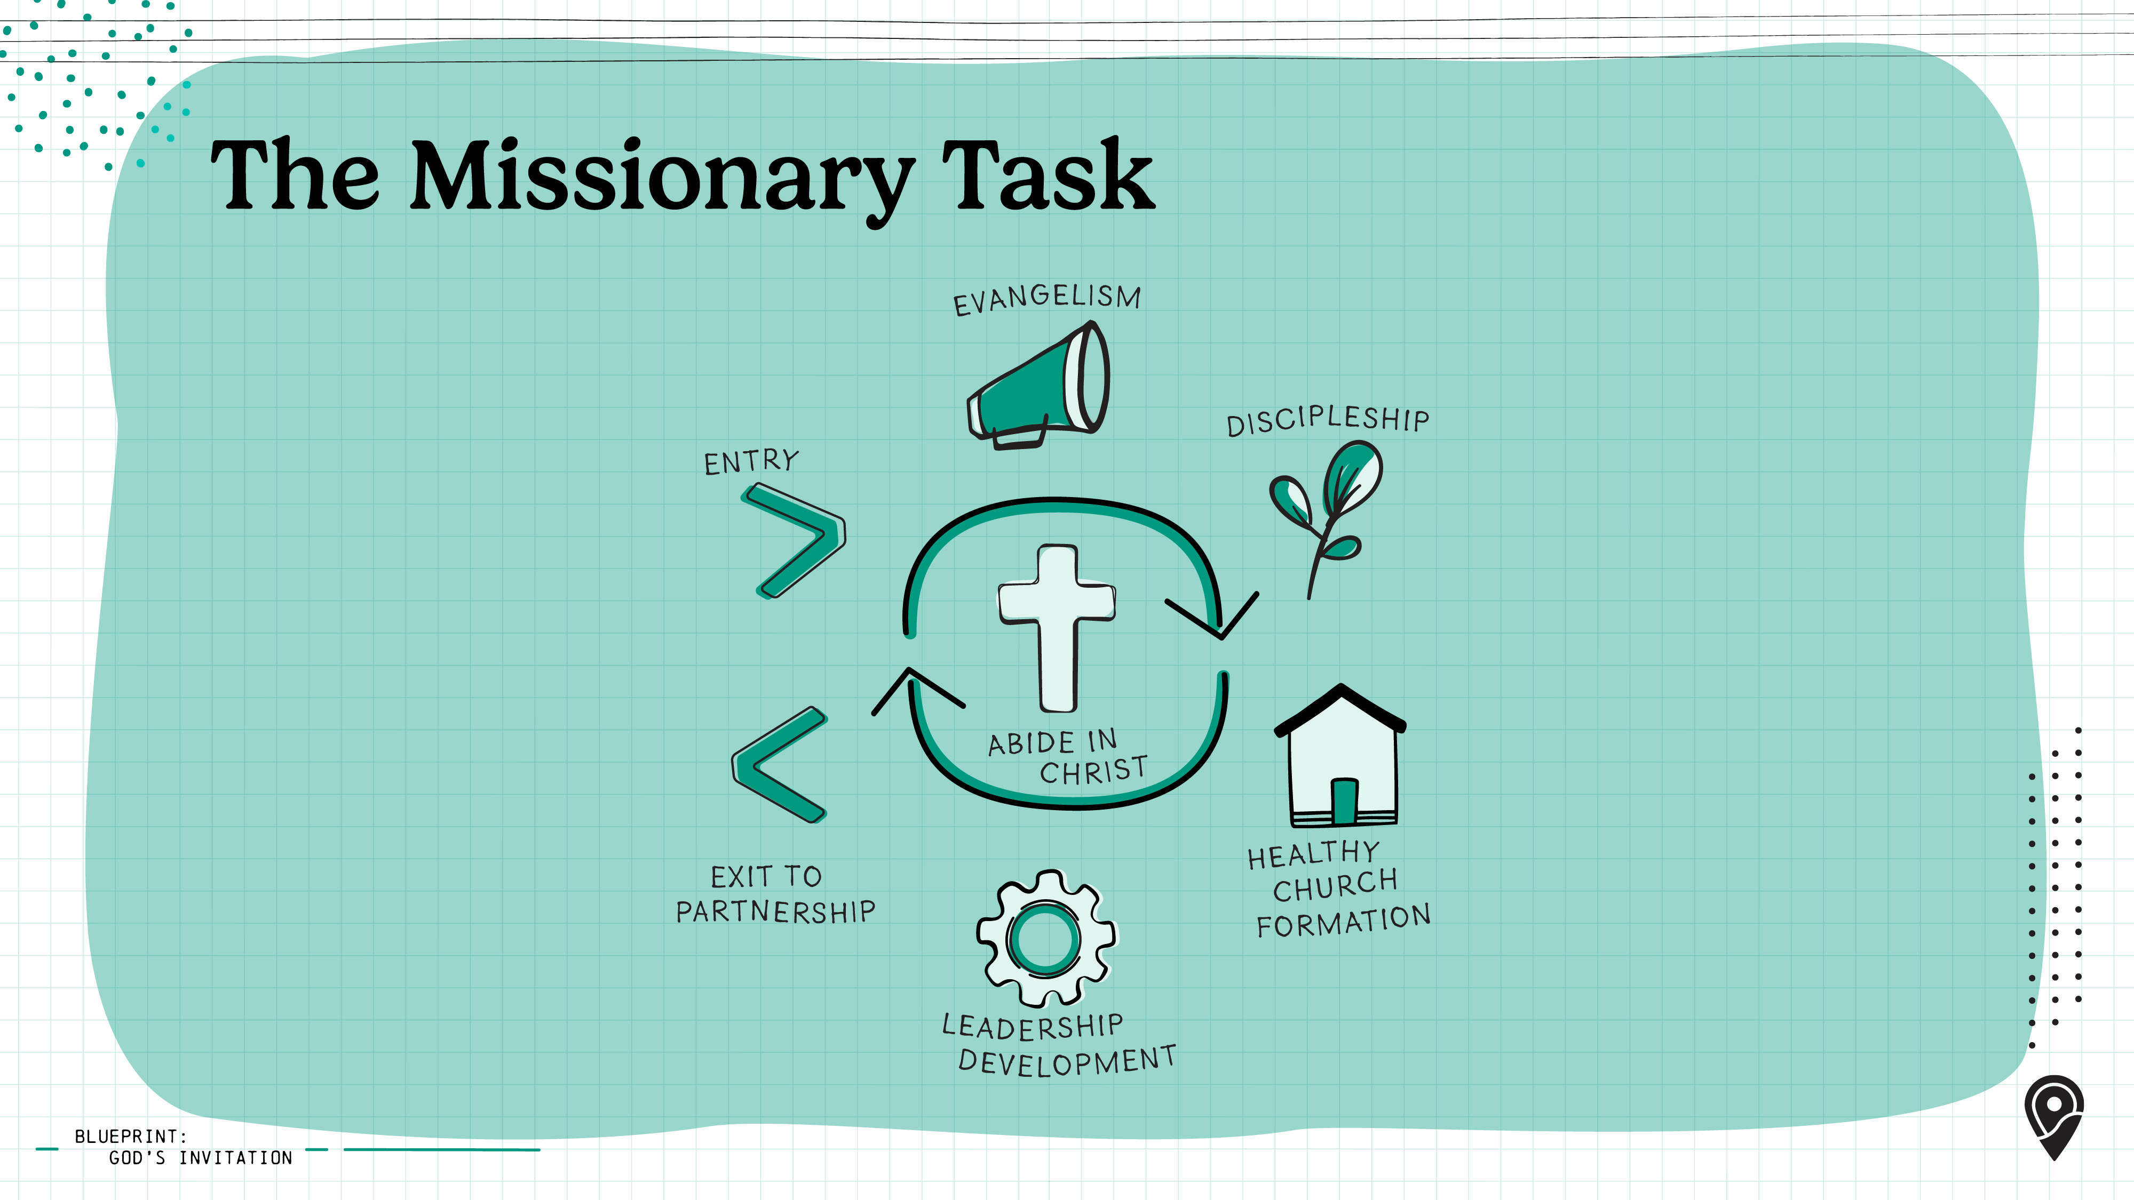
Notes:
[Leader: As you display the missionary task graphic, ask your group to share their initial observations.]
Every disciple needs to understand the missionary task, whether we actively proclaim the gospel at the ends of the earth or pray for those laboring among unreached people and places. The missionary task also informs our sending and support of laborers for the harvest fields. As we seek to make disciples with others from the church where we grew up, or create partnerships to advance the gospel among the nations, we are focusing on components of this one missionary task.
Understanding what the Bible says about God's mission and the Church's role is essential. We're all a part of the same mission, to make Jesus known and bring God glory.

Slide 7
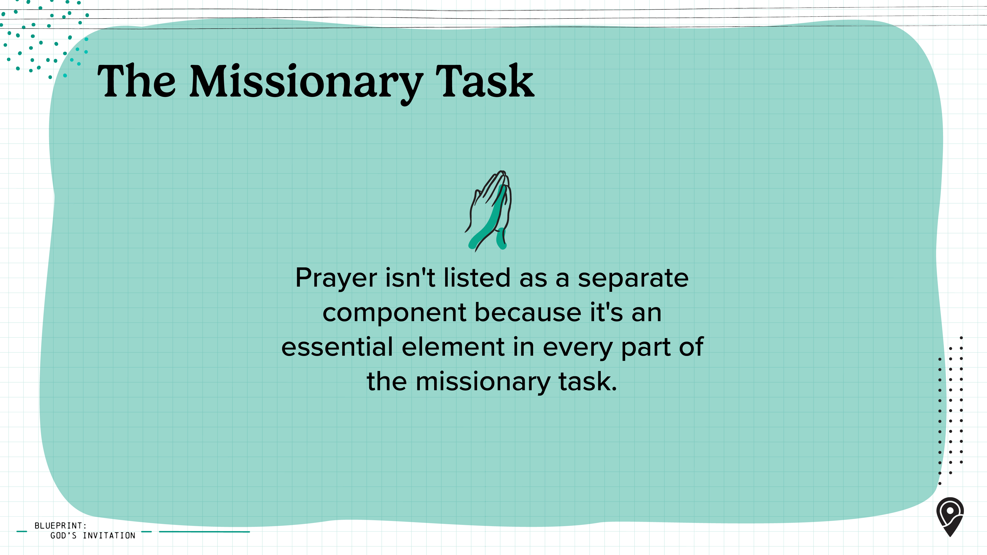
Notes:
You may notice that prayer isn't one of the six separate components. That's because prayer is an essential element and must permeate every part of the missionary task.

Slide 8
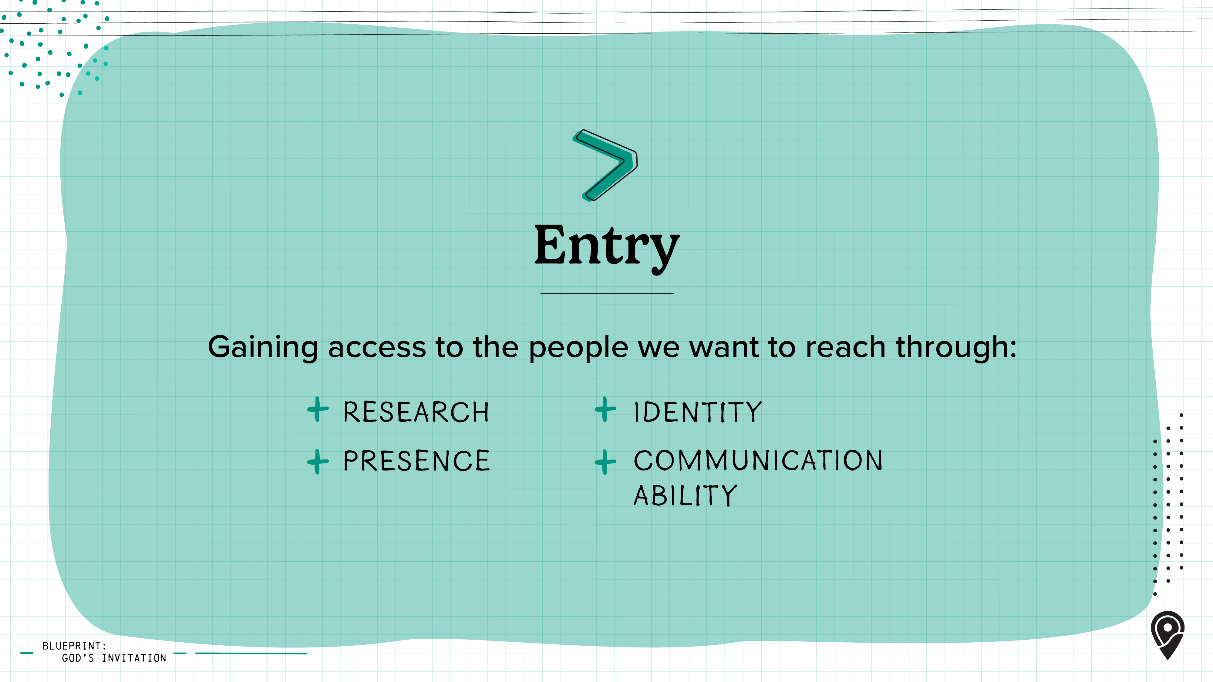
Notes:
Let’s look at each of the components. To carry out the missionary task, we as the Church need to first gain access to people groups who have yet to hear the gospel. This begins with identifying where they are through intentional research and then moving toward them with a trusted presence and identity. From there, God's people communicate the gospel effectively and biblically, with an understanding of their language and culture.

Slide 9
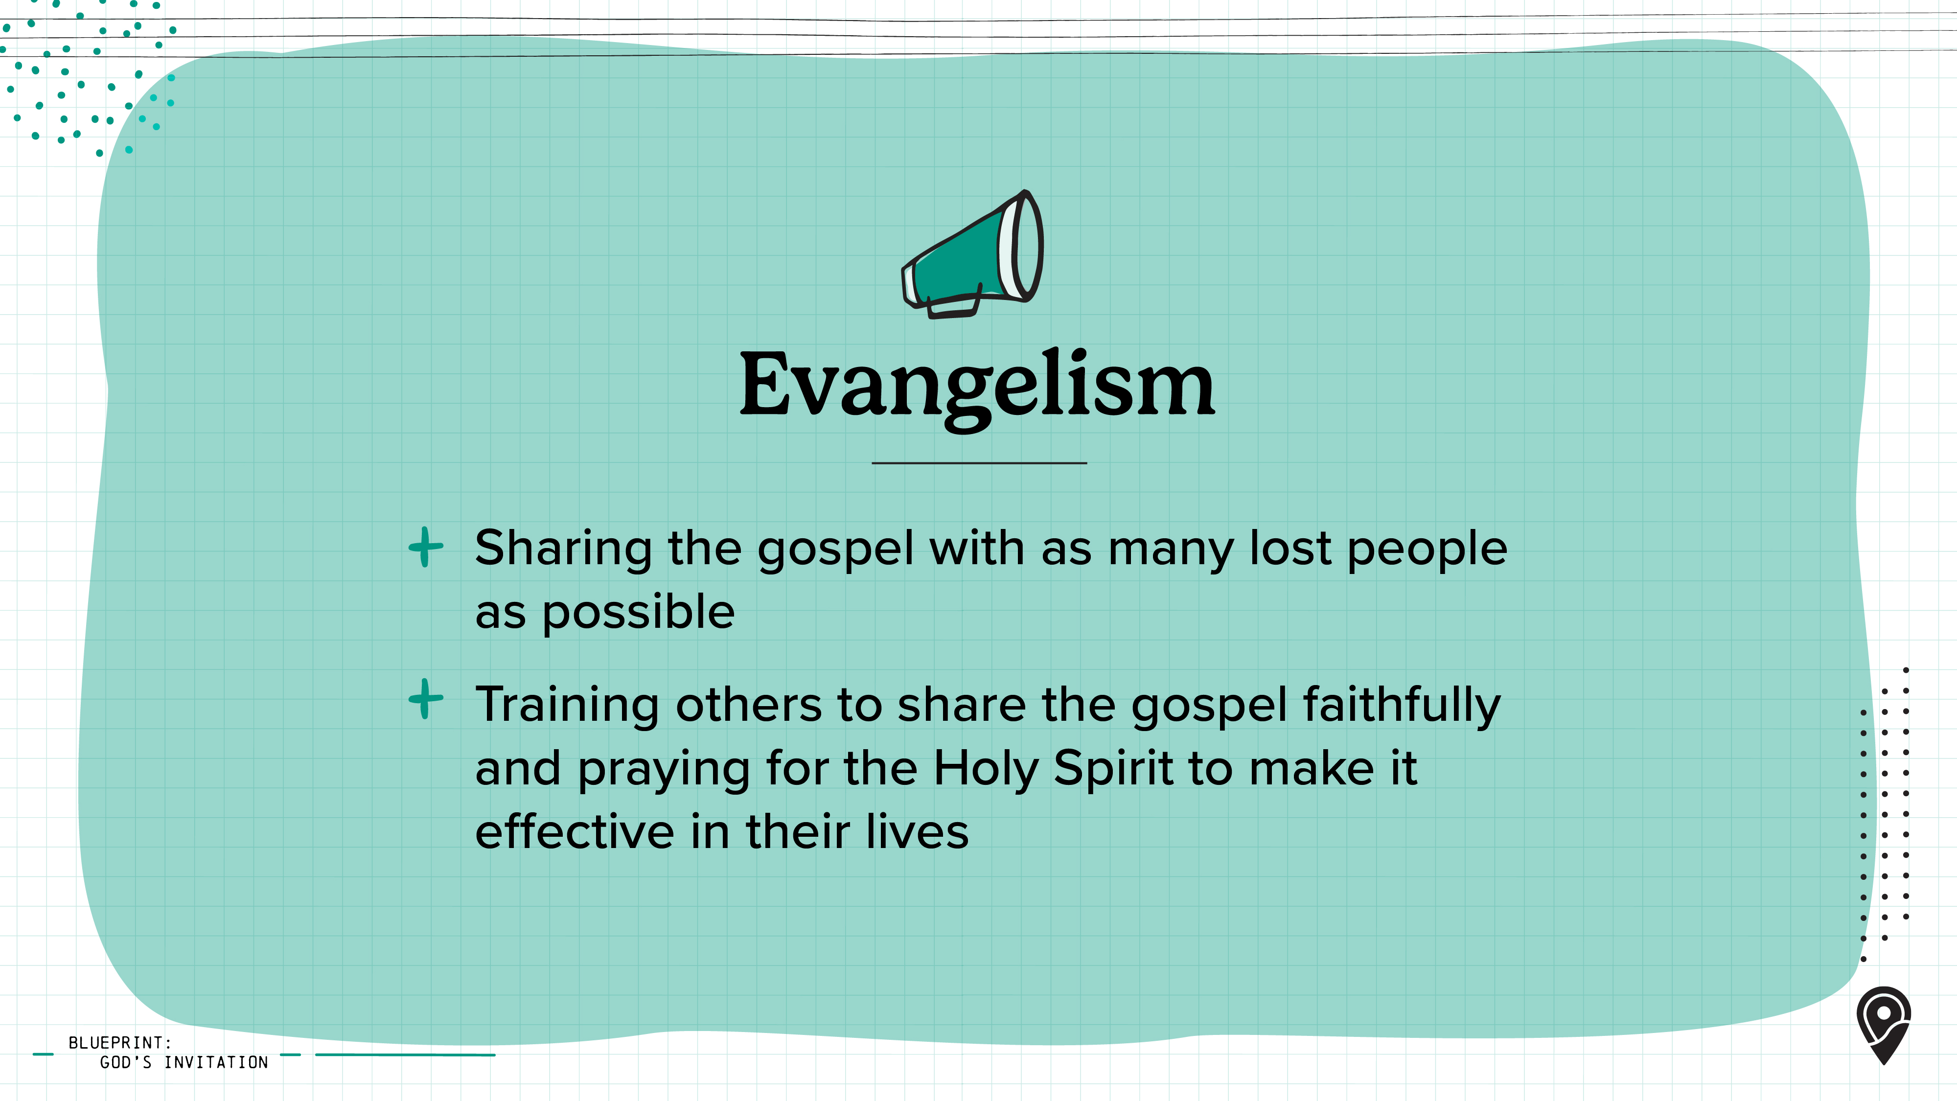
Notes:
From the New Testament, it is clear that ordinary Christians regularly shared the gospel wherever they went (see Acts 8:4). They knew and believed that lost people only come to faith in Jesus through the gospel message (see Romans 10:9–17). Like the early Church, we also must embrace the responsibility to share the good news, train others to proclaim the gospel faithfully, and pray for the Holy Spirit to change lives.

Slide 10
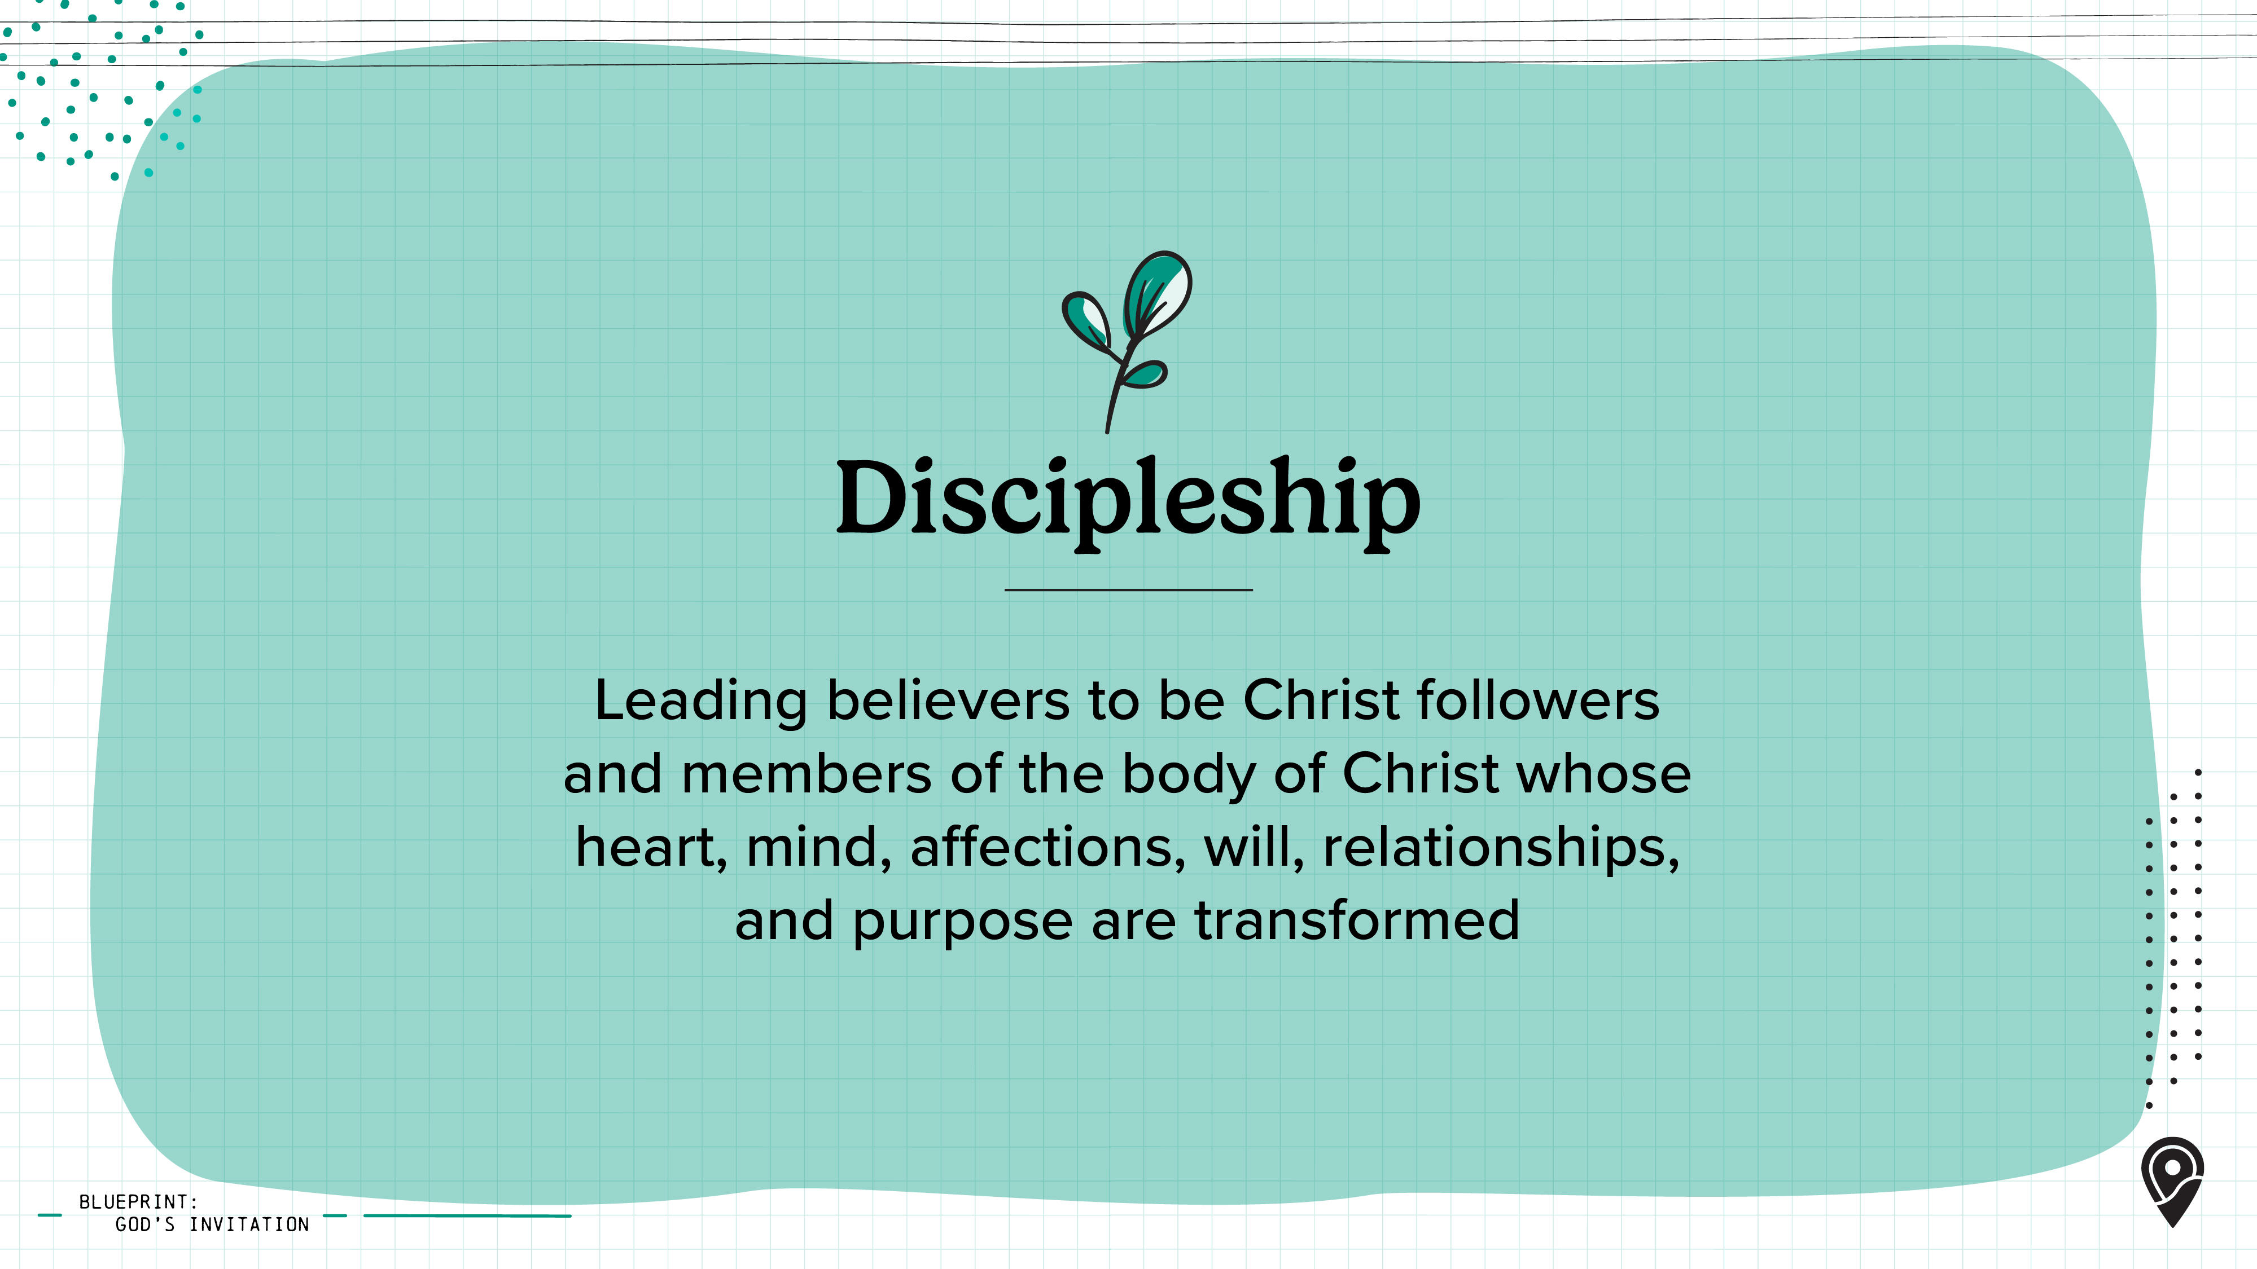
Notes:
Once someone comes to know Jesus as Lord and Savior, they should immediately receive biblical training through discipleship and be encouraged to share the gospel with others. The best training is relational and done within the local church, focusing on God's Word and aiming to make disciples whose lives are completely transformed (see Titus 2:11–13).
All of this training and discipleship is done in the context of local church relationships whenever possible.

Slide 11
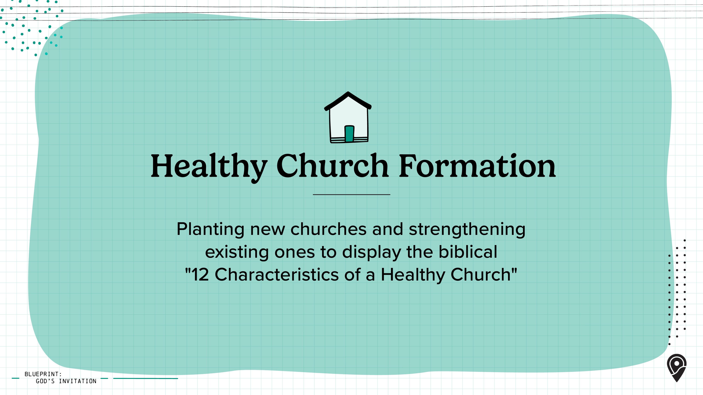
Notes:
A church is a group of baptized believers in Jesus who are committed to be the body of Christ to one another and who assemble regularly to fulfill the functions of a healthy biblical church.
[Leader: Refer back to the 12 Characteristics of a Healthy Church in course "What is a Church" step.]

Slide 12
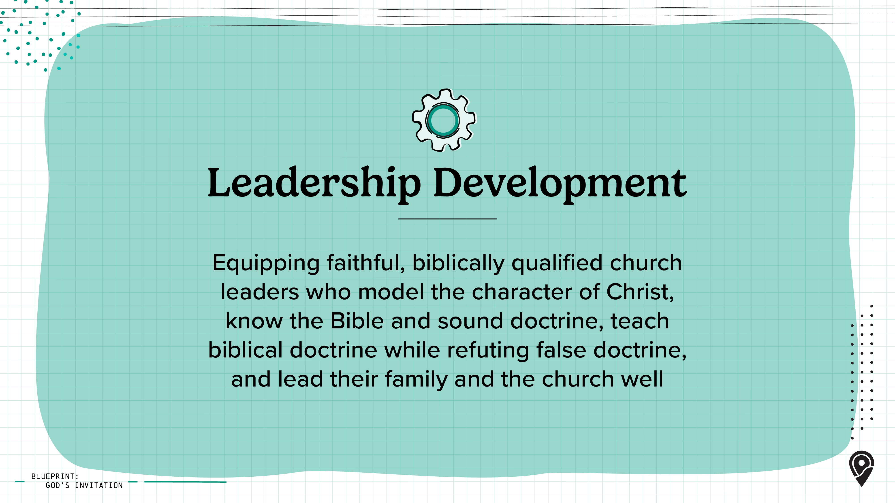
Notes:
Leadership development includes developing pastors and overseers, but it also includes developing all kinds of leaders for ministry in the local church and beyond. Within the local church, disciples train and equip faithful, biblically qualified church leaders who model the character of Christ, faithfully teach the Bible and sound doctrine, and shepherd and lead the church well. In essence, a church leader is to be an exemplary disciple of Jesus.
Therefore, leadership training flows out of basic discipleship. As we develop local church leaders, we look to the clear qualifications in Scripture. "We believe both men and women have vital roles in the ministry of the church. However, the role of pastor/elder/overseer is exclusively assigned to men in the church and not to women (1 Timothy 2:11–12) ... We strongly affirm that women must be evangelized, discipled, fully incorporated into the church, and developed appropriately as leaders" (Foundations, p. 116). Specific pastoral qualifications may be broken down into three categories: what the leader must BE (his character), what the leader must KNOW (his knowledge), and what the leader must DO (his skills/practices/habits).

Slide 13
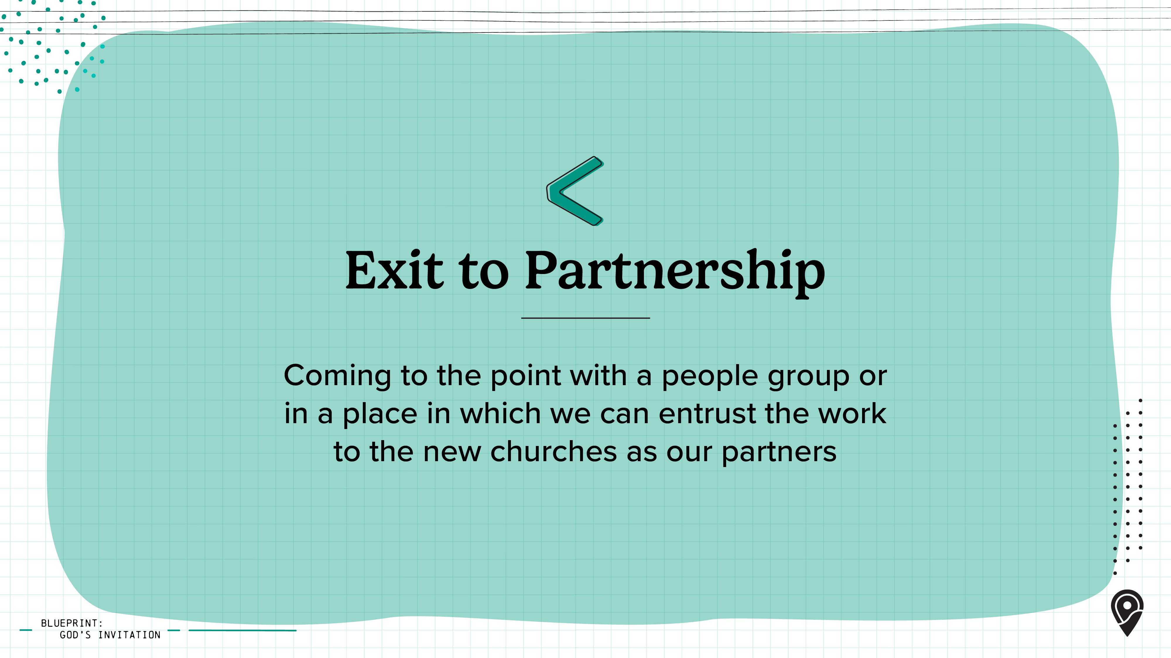
Notes:
The missionary task includes partnering with both established and newly planted churches. These churches intentionally move toward the lost, engage the places where they live, and send out missionaries to the nations. Healthy interdependence strengthens churches, helping them grow both spiritually and numerically. As part of this task, it's vital to equip, then entrust, national leaders with the responsibility of leading churches toward biblical health.
After a missionary's full-time presence is no longer needed, they follow the example of the apostles—continuing to pray for, care for, and advise the newer churches. They do not abandon their brothers and sisters in Christ. Rather, they enter into a new phase of partnership with these churches, pressing on together to complete the Great Commission both near and far.
Because prayer and abiding in Christ are central to the missionary task, they are not separate components but essential elements through every part

Slide 14
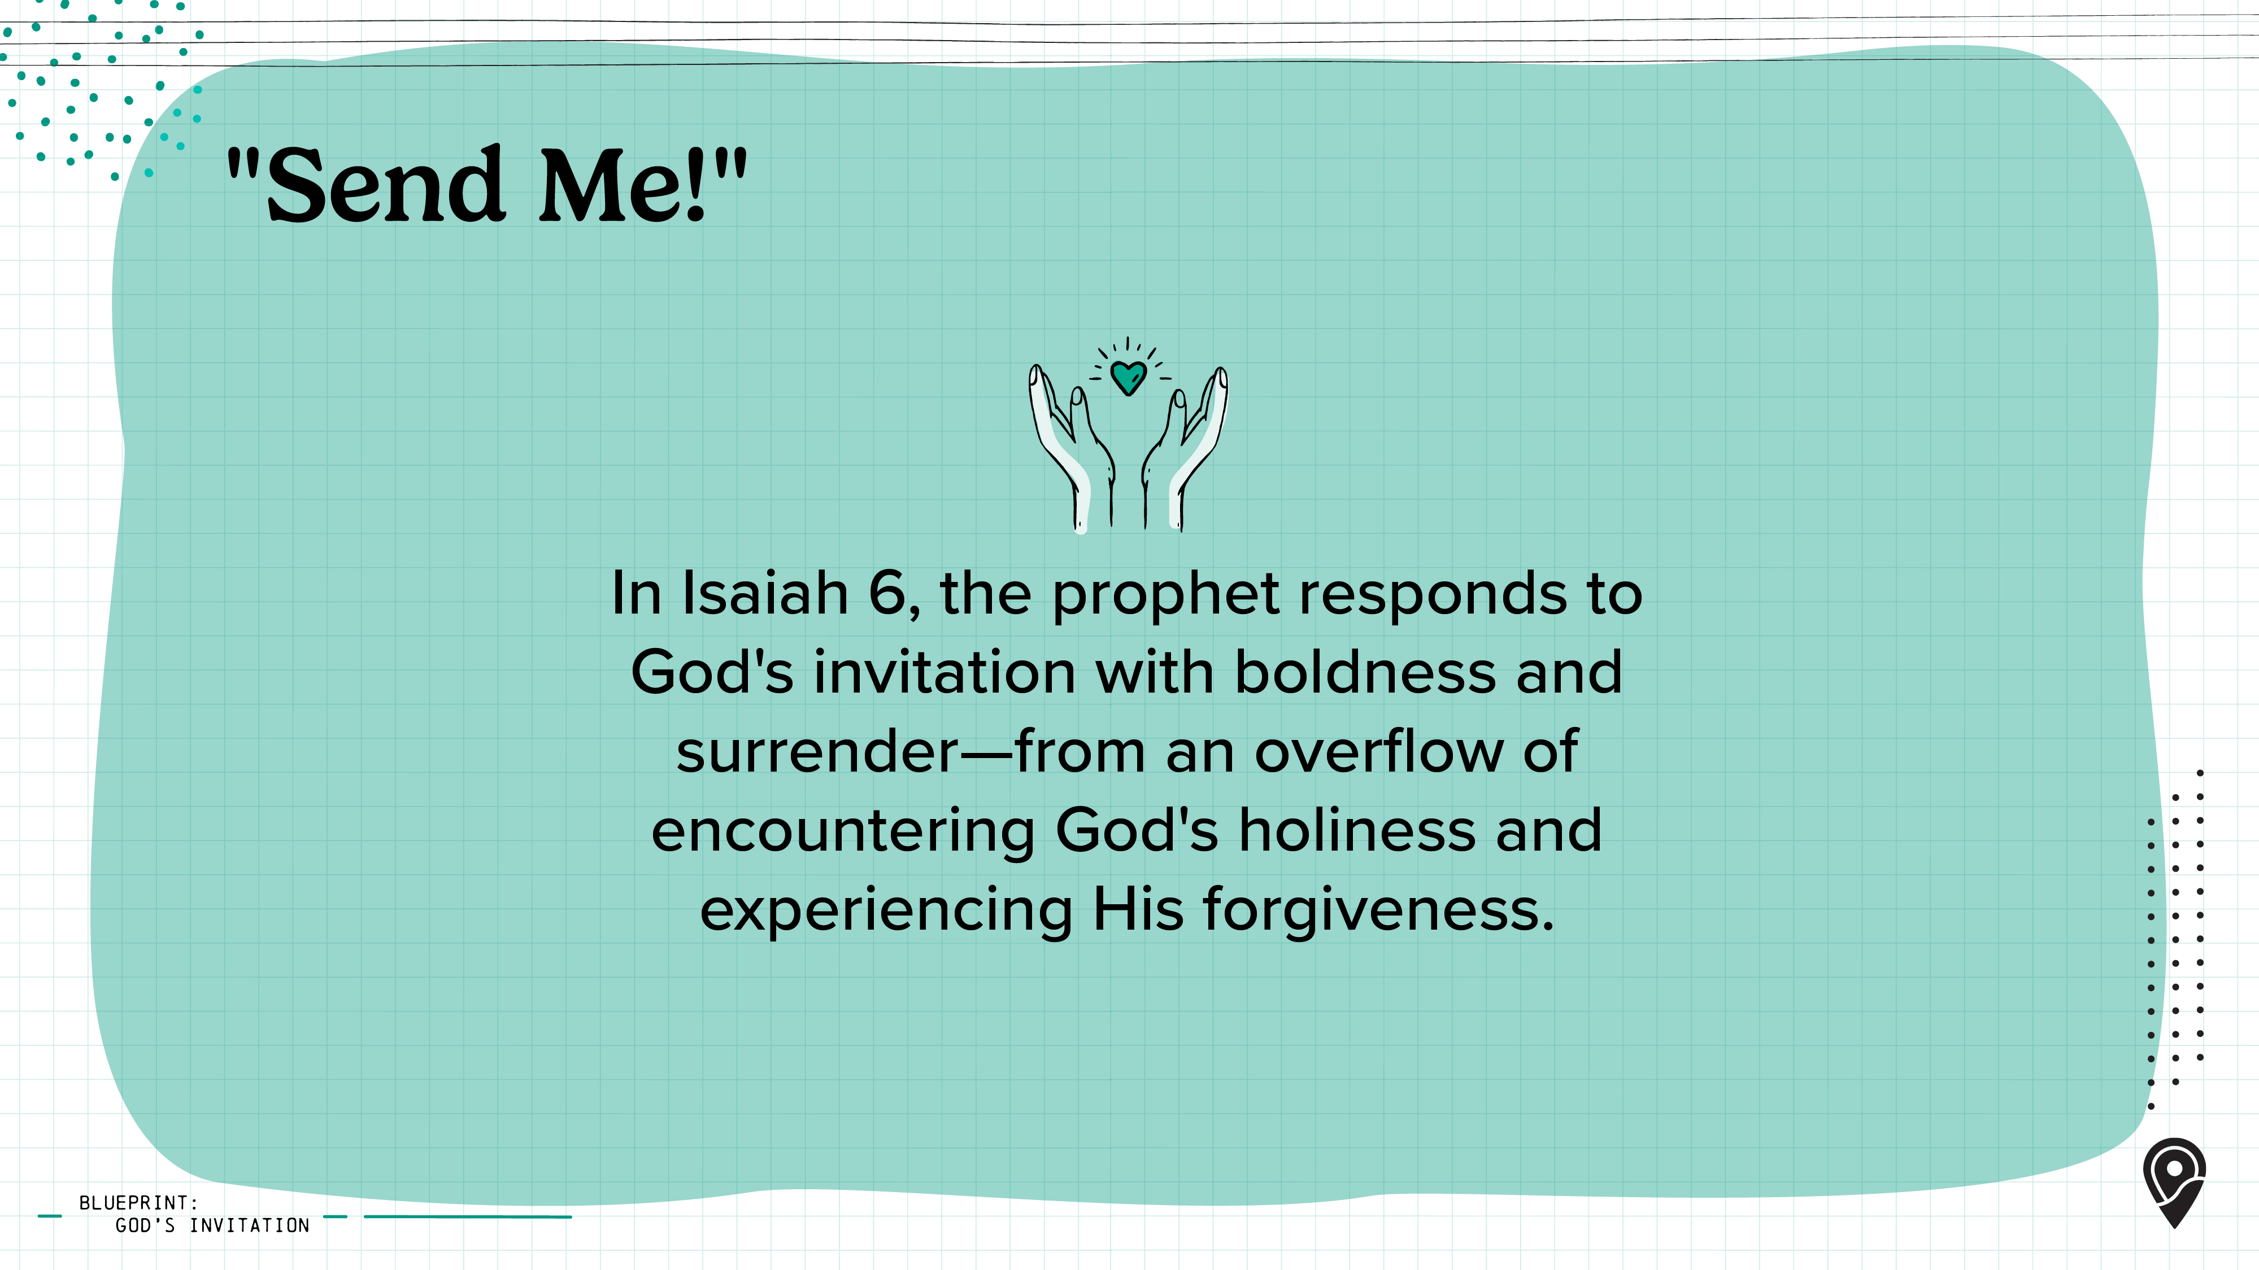
Notes:
In Isaiah 6, the prophet records a powerful moment of calling: "Then I heard the voice of the Lord saying, 'Whom shall I send? And who will go for Us?' And I said, "Here am I. Send me!" (Isaiah 6:8). In that instant, Isaiah's faith becomes personal, and God's mission becomes his own.
In the verses just before this, Isaiah is completely undone by a vision of God on His throne. He sees his own sin clearly, confesses it, and is cleansed by God's grace. It's out of that place—from an overflow of encountering God's holiness and experiencing His forgiveness—that Isaiah responds to God's invitation with boldness and surrender: "Send me!"
God is still asking, "Whom shall I send?" Will you listen and say "send me"—to your campus, your friends, your family, your workplace, or even the nations?

Slide 15
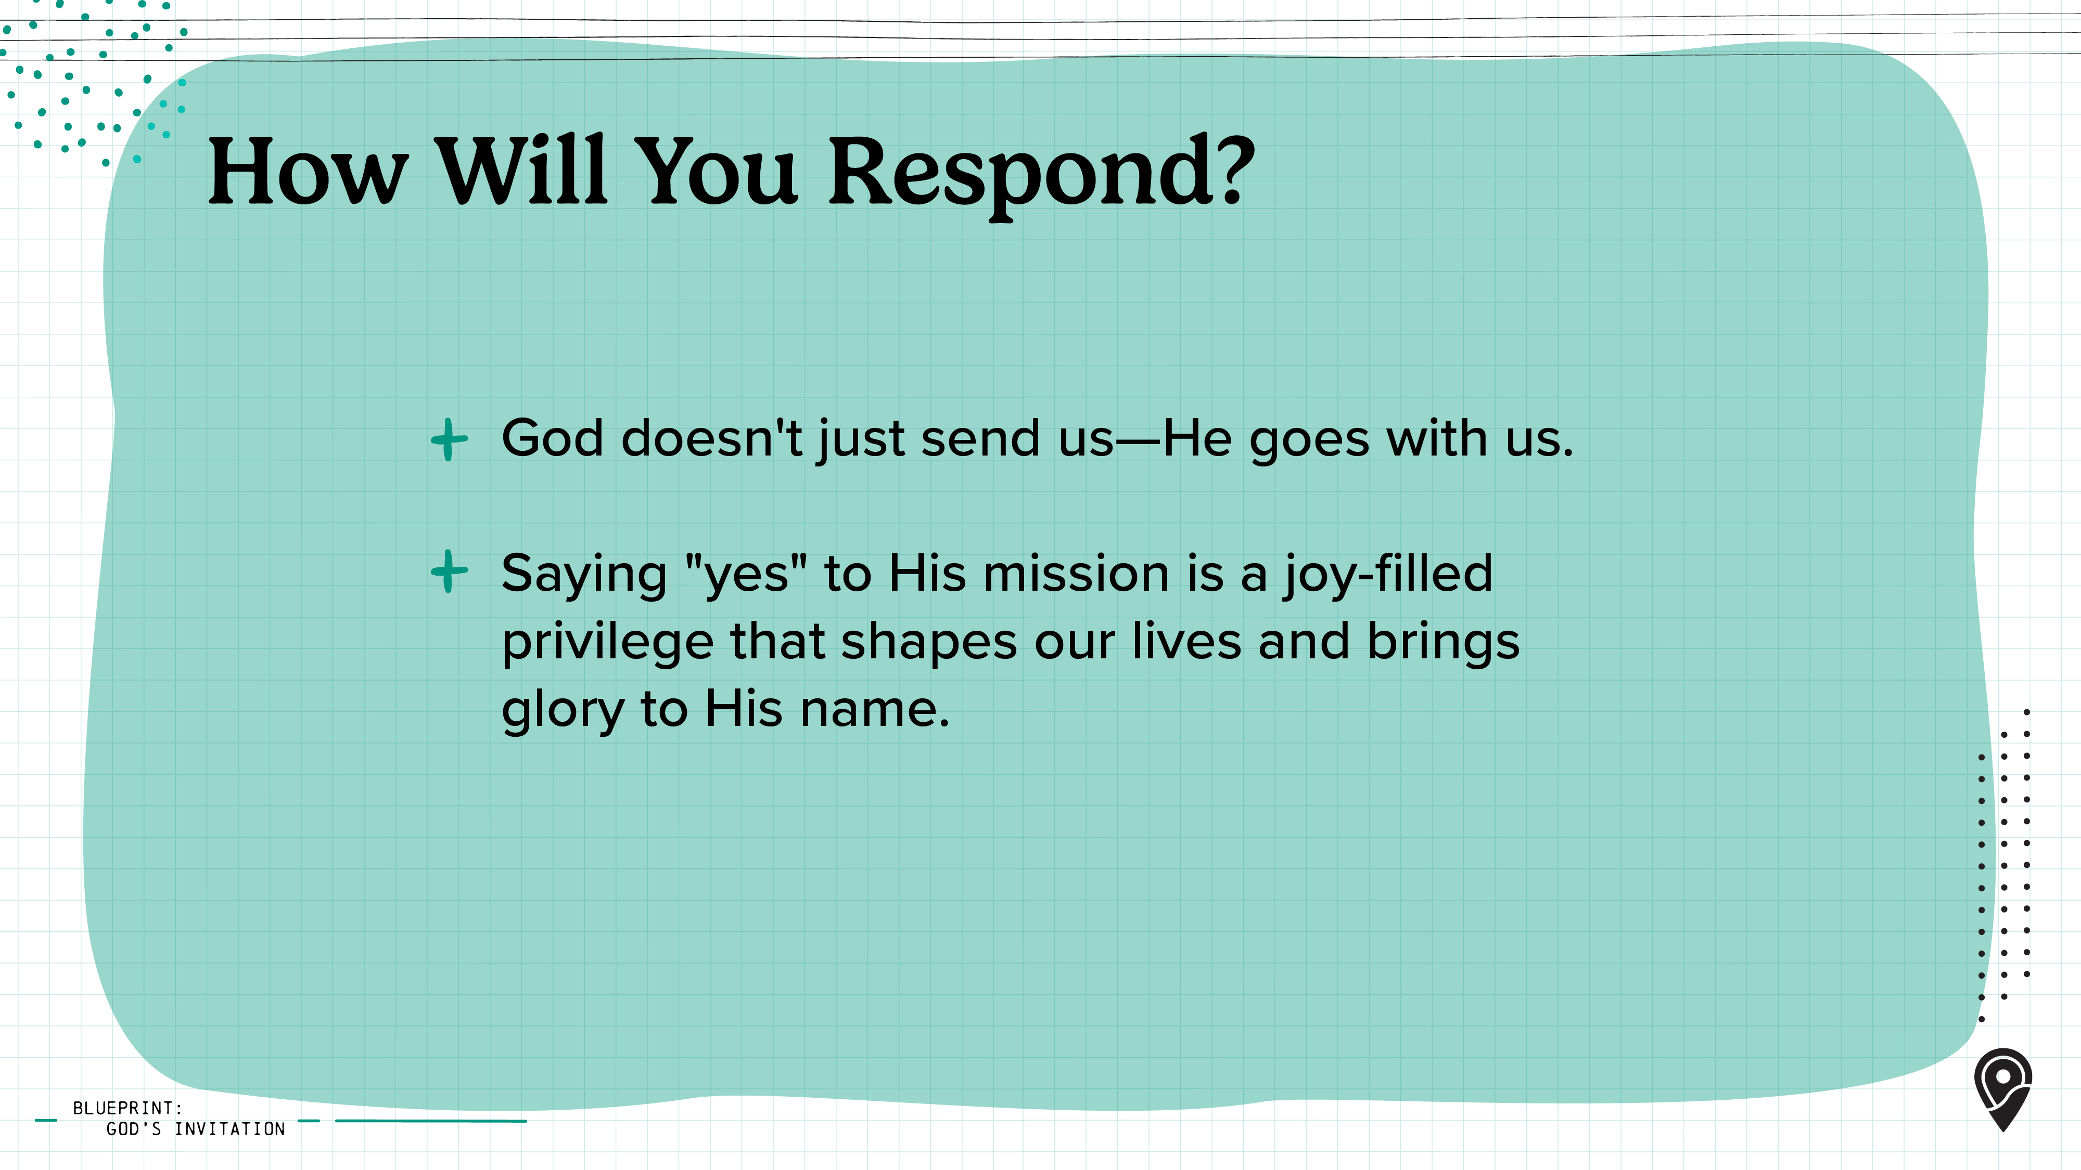
Notes:
Saying "yes" to God's mission can feel risky—it often means stepping into the unknown and trusting Him in ways you've never had to before. Maybe you're thinking, What if I'm not enough? What if I fail? What if this costs more than I expect? But here's the truth—God never calls us without also going with us.
When we step into God's mission, we're not promised an easy road. There may be rejection, discomfort, sacrifice, or even seasons of pain. But Scripture reminds us again and again that what we gain in Christ far exceeds what we lose for Him (see Romans 8:18).
The mission may not always be easy, but it will draw us closer to Jesus, lead others to eternal life, and bring glory to the One who is worthy of it all.
The glory of God outweighs any suffering we may experience.

Slide 16
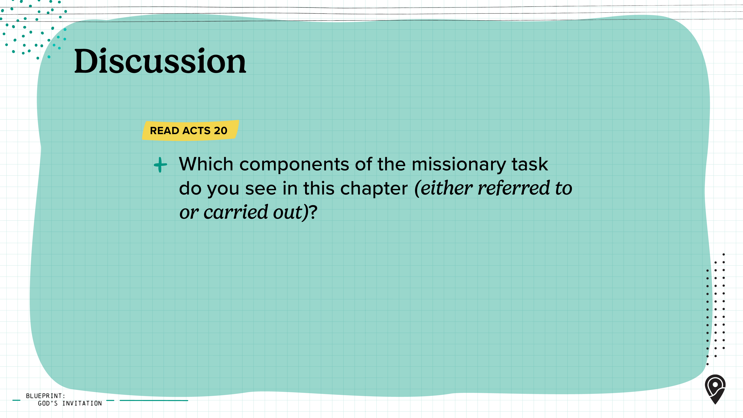
Notes:
[Leader: Read the Scripture passage with your learners and then take time to discuss the following question.]

Slide 17
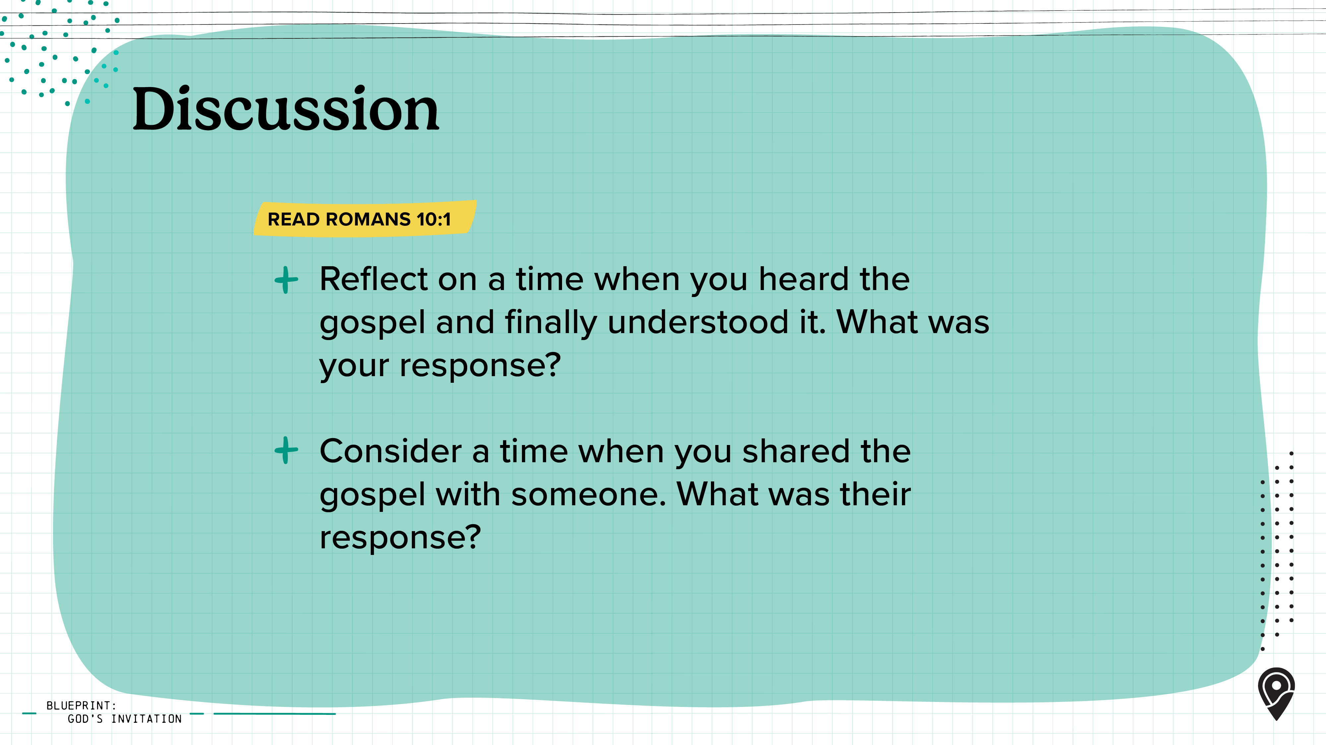
Notes:
[Leader: Read the Scripture passage with your learners and then take time to discuss the following question.]

Slide 18
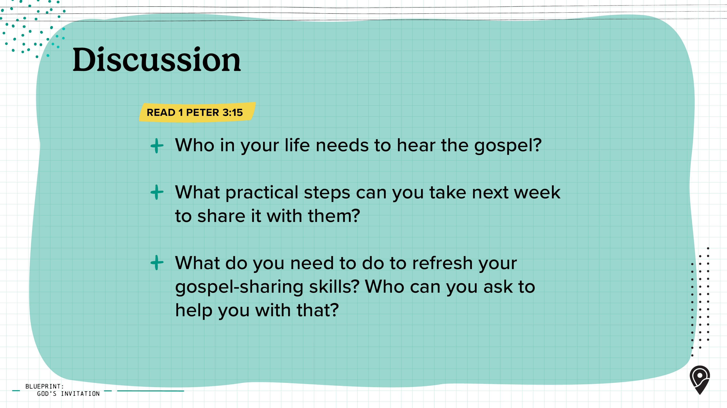
Notes:
[Leader: Read the Scripture passage with your learners and then take time to discuss the following question.]

Slide 19


Slide 20

Notes:
[Leader: Use this slide if you'd like to add your own content within the PPT or delete it if not needed.]

